Slide 1
P1 June Homelearning
UP UP AND AWAY!
Literacy Activities

Slide 2
June P1 learning overview
This is an overview of the work that would be completed under normal circumstances in school.

Slide 3
Daisy is learning to ask questions. Do you know question words?

Slide 4
A question ends with a question mark. Can you write one? Maybe you can make a question mark with playdough or write it on the ground with chalk?

Slide 5
Have a go at writing some questions before you read a new book. (you can write the question words and your adult can help with the tricky words) ‘Finding out’ books are called Non Fiction books.
How many minibeasts are in this book?
What do most minibeasts eat?
Why do bees sometimes sting?
Where do ladybirds live?

Slide 6
These non-fiction books can be found www.oxfordowl.co.uk Click on ‘my class login’ (this is a pink icon at the top right of the screen)Username: p1stpauls Password: readingisfun
You can enjoy sharing these books with an adult. Be sure to ask lots of good questions! I know that the P1 girls and boys are really good at this during our shared reading time.

Slide 7
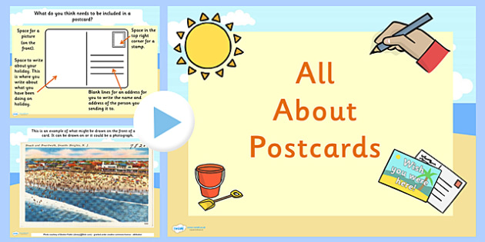
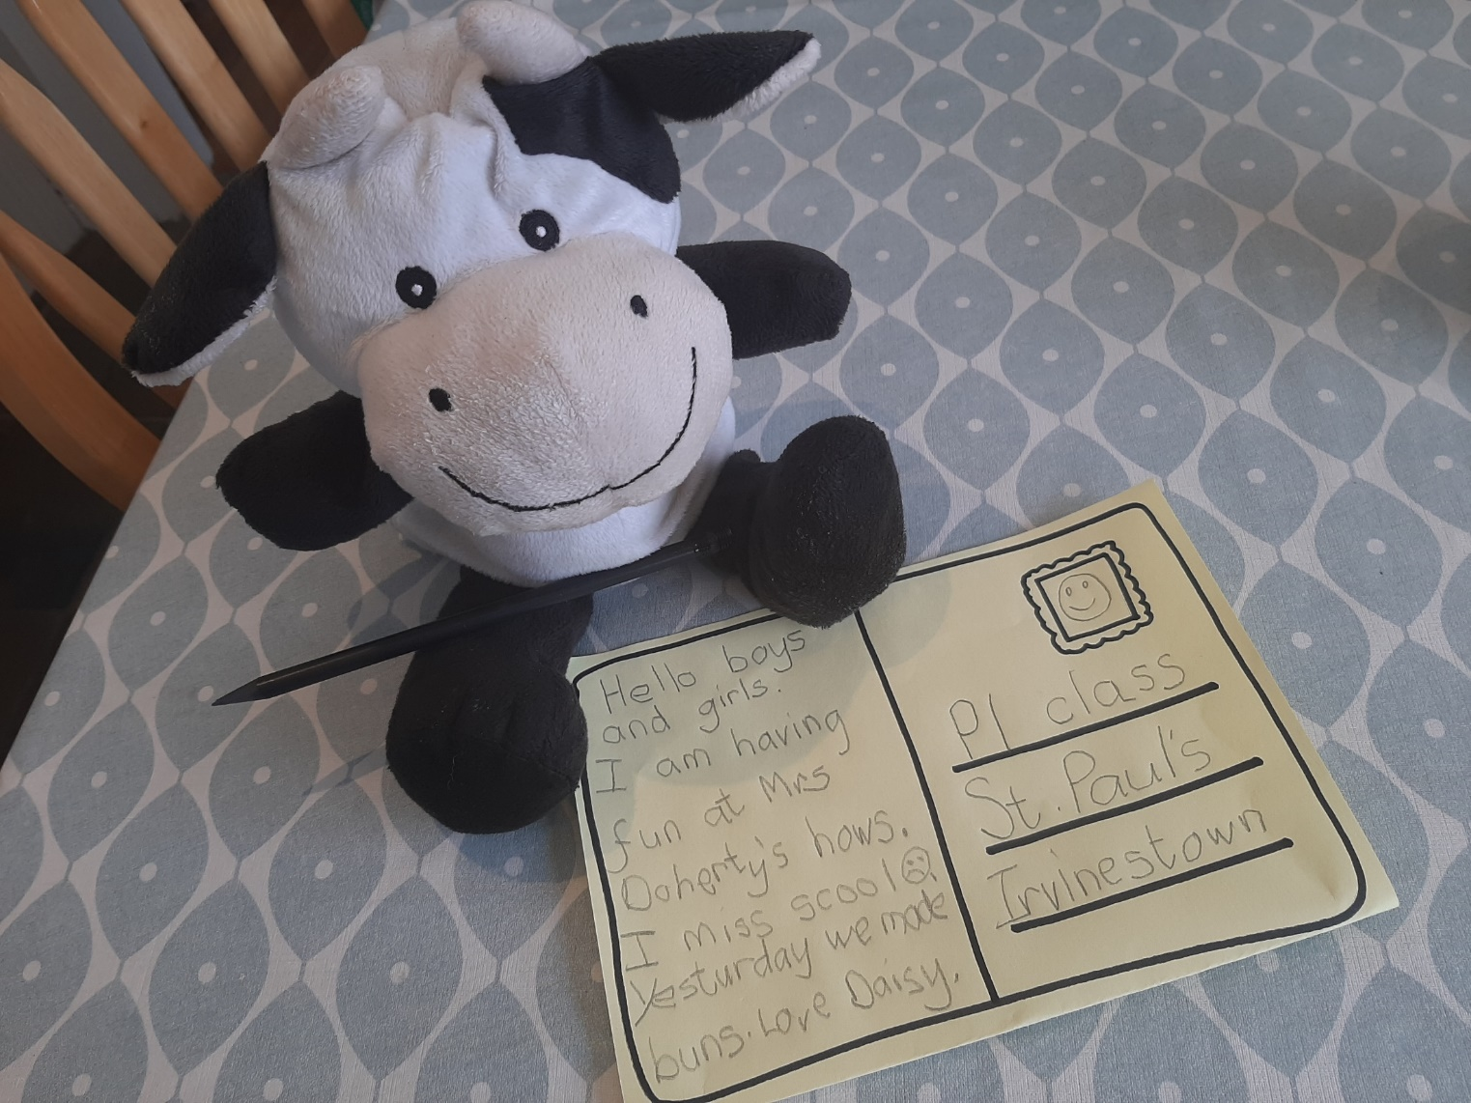
Daisy is learning to write a postcard.
Find out all about postcards here……
https://www.twinkl.co.uk/resource/t-t-11903-eyfs-all-about-postcards-powerpoint

Slide 9
Daisy and Teacher wrote this poem. Read it with a grown up and talk about your own ideas. What else could we have written? Maybe have a go at your own summer senses poem.

