Slide 1
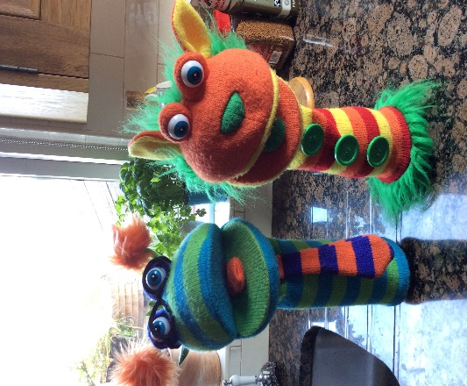
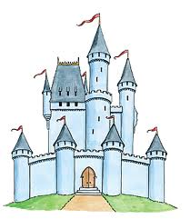
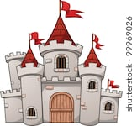
May learning for P2 Castles
Remember us?
It’s Wookie and Podge!
Hello Everyone!
These are some of the activities and writing we would have been doing if we were at school in May.
Please have a look and feel free to do as many or as little as you please.
Also, we would do these lessons over the month in school – don’t try to do them all in one session. Spread them out and have fun!

Slide 2
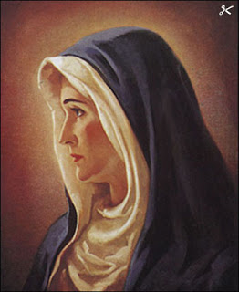
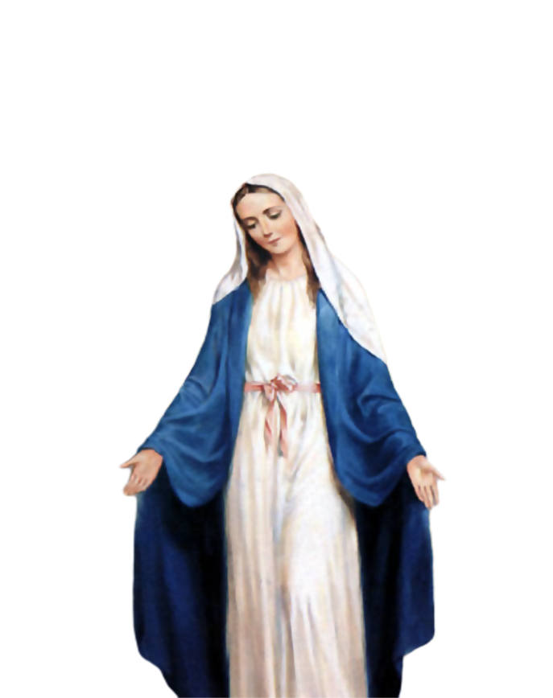
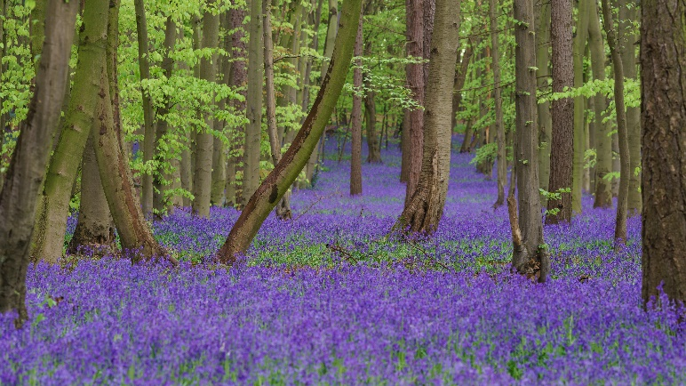
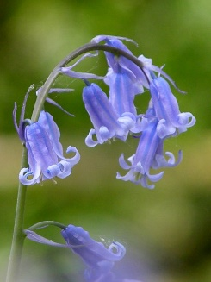
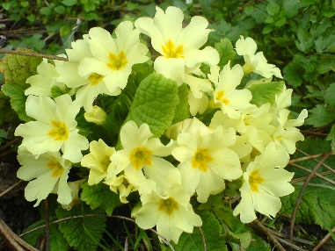
May is the month of Our Lady
Remember to pray the Hail Mary every day.
You can set up a May altar in your home.
Place a statue of Our Lady, some flowers, rosary beads and a candle in a quiet place or as many of these as you have.
There are nice May activities on the Grow in Love website – accessible from the school app where you can make an online May altar.
Look out for bluebells and primroses that grow wild this time of year.

Slide 3
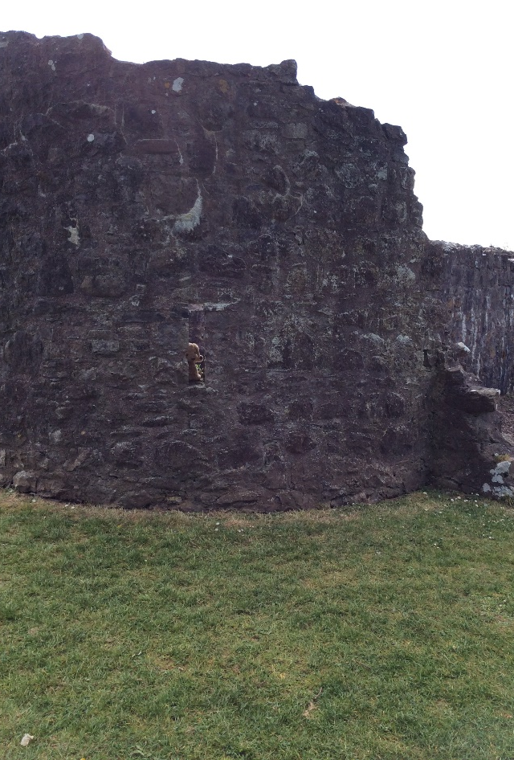
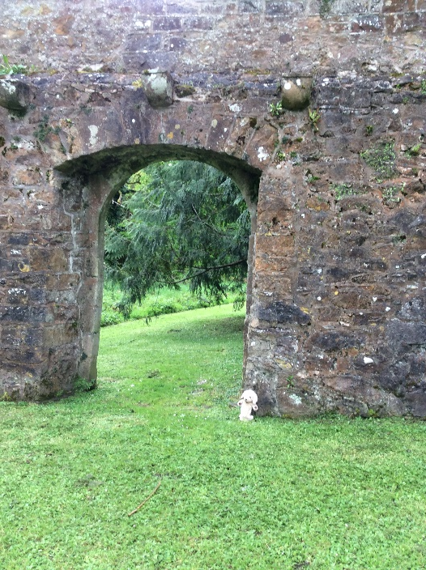
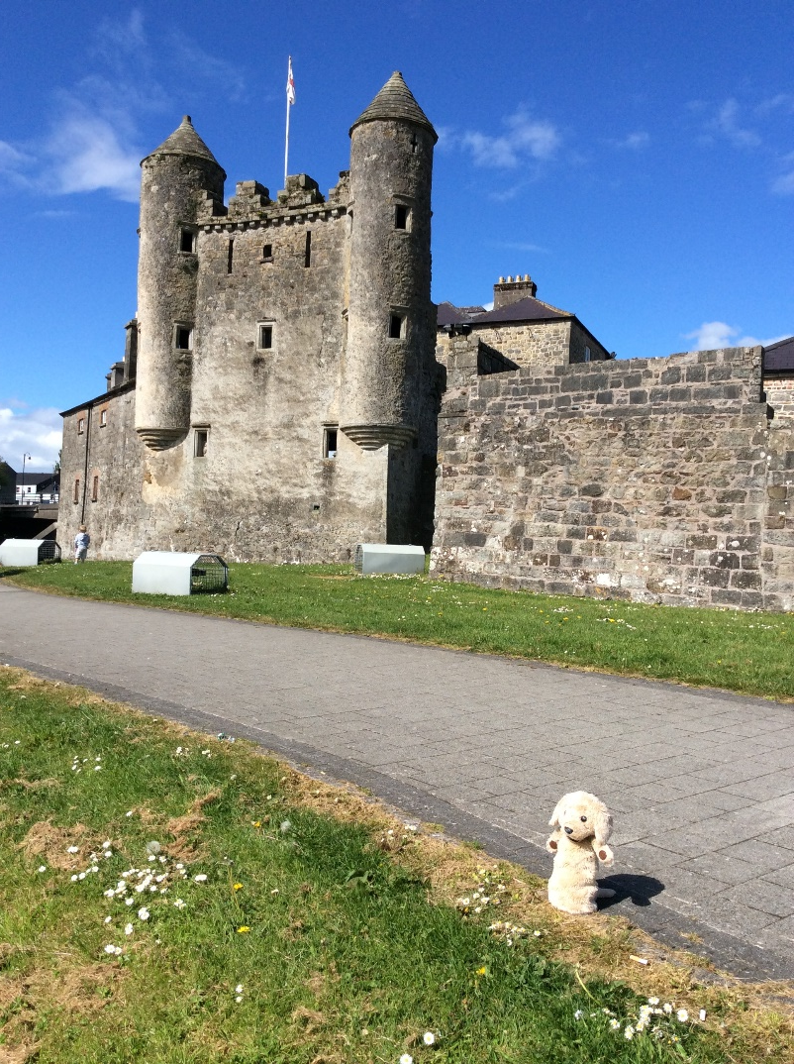
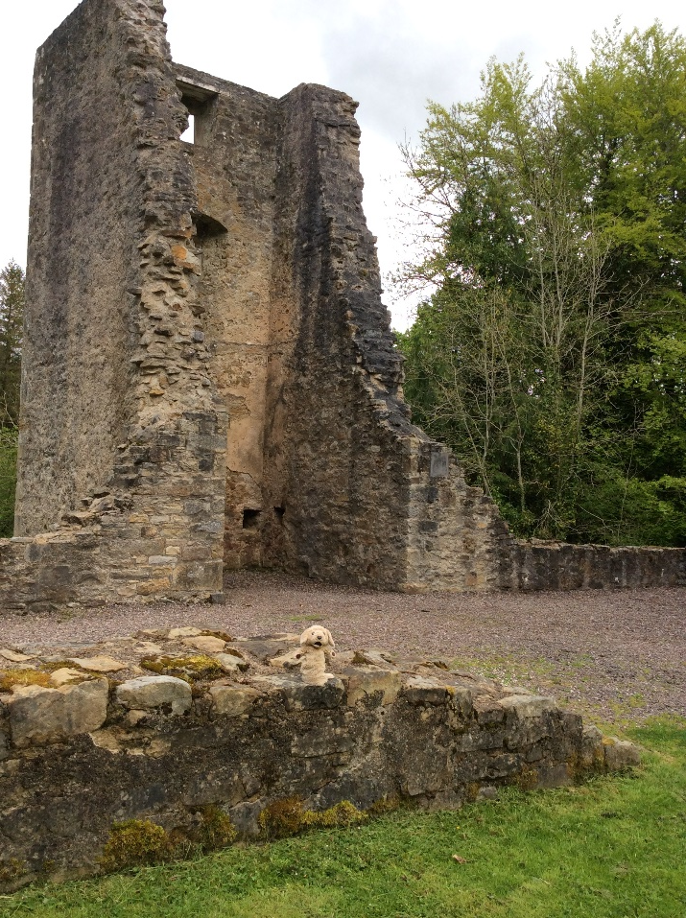
Marley has been visiting castles near us and learning all about them. Ireland has loads of castles and Fermanagh has 10!!
Do you recognise these local castles? Can you spot Marley in the pictures?
Castle Archdale
Enniskillen Castle
Portora Castle

Slide 4
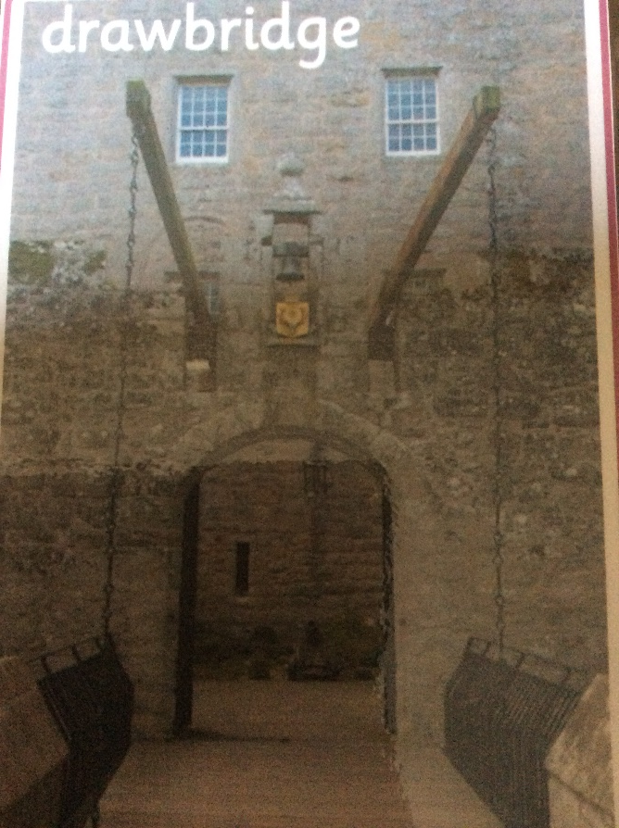
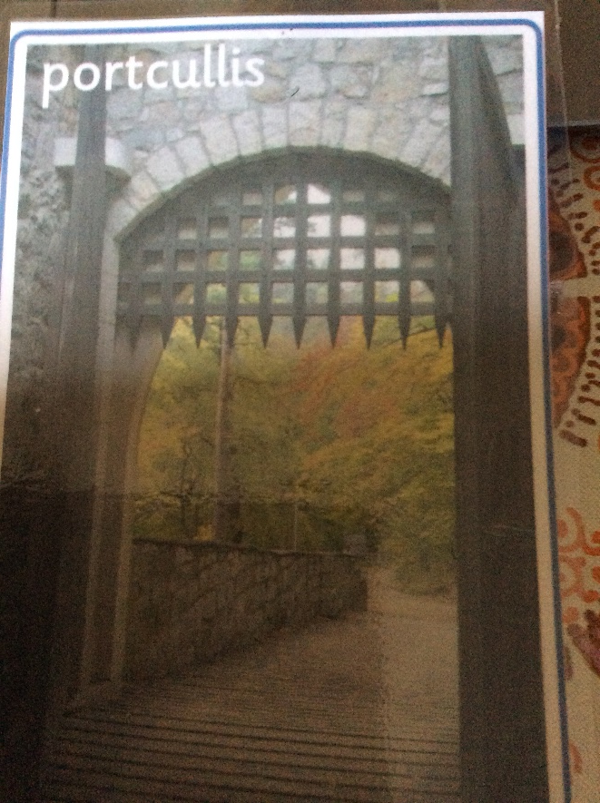
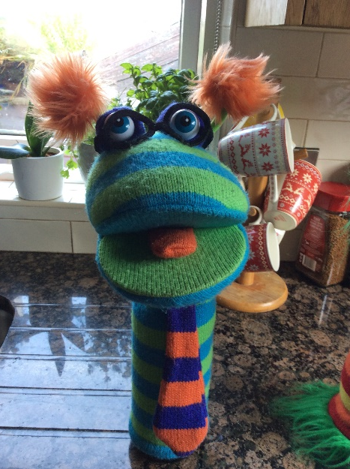
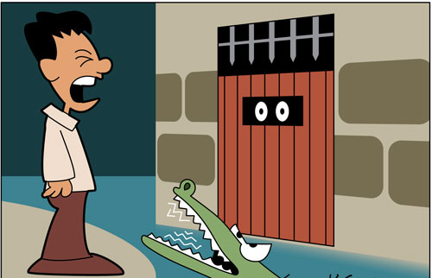
Castles are not just ordinary houses.
If you see any castles when you are out for your walk, see if you can spot any of these features?
Remember, castles were built hundreds of years ago, most of the castles that are left are at least partly ruined. You might have to imagine some of the features that used to be there!
moat

Slide 5
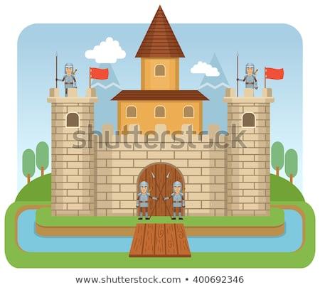
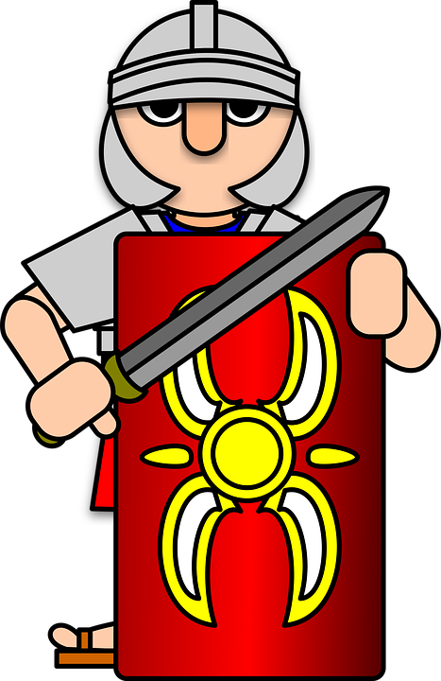
The People who built the castles had lots of enemies that they had to keep out.
That’s why lots of the features of castles were designed to protect them from enemies and intruders.
A moat made a castle hard to get in to. The people who owned the castle lowered the drawbridge so they could get in and out, but them if the enemies came, they raised the drawbridge and the enemies could not get across the moat.
If they hadn’t been paying attention and the enemies got as far as the drawbridge, they dropped the portcullis – it had very sharp points and would kill anyone stuck underneath it!
The people who were supposed to be paying attention and looking out for enemies, were the guards. Castles had special features to help them.
Oopsie! – better waken up and pay attention!

Slide 6
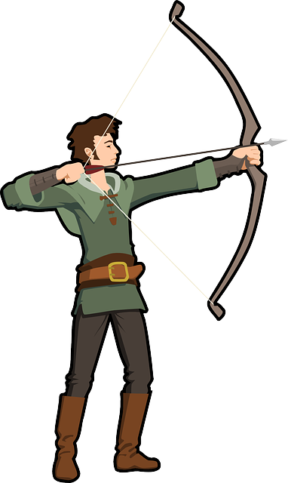
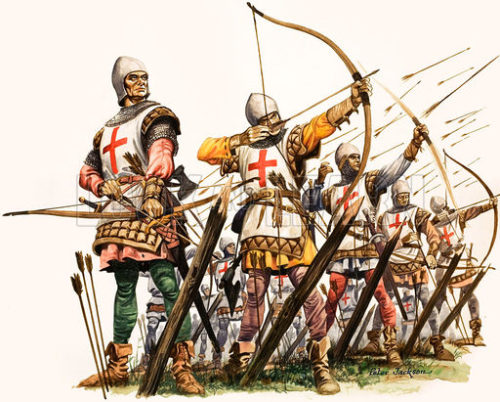
Ramparts, battlements and ARROW SLIT WINDOWS
Ramparts are walkways behind the up and down bits, (battlements) so the guards could hide behind the high part of the wall and shoot out through the low bits.
Arrow slit windows were easy to shoot out of at the enemies but very hard for the enemies to shoot back in through!

Slide 7
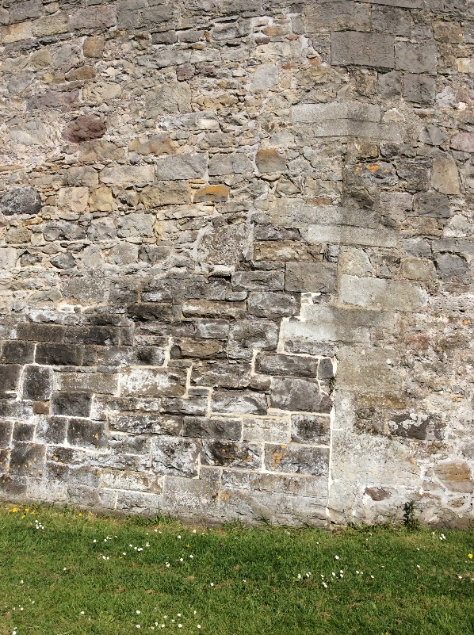
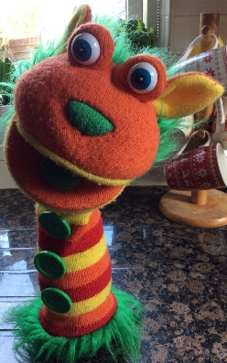
Castles had thick stone walls to keep out enemies
The enemies had all sorts of weapons to try to break down the castle walls like this trebuchet. It took lots of strong men to operate these machines.
No wonder all the castles are ruined!
Listen to some funny facts about castles from Wookie and Podge’s cousin, Fuzzy from America. Click on the link below:
https://www.youtube.com/watch?v=hQ8PT-10_ss

Slide 8
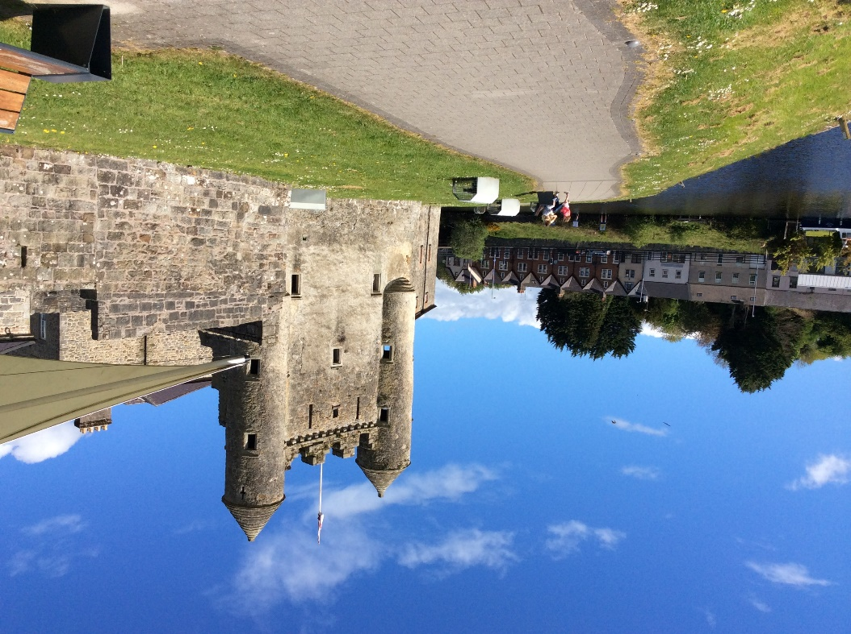
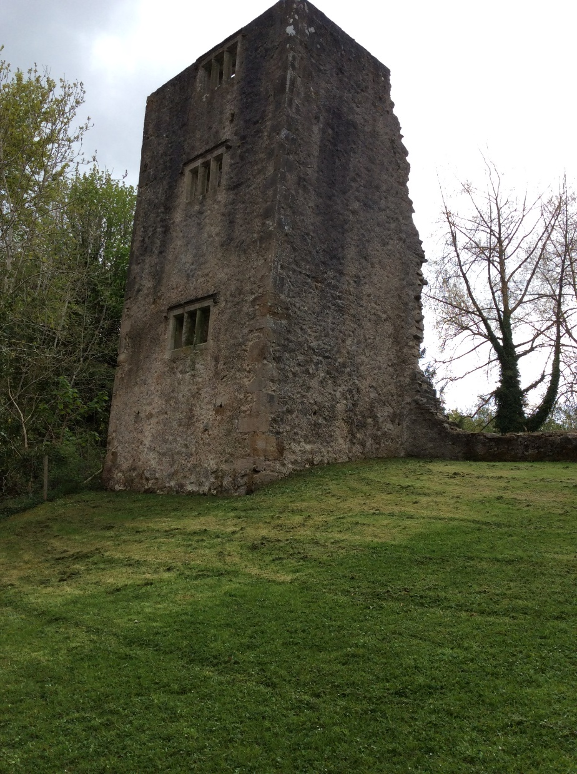
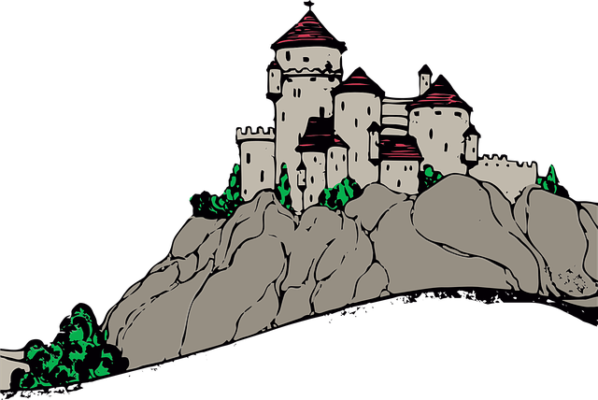
They built the castles on a high hill or clifftop to make them hard to get to, or else surrounded by water.
https://www.dkfindout.com/uk/history/castles/
Click on the link for some interactive info about castles and try the quiz for fun.

