Slide 1
Wow! Great work so Far!
Now let’s do some non-fiction writing.

Slide 2
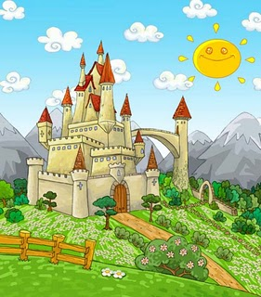
If you want to find out more -Do you remember how to find information?
Look in books about castles.
Look on the internet.
Go and visit a castle with a grown-up.

Slide 3
Let’s write an information report about castles!
I wonder can you finish these sentences?
built hundreds of years ago.
were
made of stone.
built on hills or cliffs.
Castles
had
towers and turrets.
a drawbridge.
a moat to keep out enemies.
battlements and arrow slit windows..

Slide 4
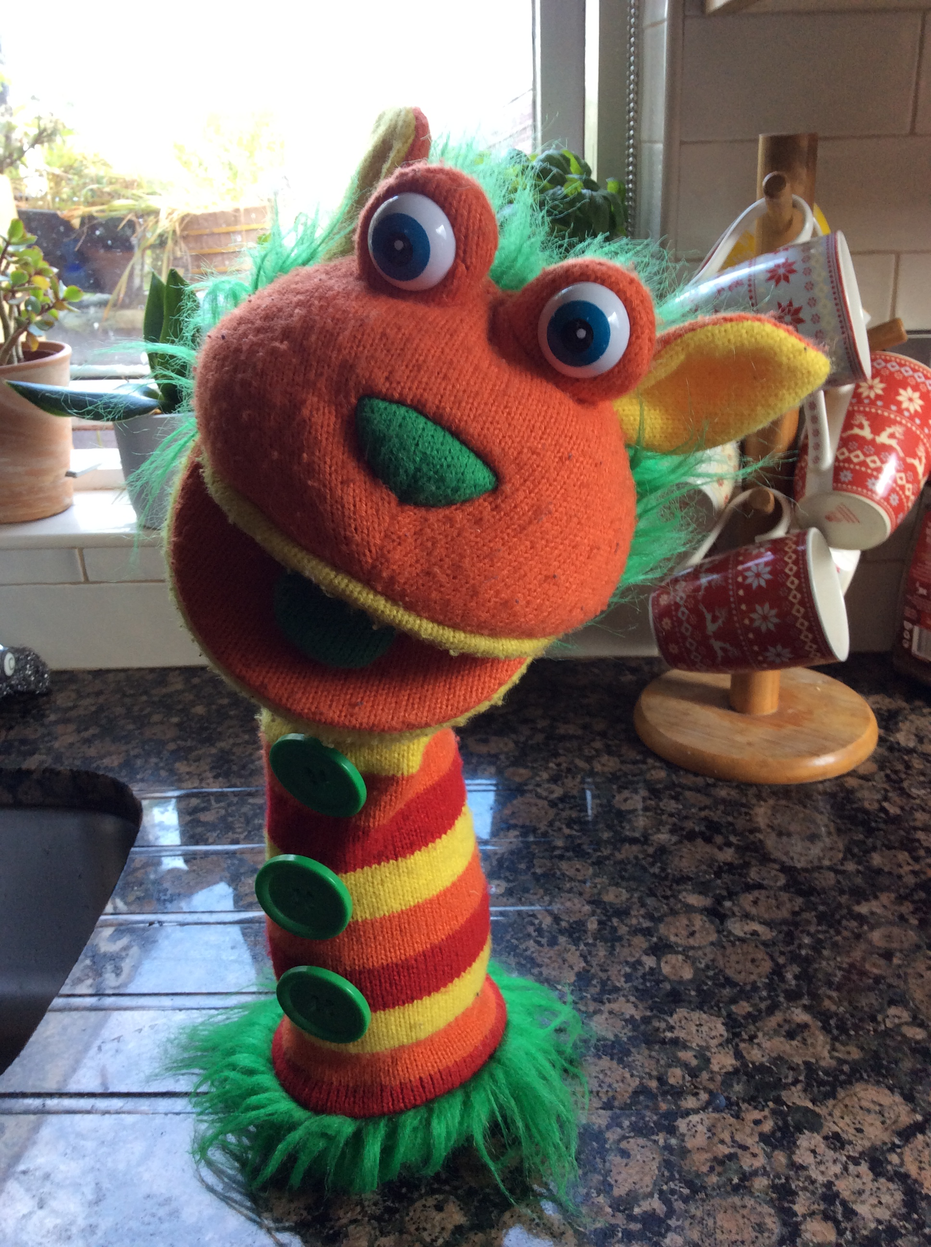
Here is a castles wordwall to help you.

Slide 5
Here is an example from last year
We used scissors to cut our page along the top to look like battlements on a castle.
We drew a picture of a castle to put beside our writing like in an information book.
Remember if you need a word, you don’t have to ask a grown-up!
You can:
Check the wordwall
Check the writing wall
Sound out a word slowly for yourself
If you’re still stuck, you can ask a grown-up now
Wow! That is good work! If you want to send a picture of your work to Teacher, she would love to see it.

