Slide 1
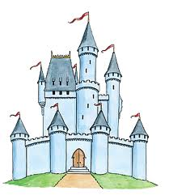
Awesome work!
It’s playtime!
Now, let’s have some fun! At school, we make up lots of great stories at playtime. Do you have any castle toys or princesses or knights and horses? What about Lego or just empty boxes.
Don’t worry if you don’t – you can make your own!
Have a look at what the kids in school did other years.
Look out! You might see somebody’s brother or sister or cousin!

Slide 2
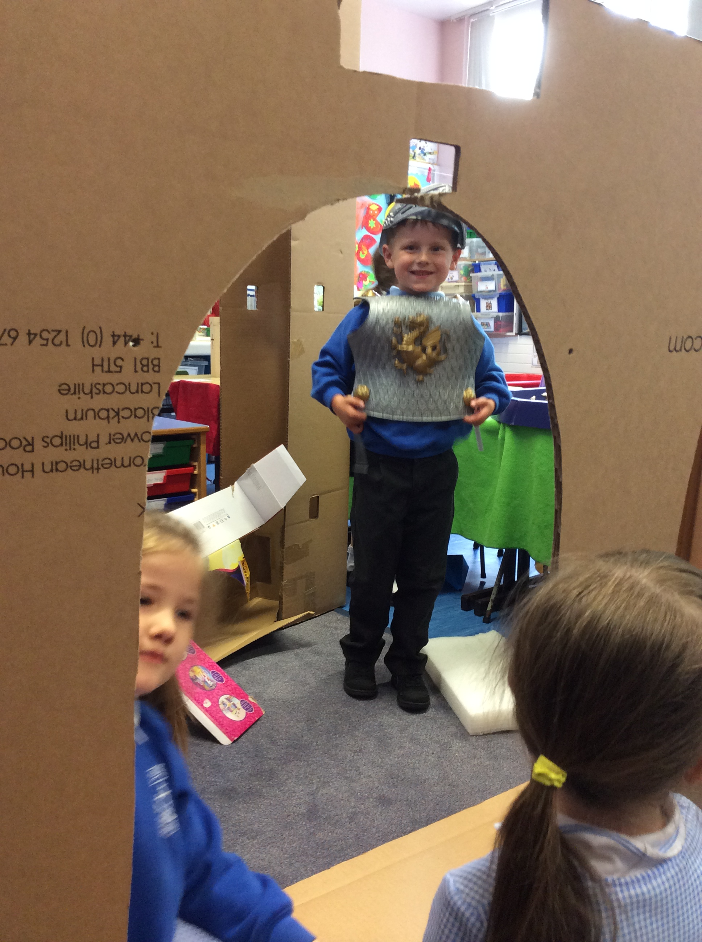
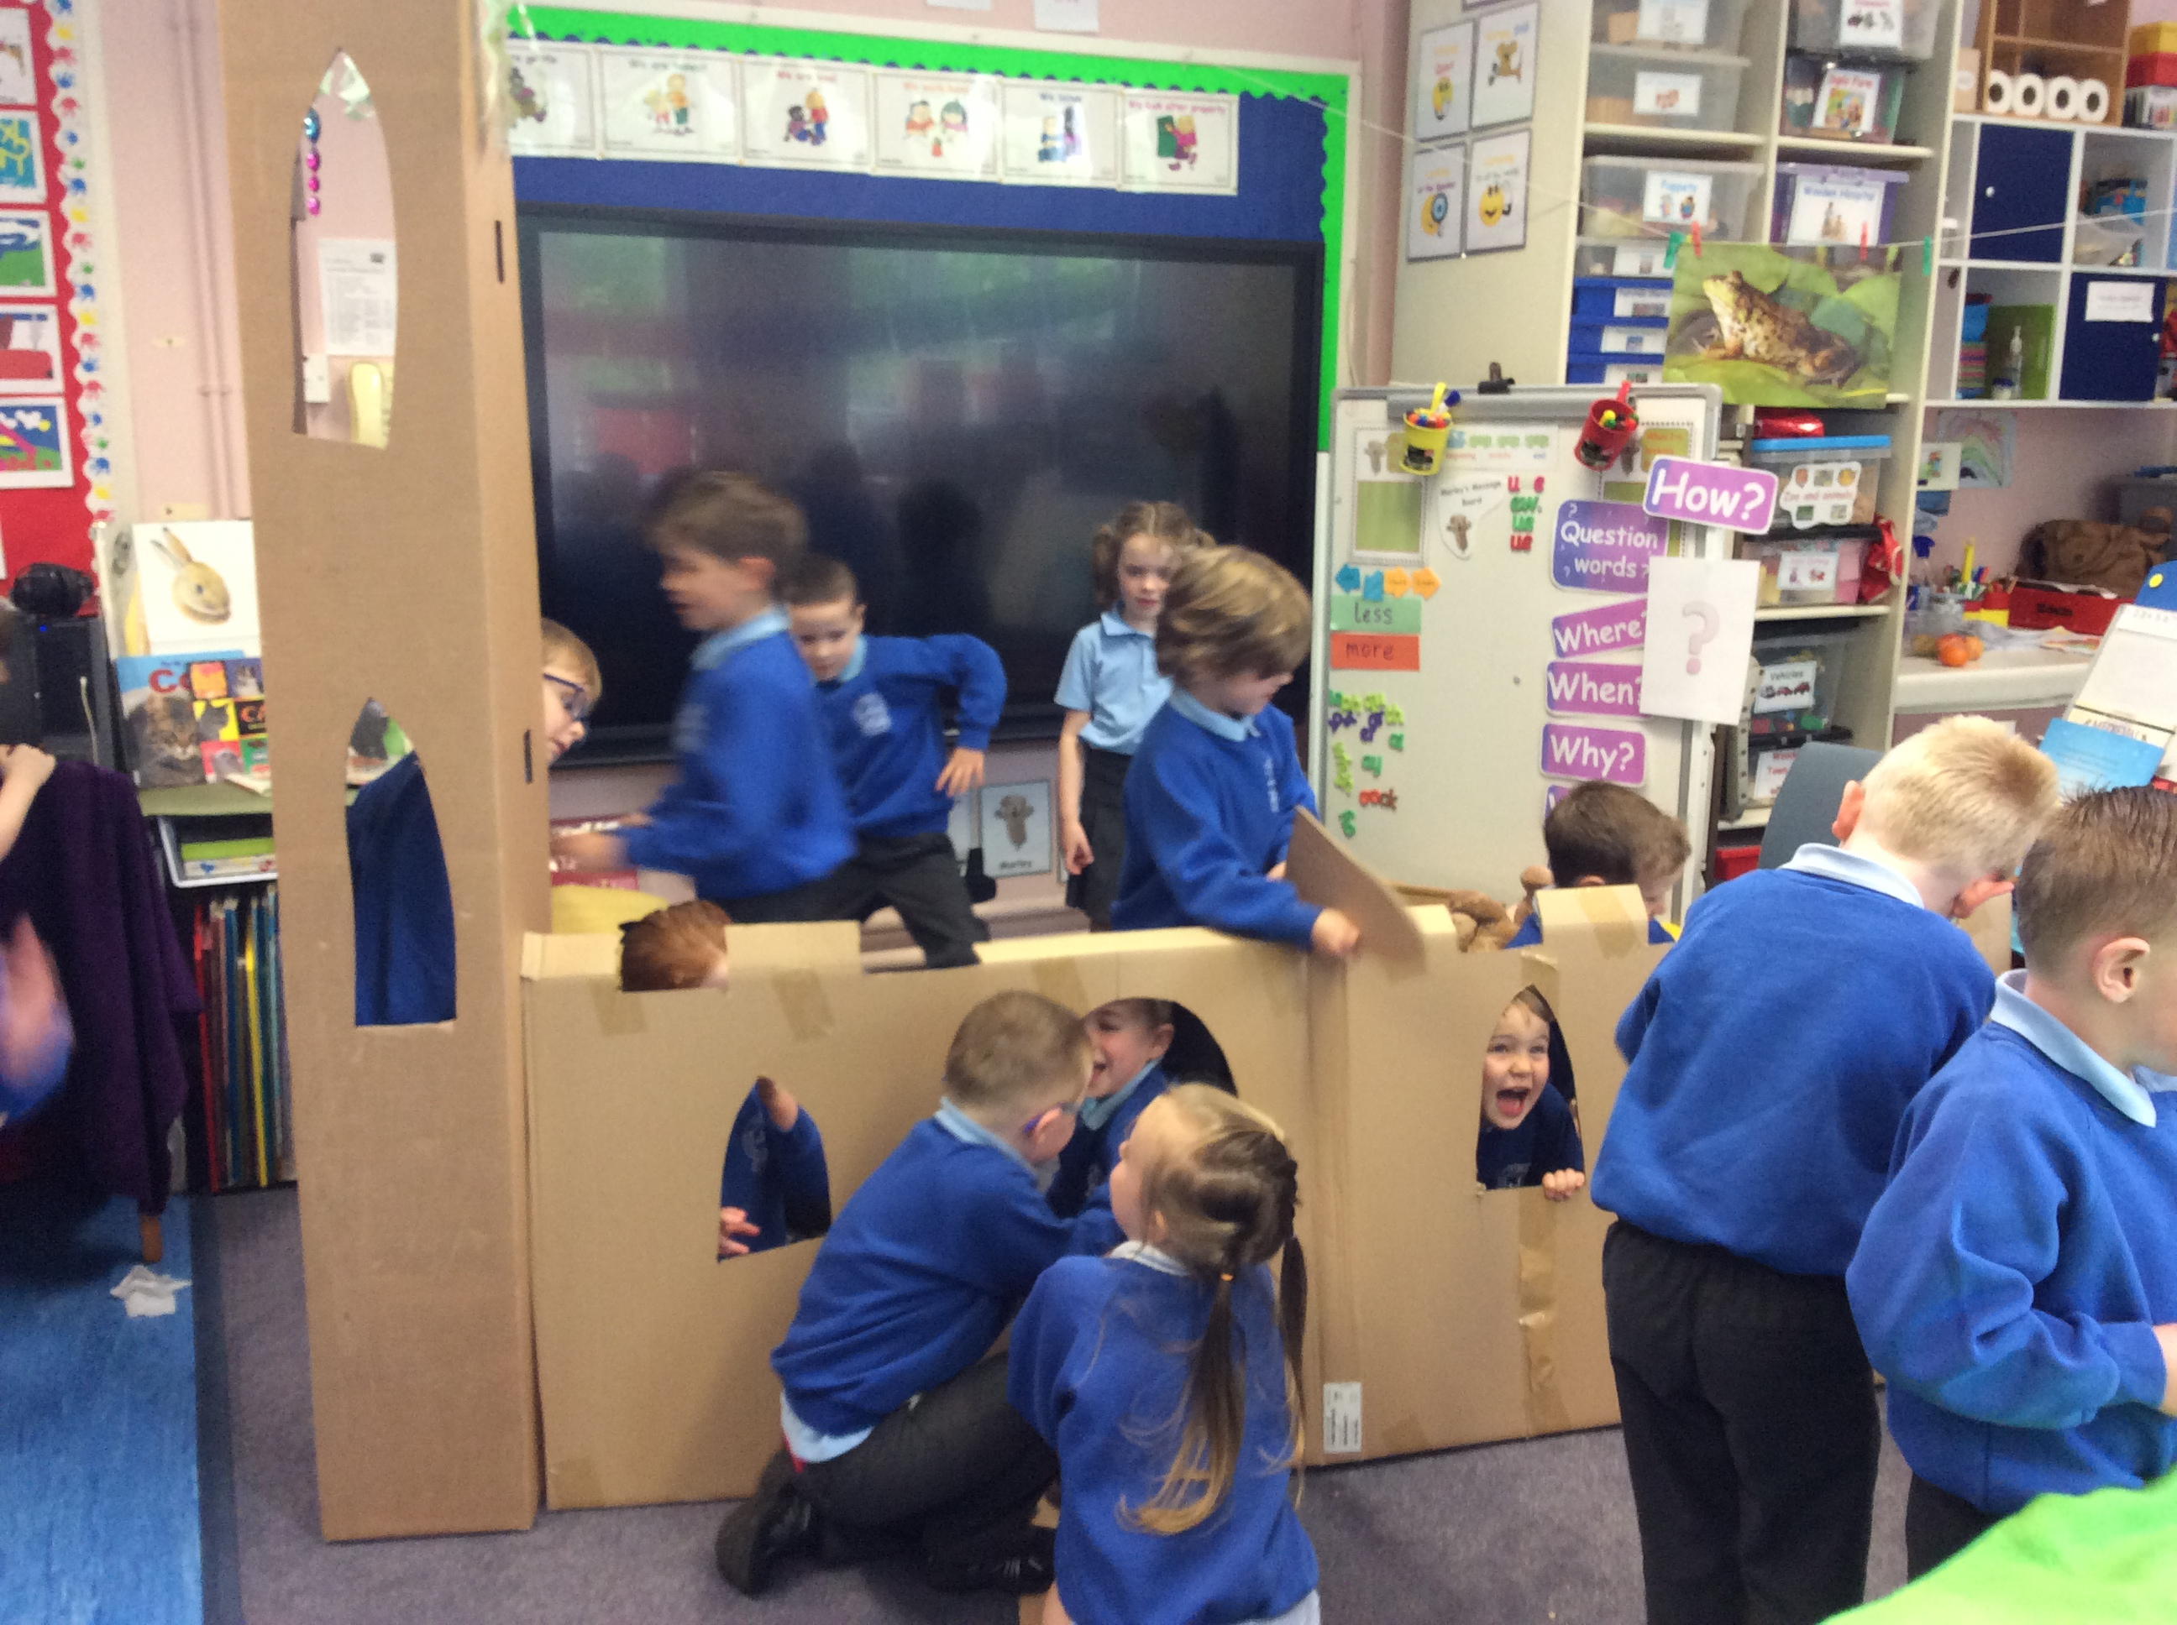
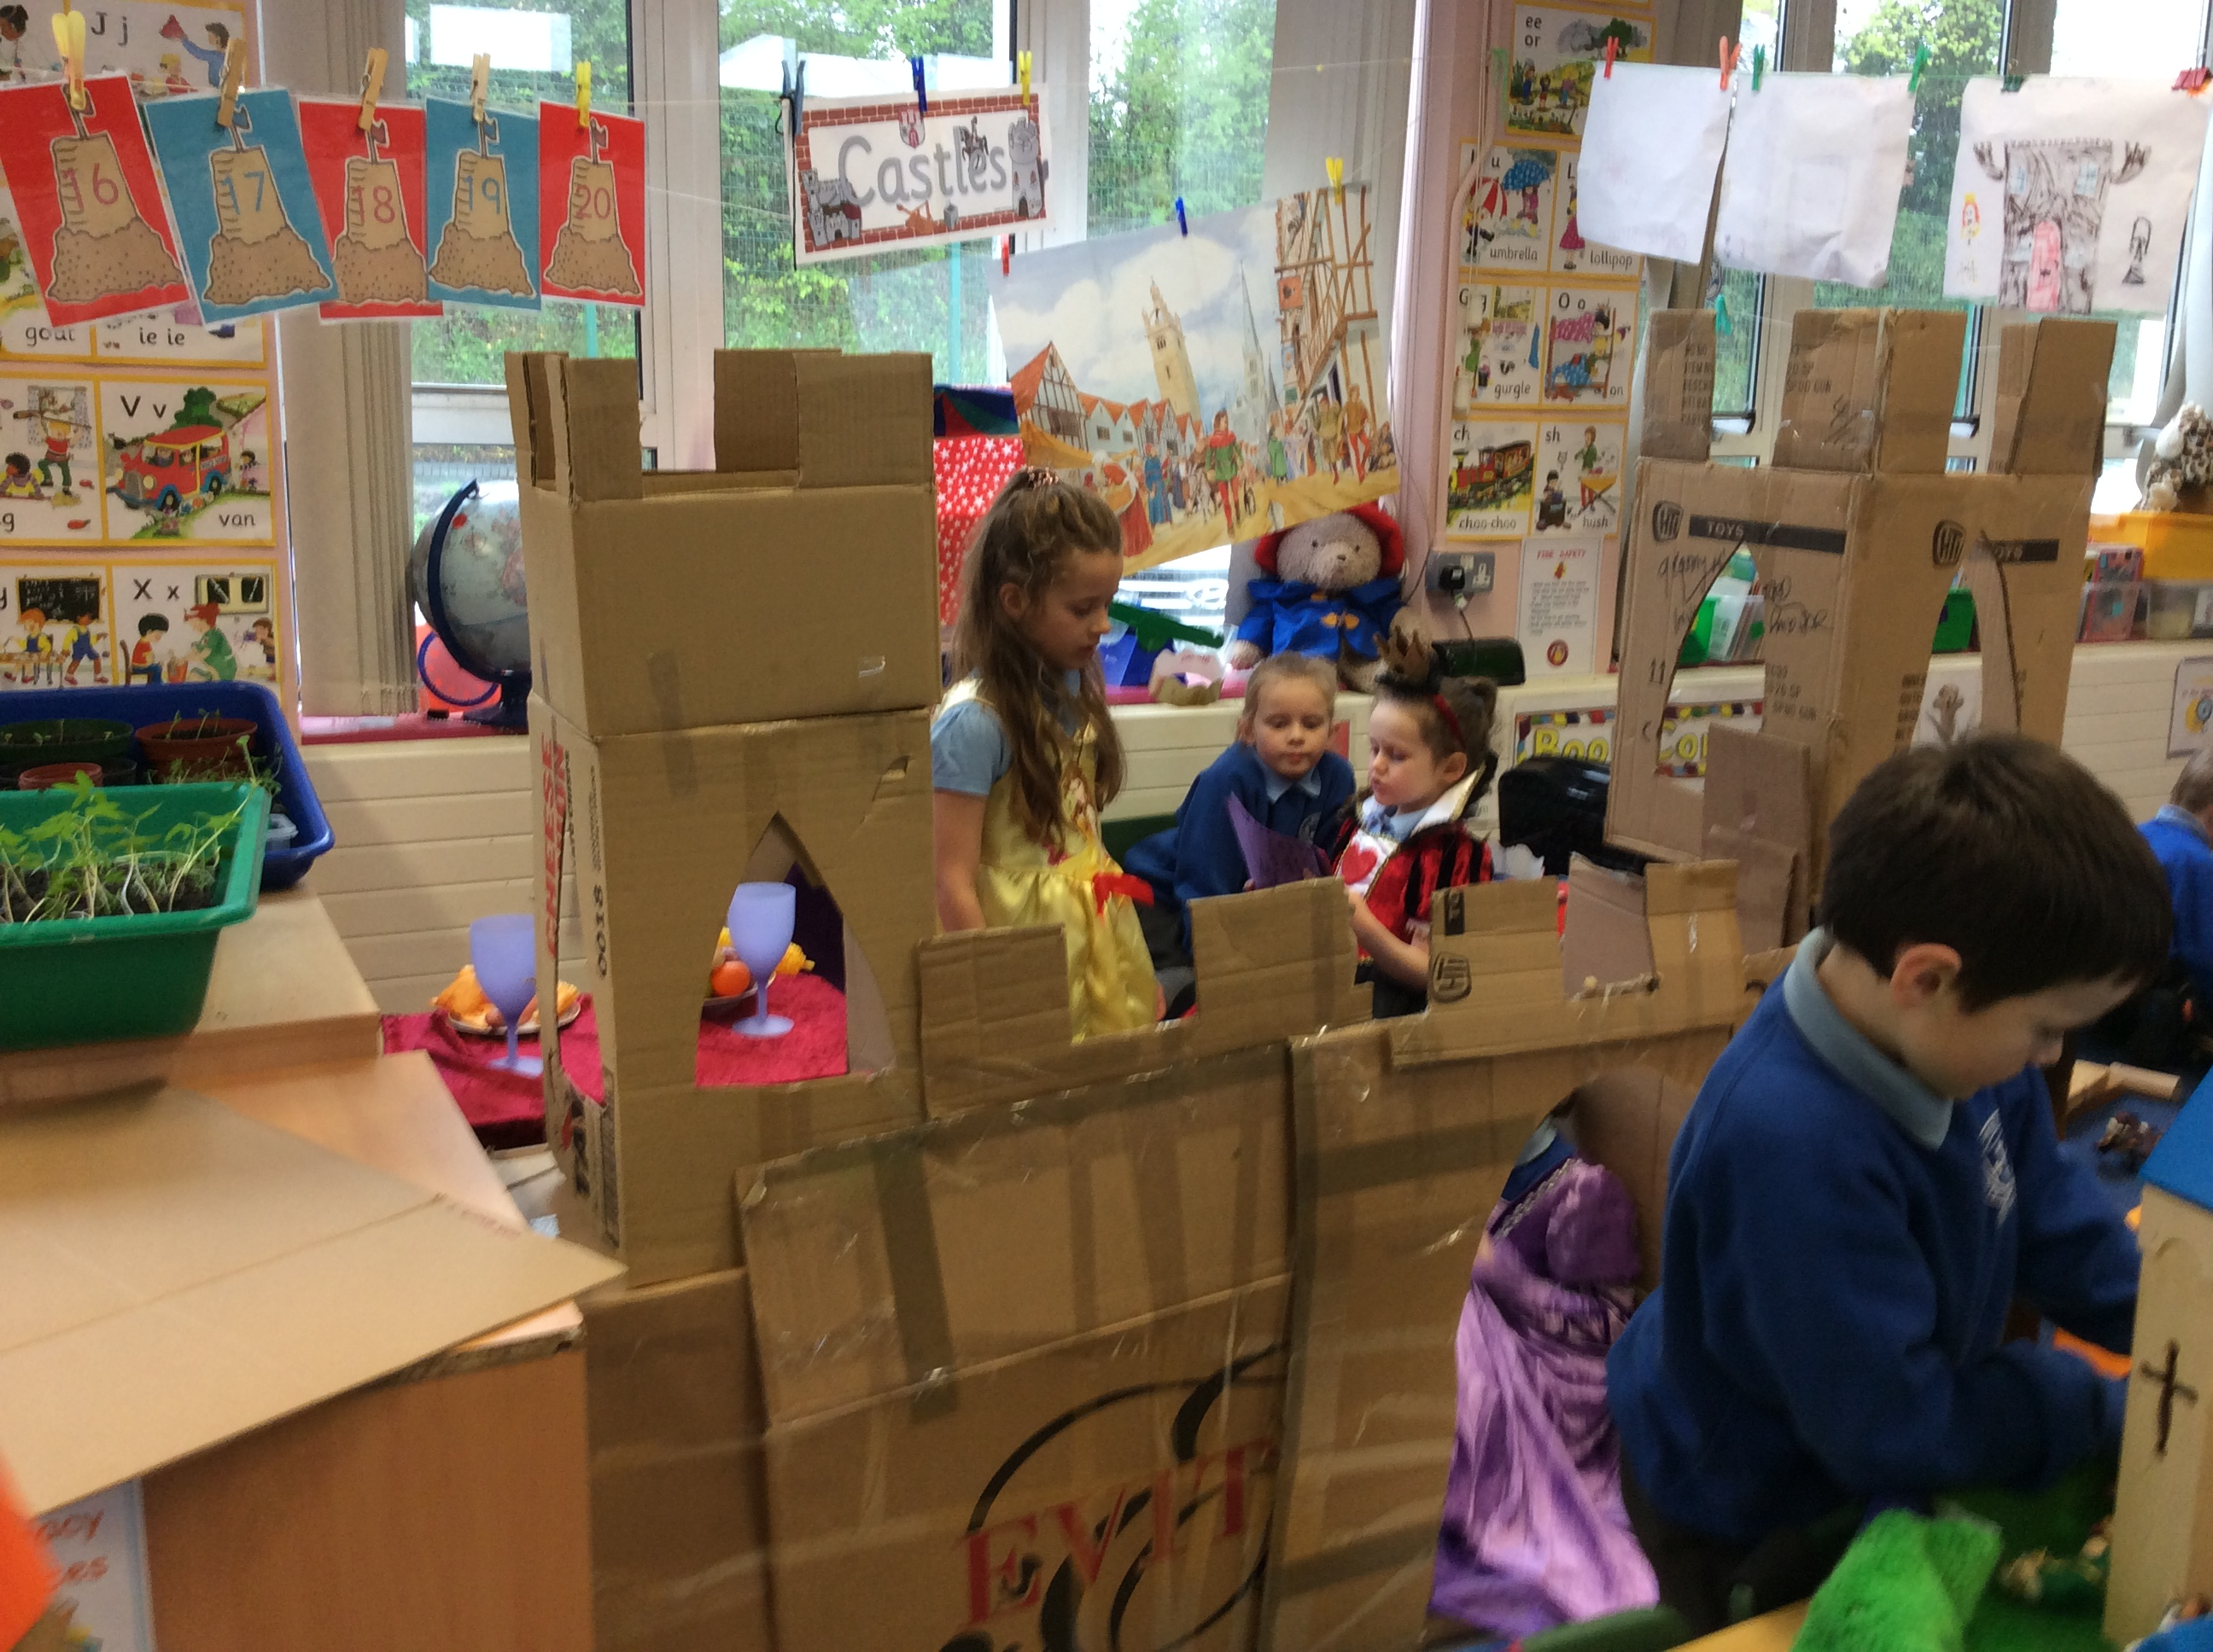
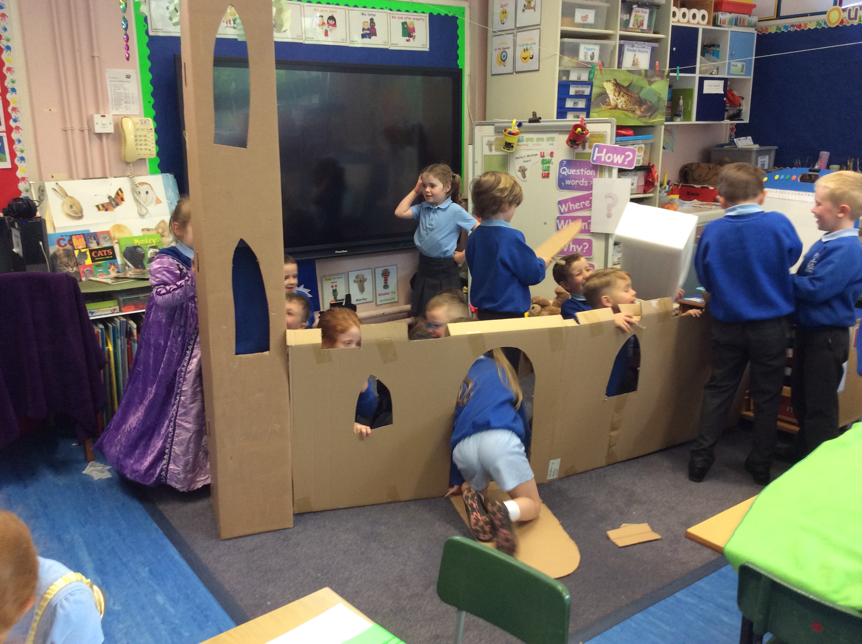
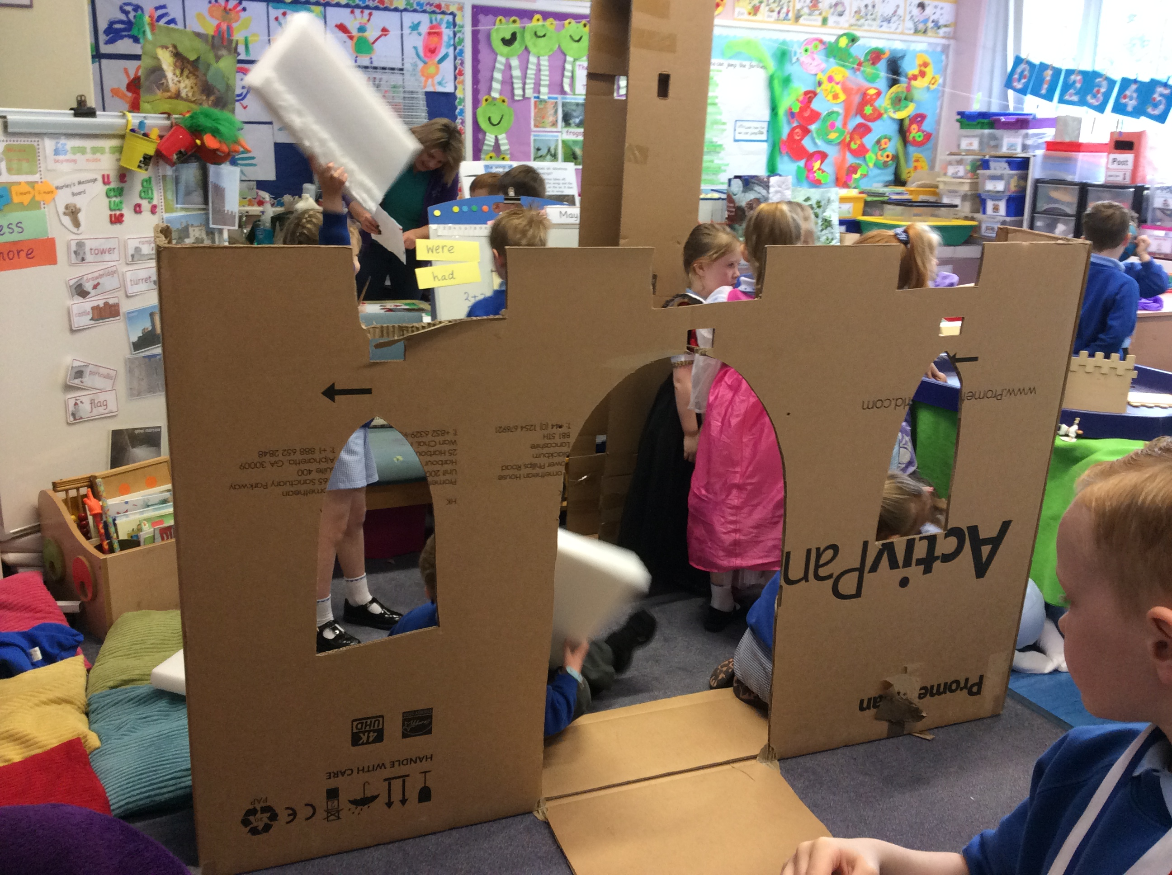
Do you think you could build a castle in your house or garden?

Slide 3
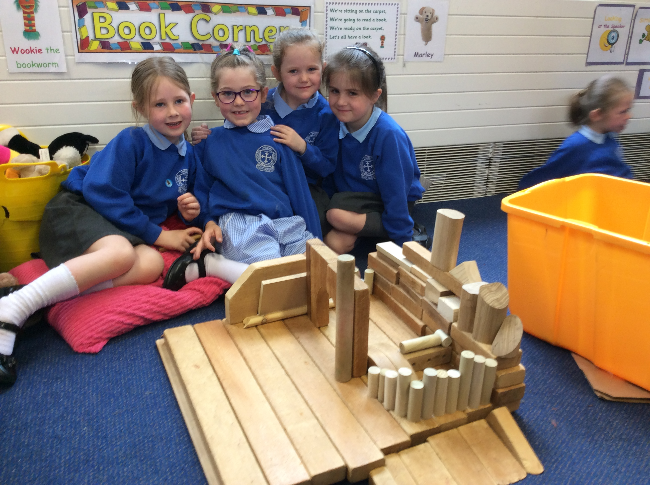
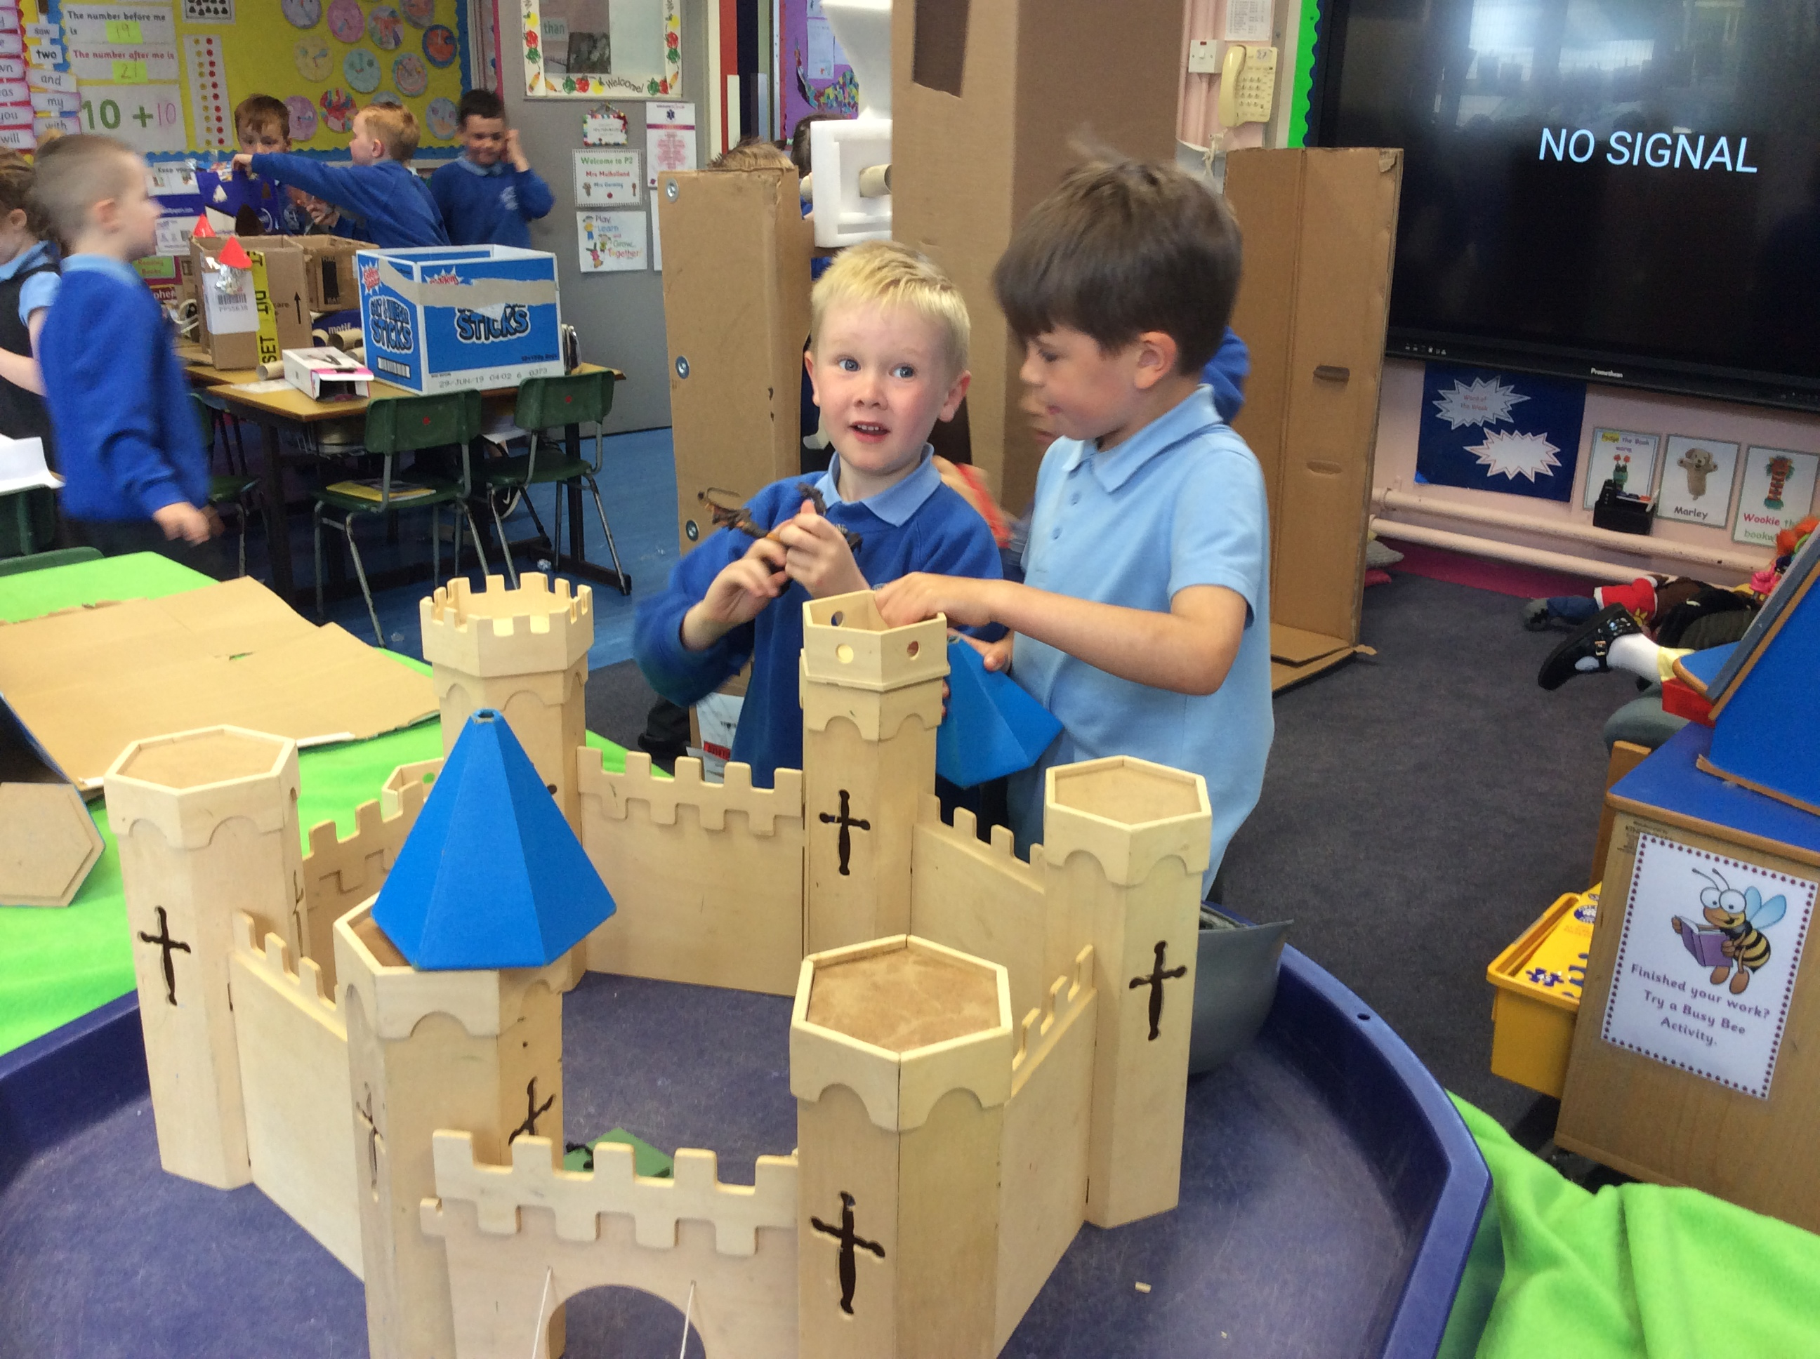
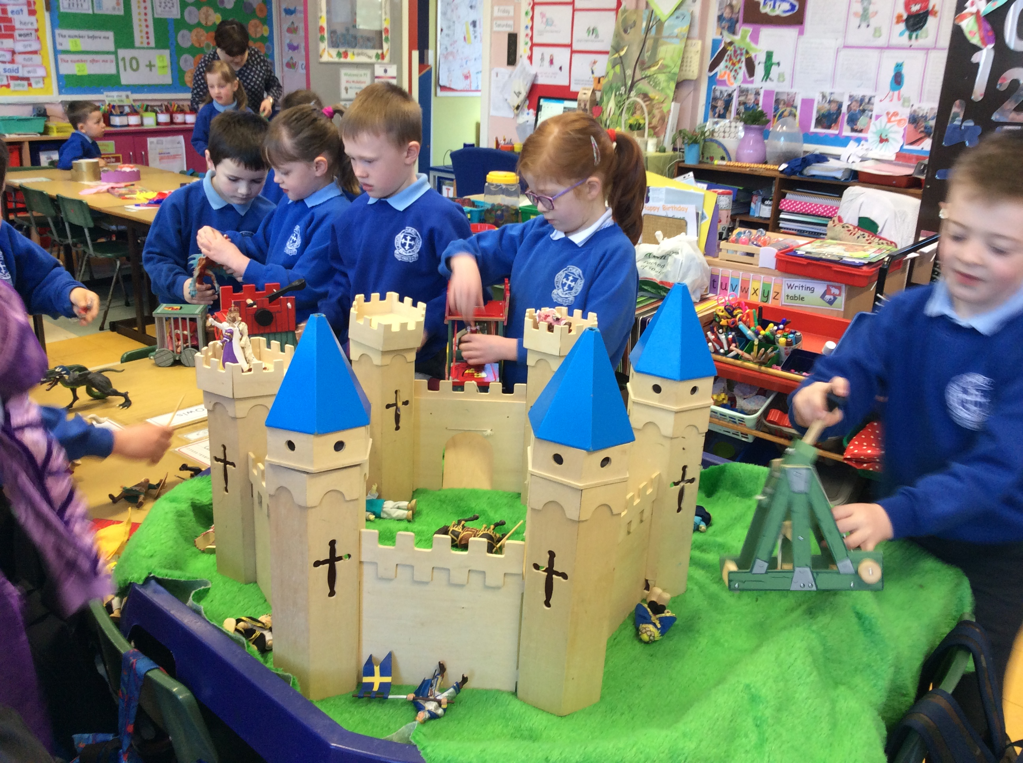
Or a castle out of blocks or toys?

Slide 4
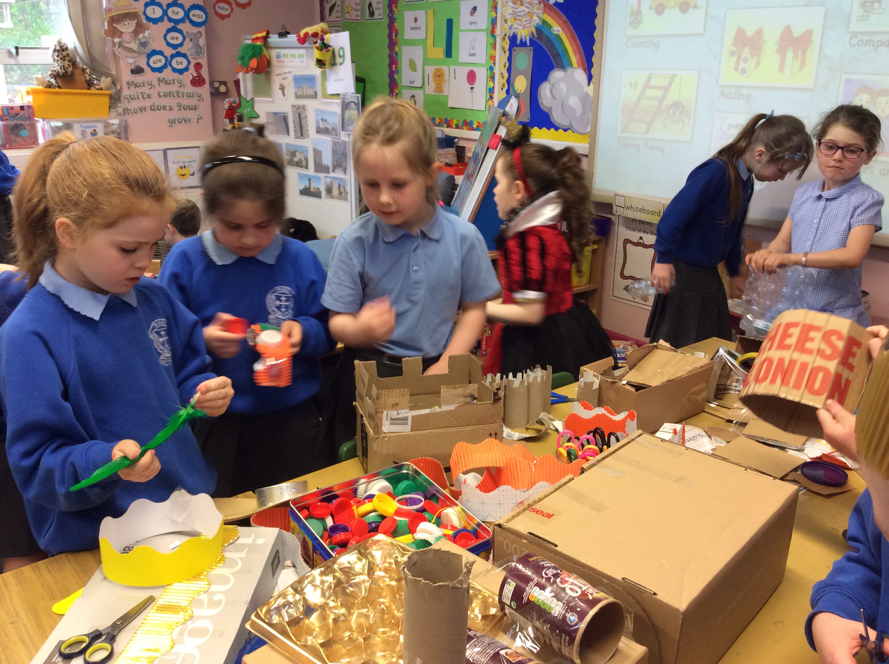
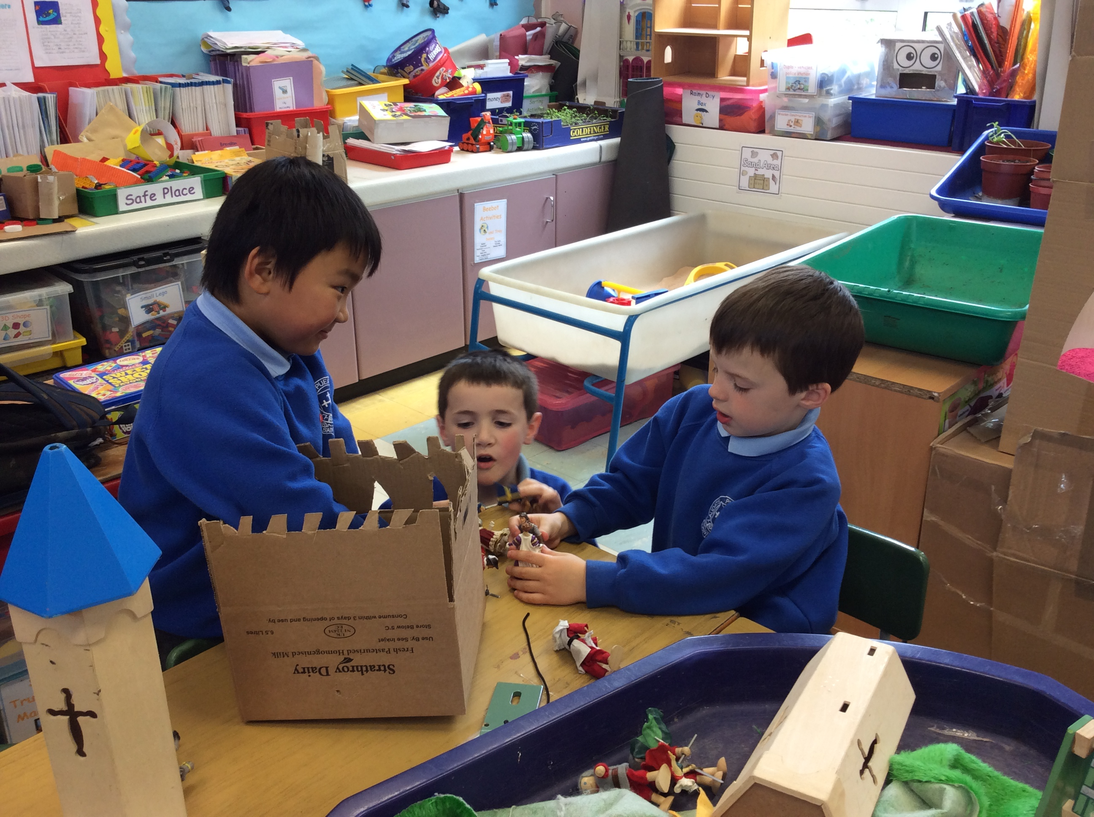
Could you make a castle out of cardboard boxes and junk?

Slide 5
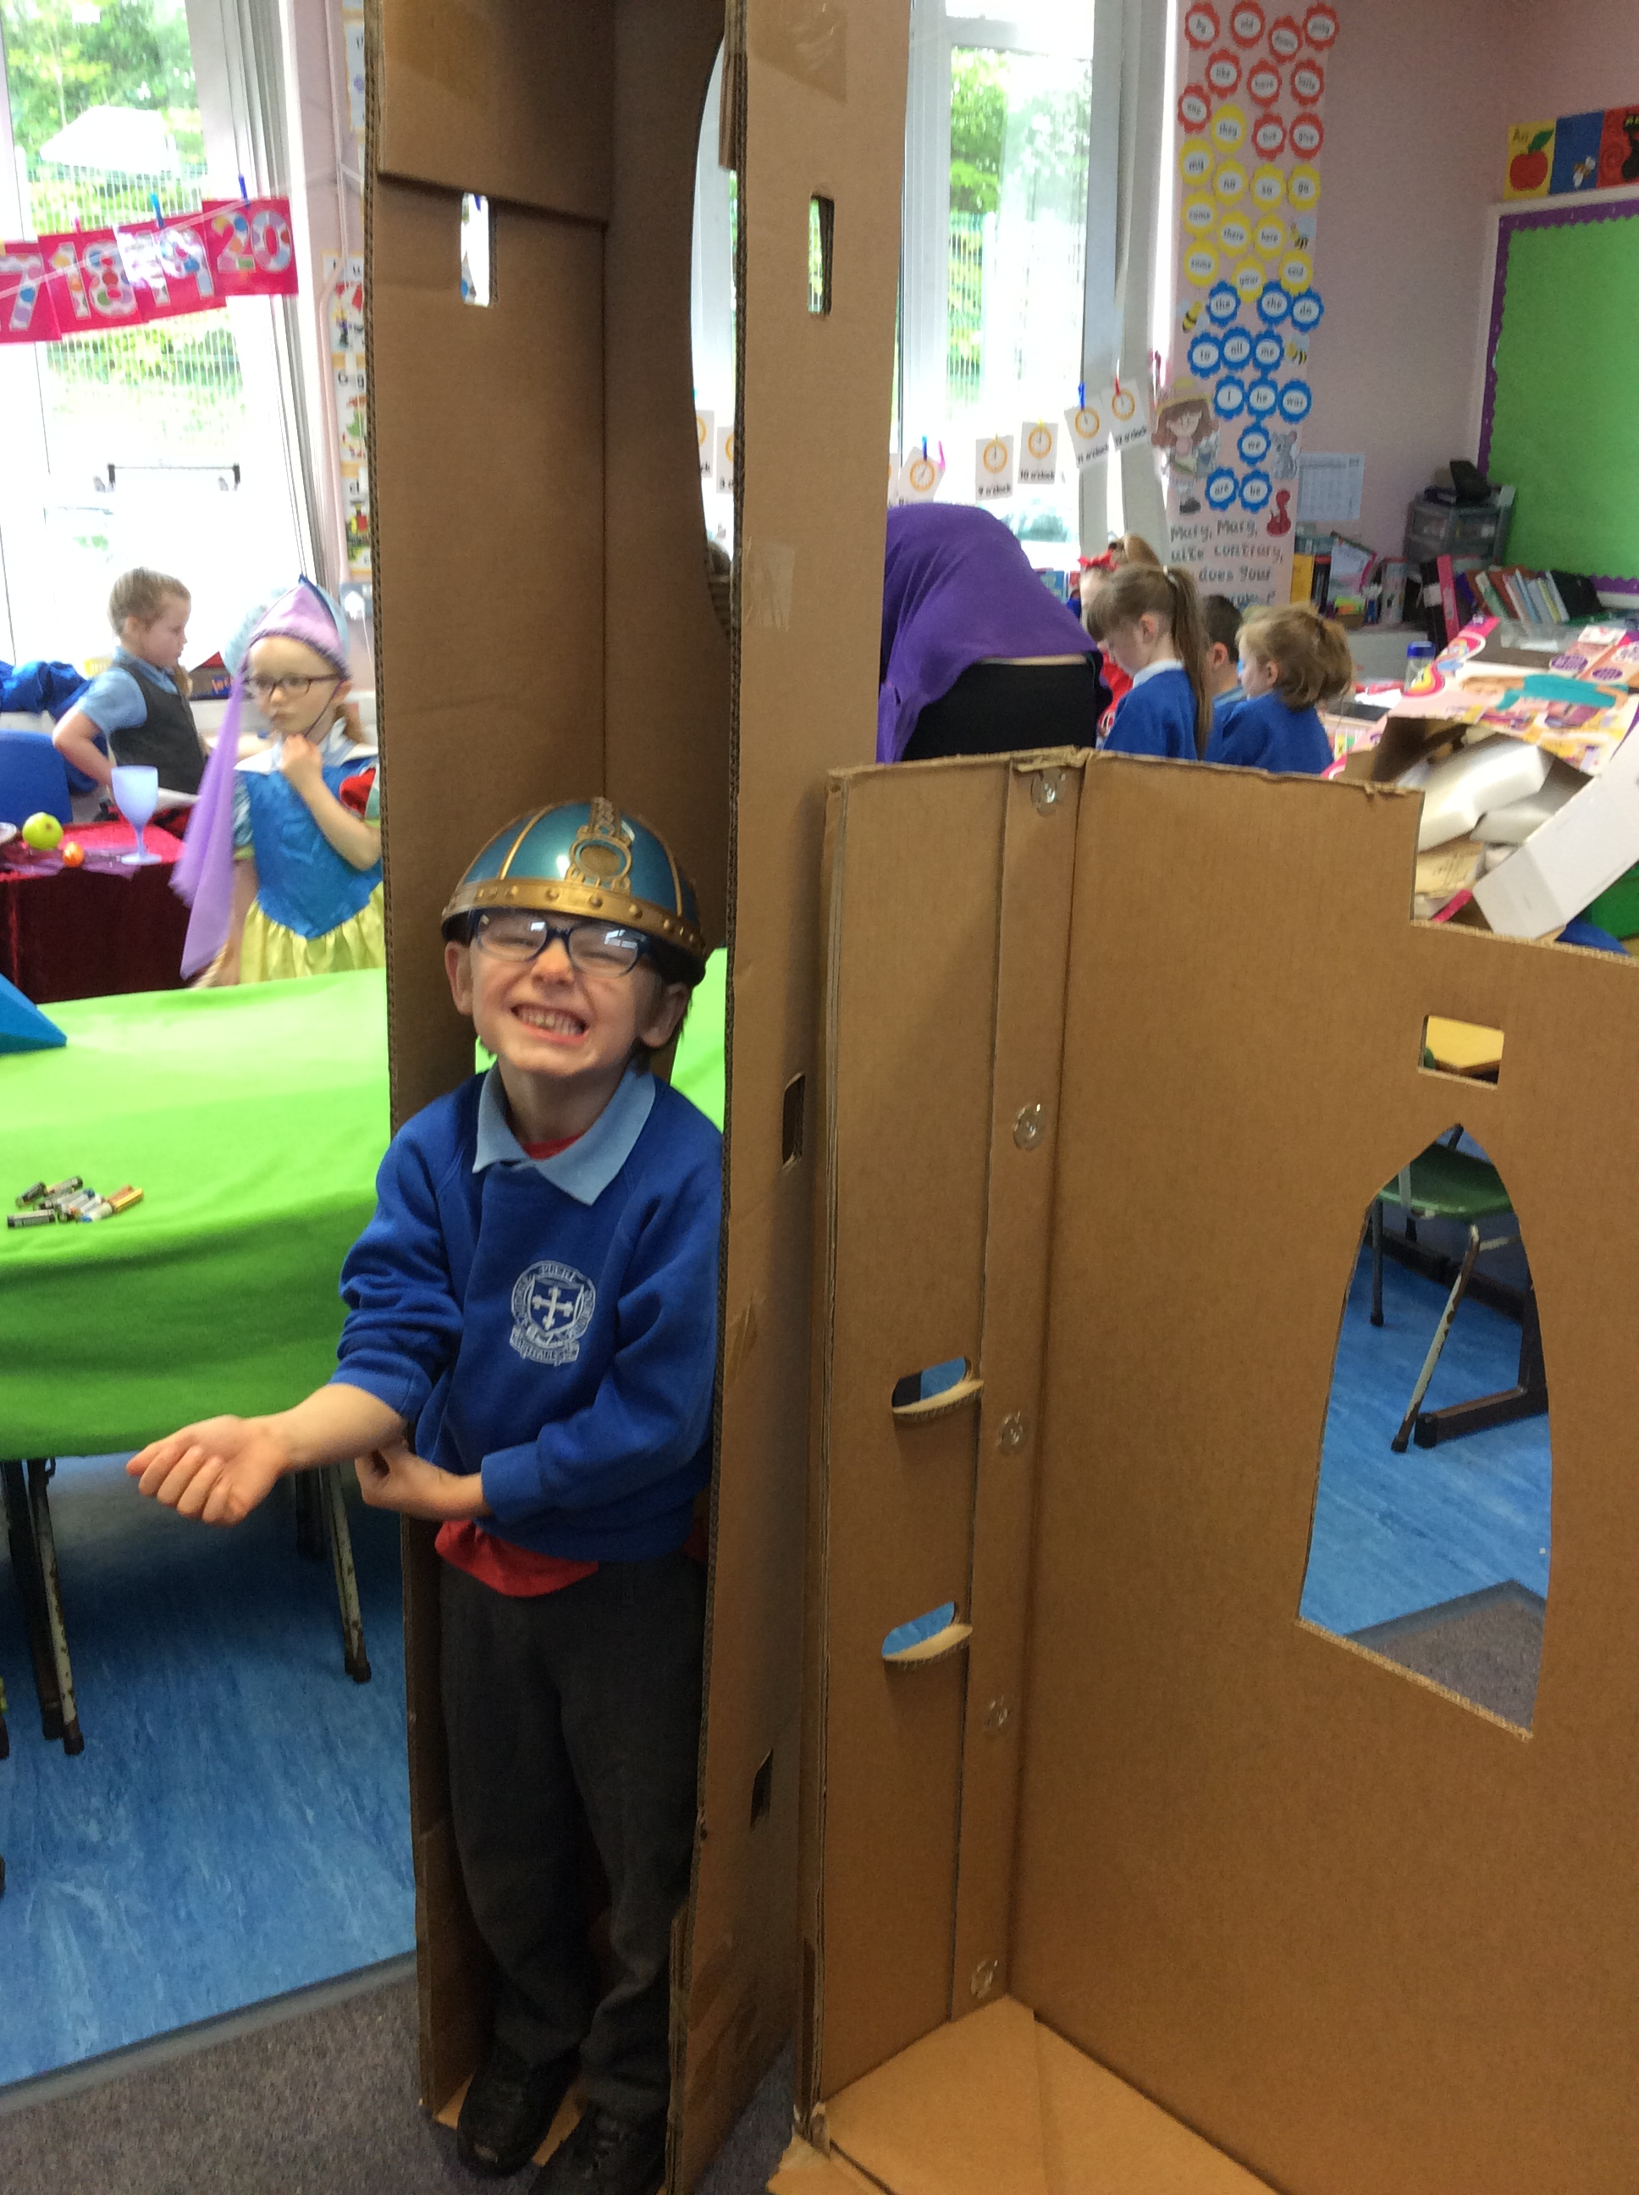
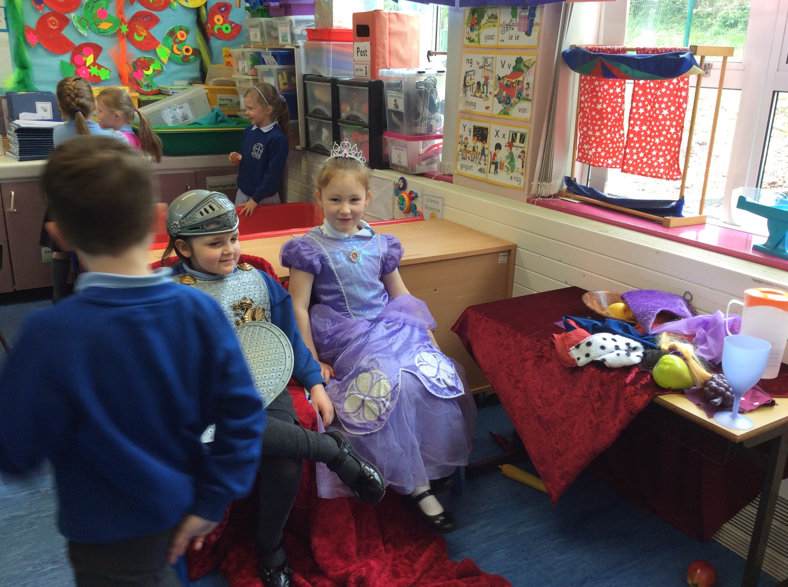
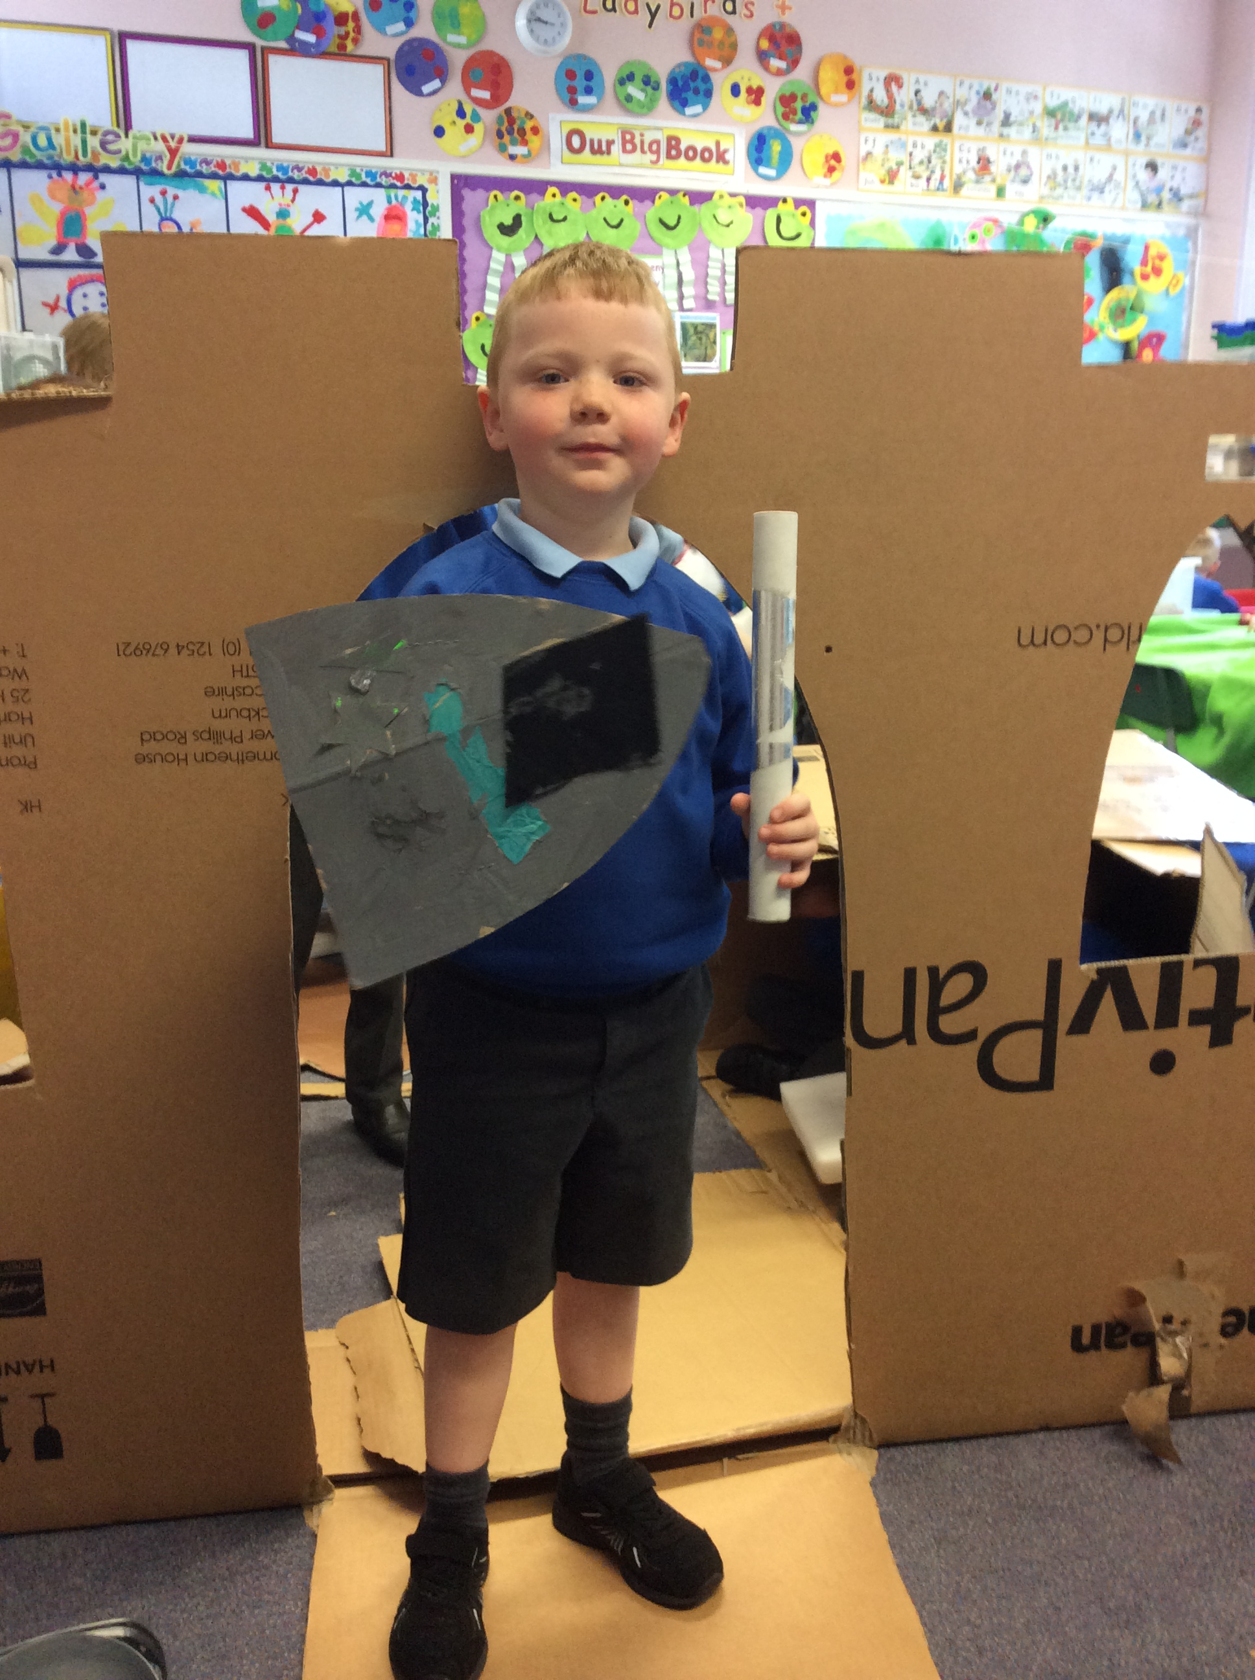
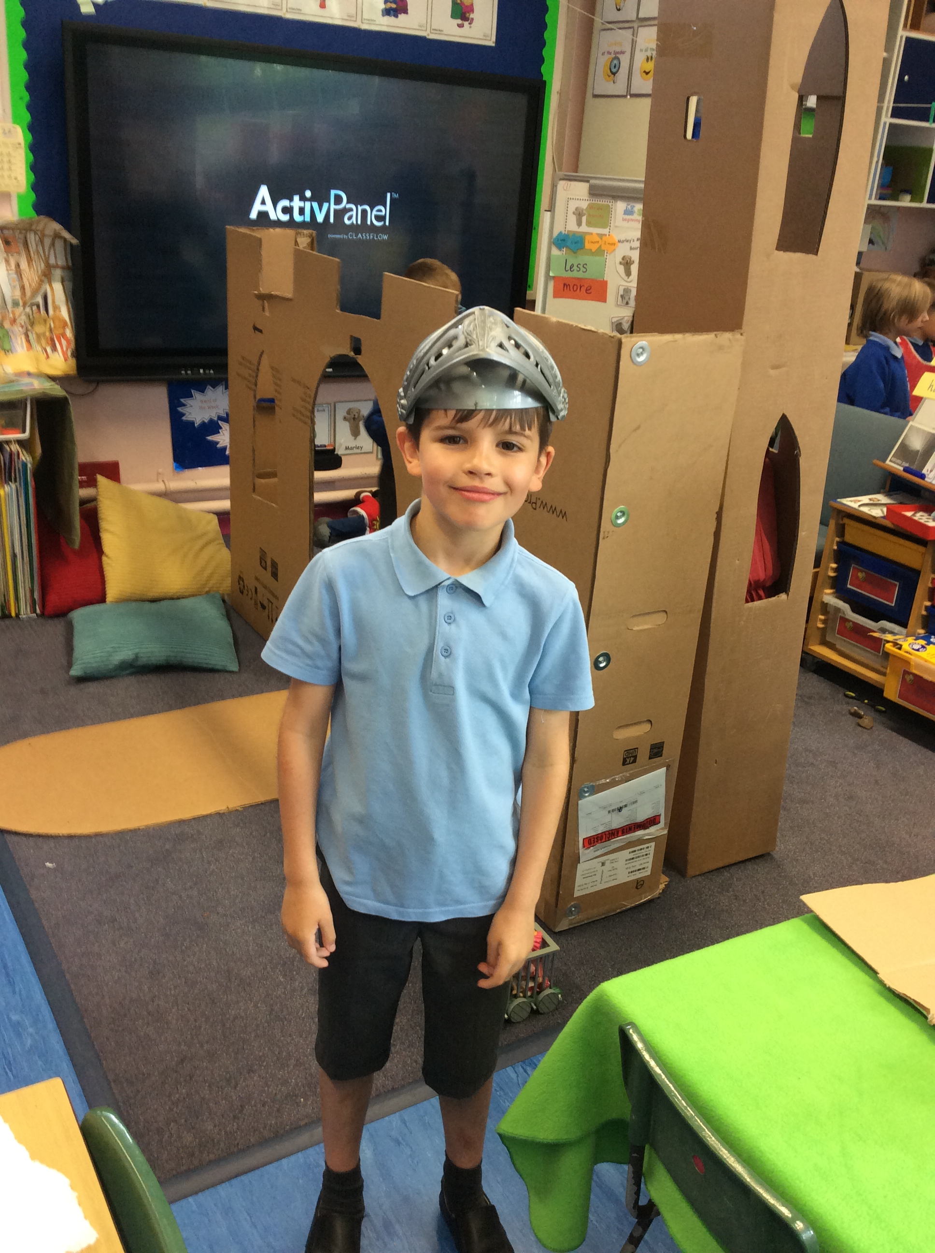
Who lived in these castles? Do you have any costumes to dress up as a princess or a king or a queen or a knight?
Why don’t you try to make your own armour out of cardboard!

Slide 6
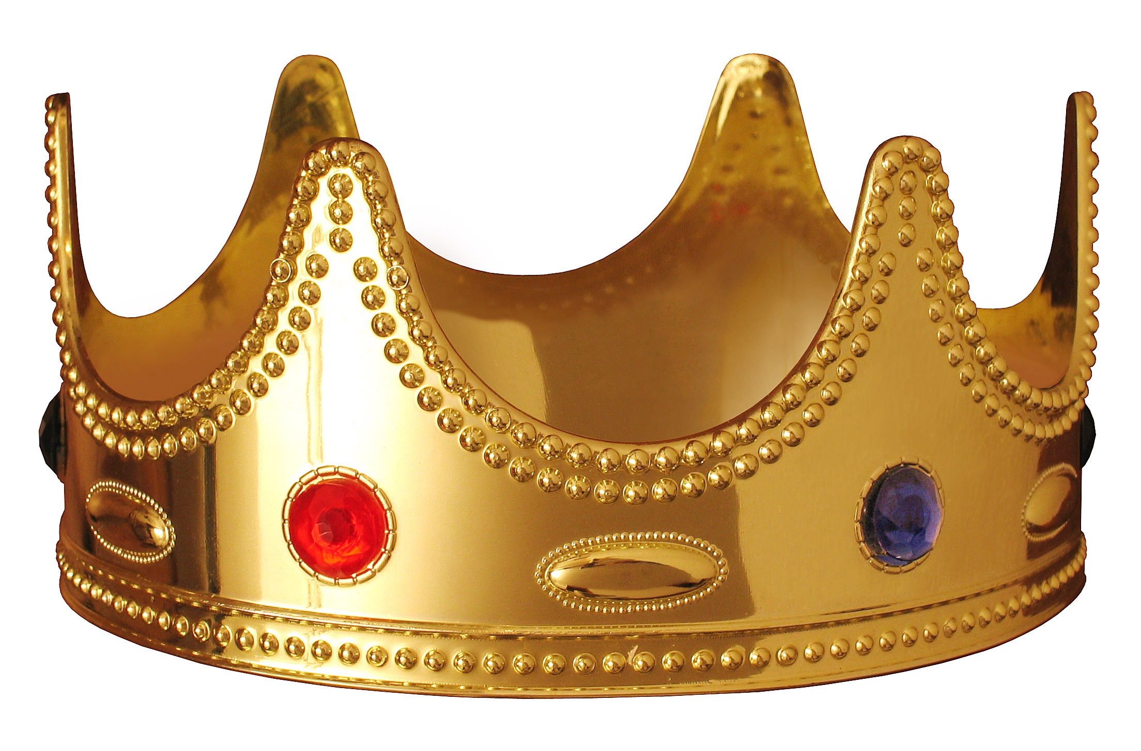
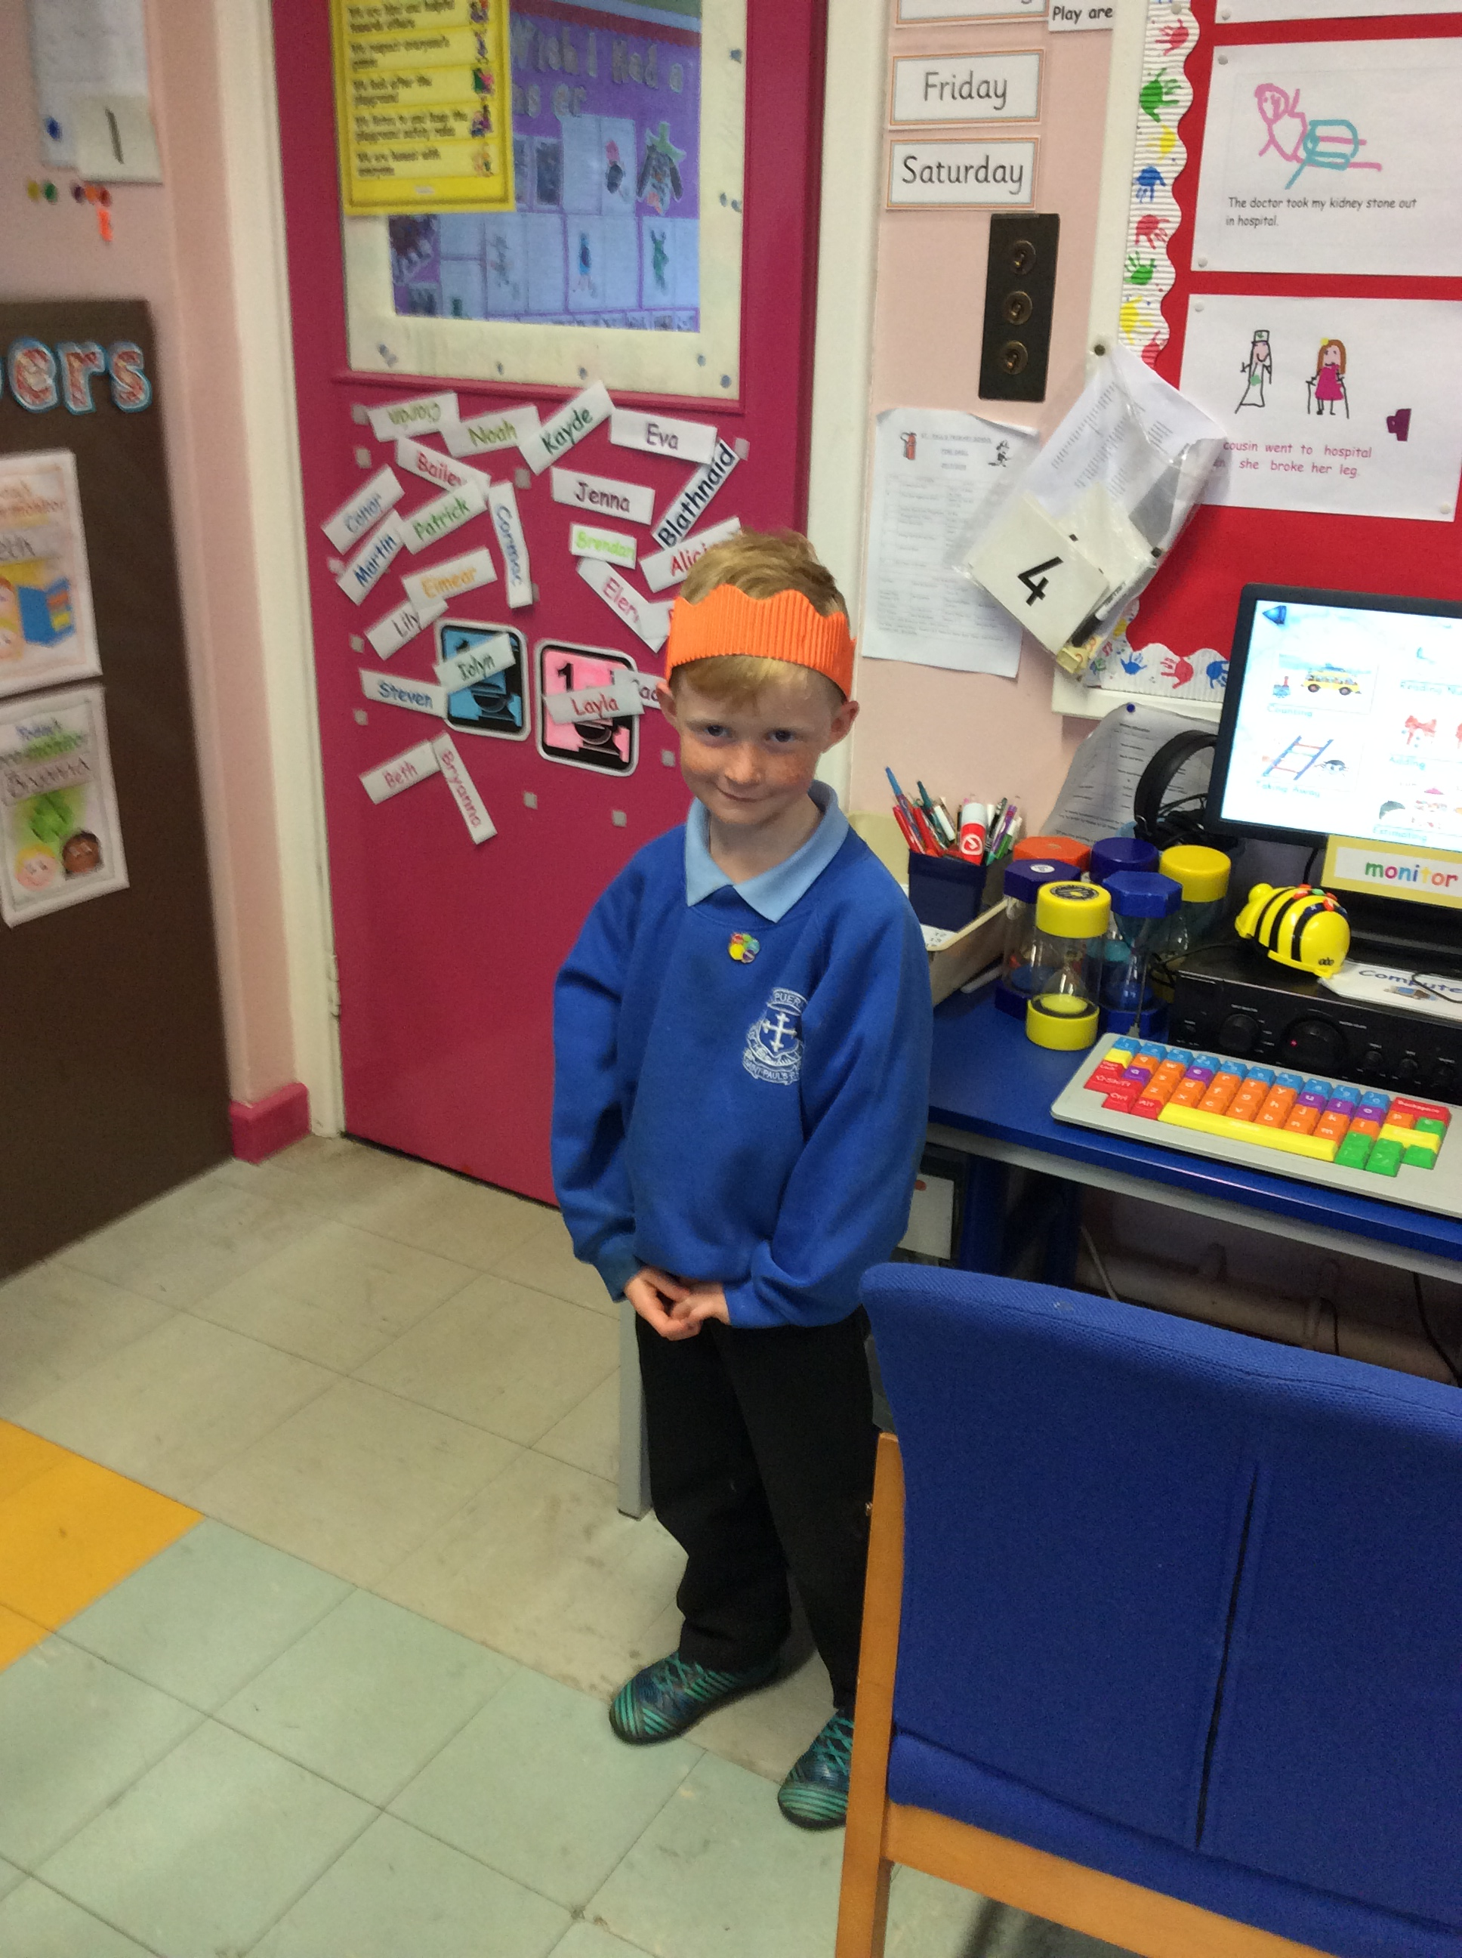
Make crowns – stick on milk bottle tops or buttons as jewels.

