Slide 1
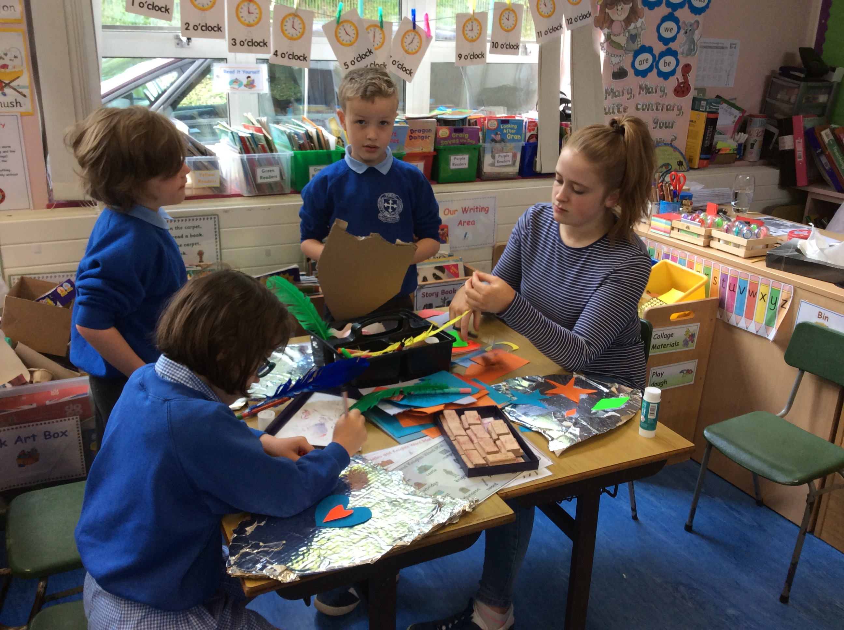
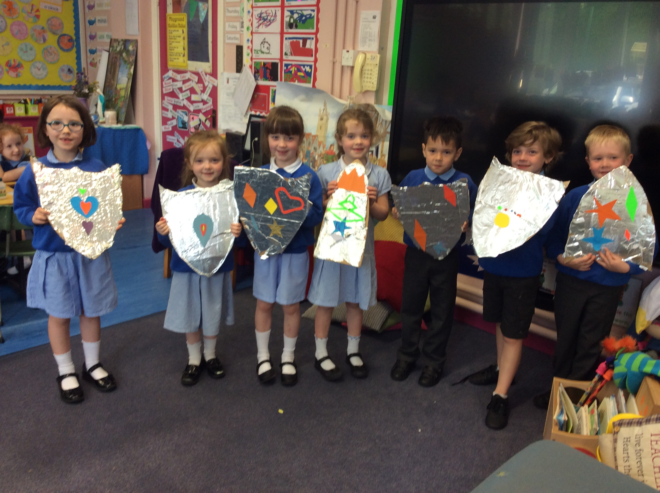
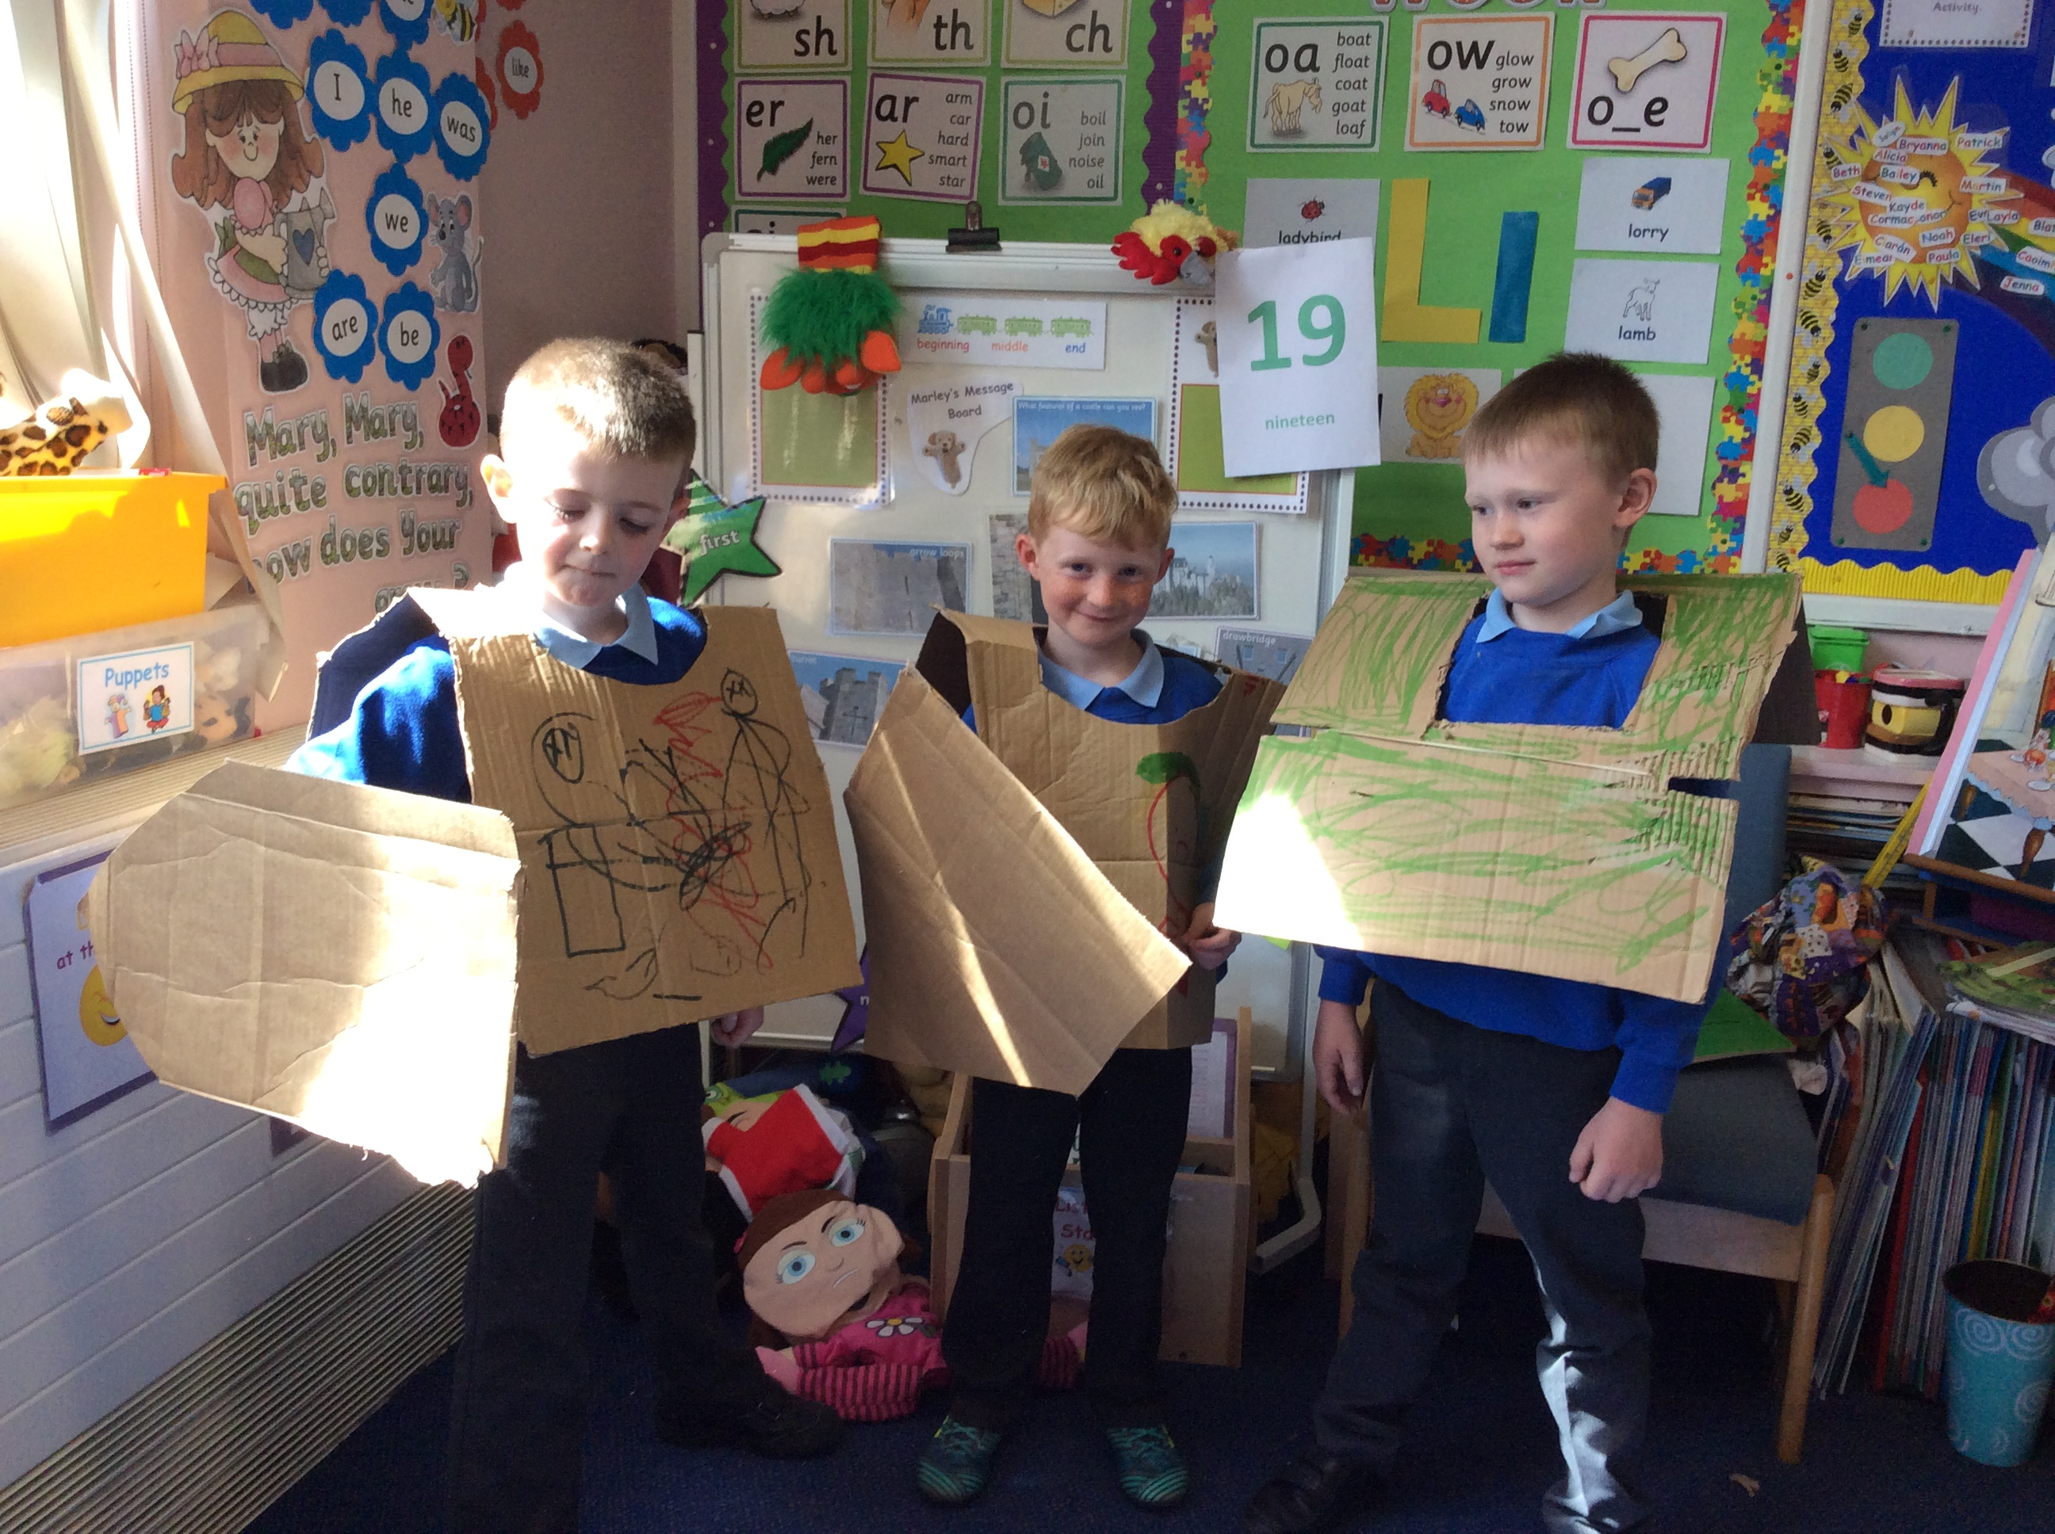
Symmetry – can you cut out symmetrical shapes to stick on your shields? – fold a page in half and then cut half a shape and open it out! Remember doing this in school before?

Slide 2
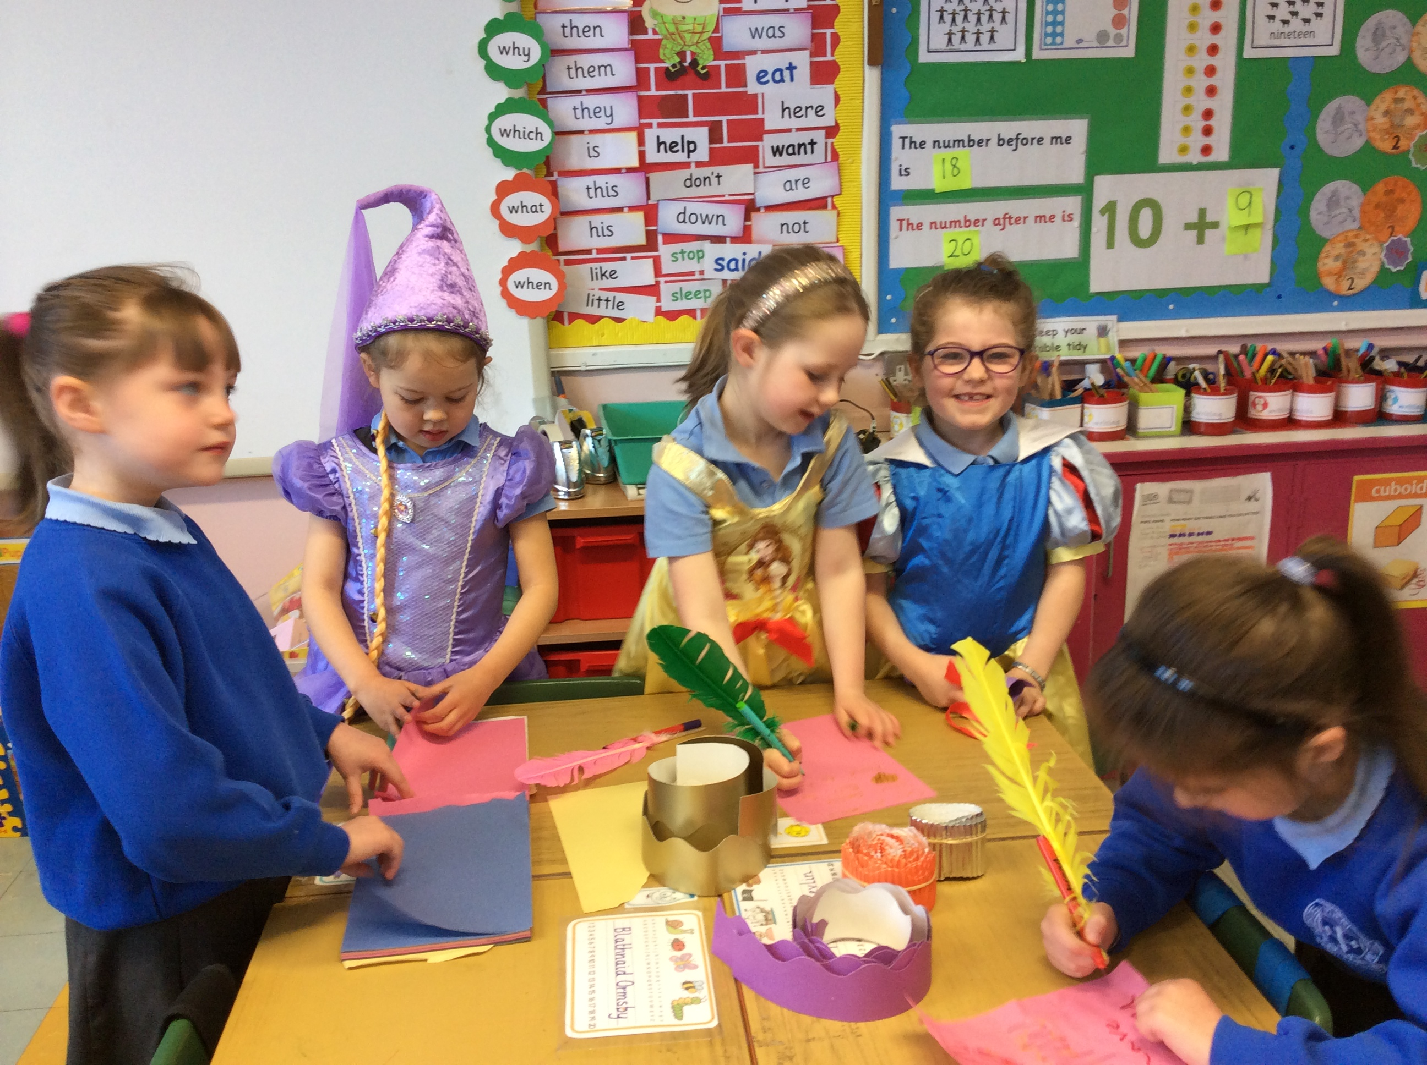
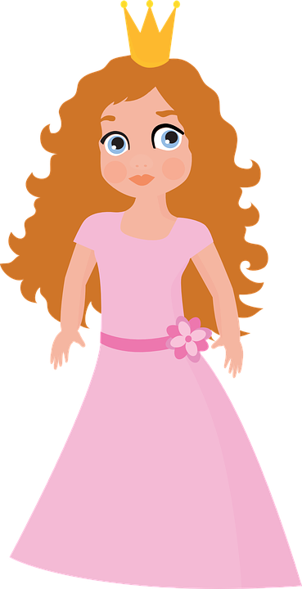
Princesses
Dress up
Make up stories using your princess toys.
Stick a feather onto your markers to make them like old-time feather quills and write invitations to balls/ banquets / letters/ diaries/ stories or draw pictures.

Slide 3
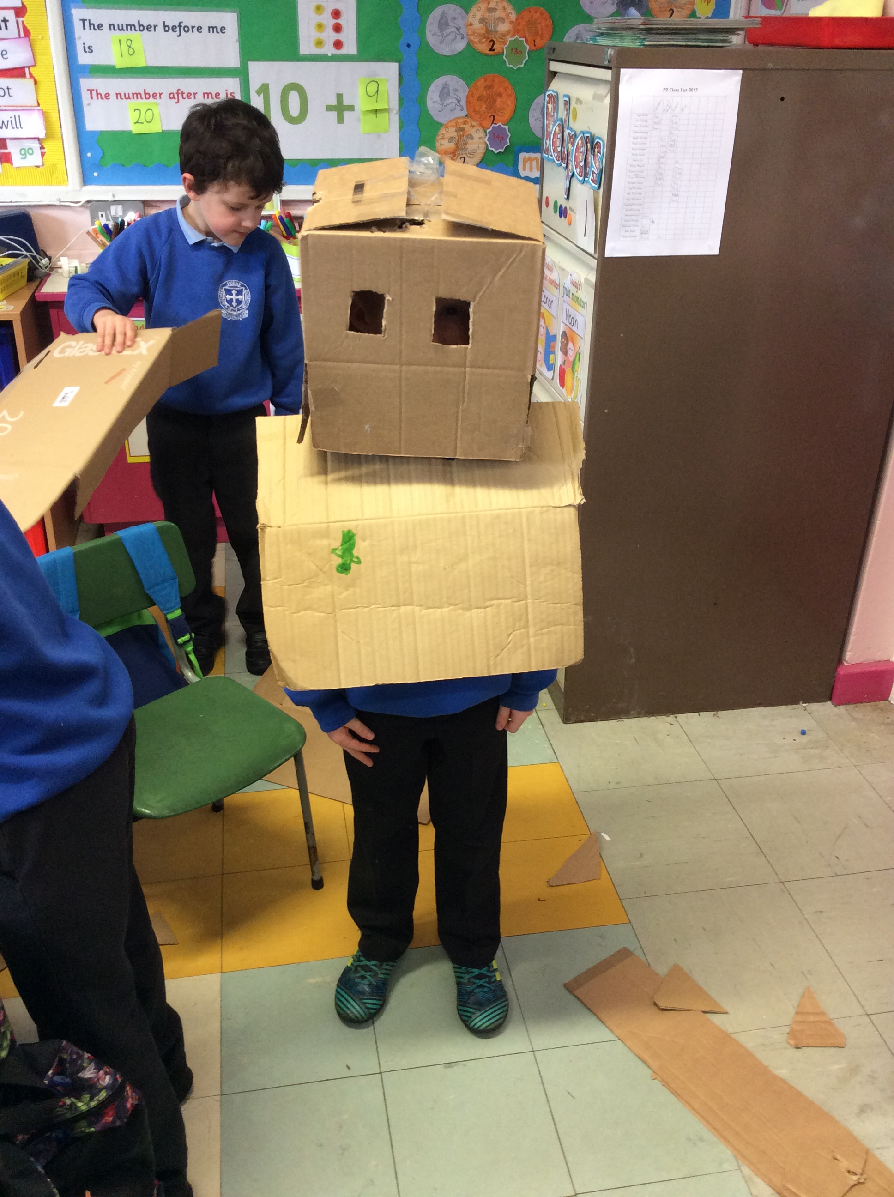
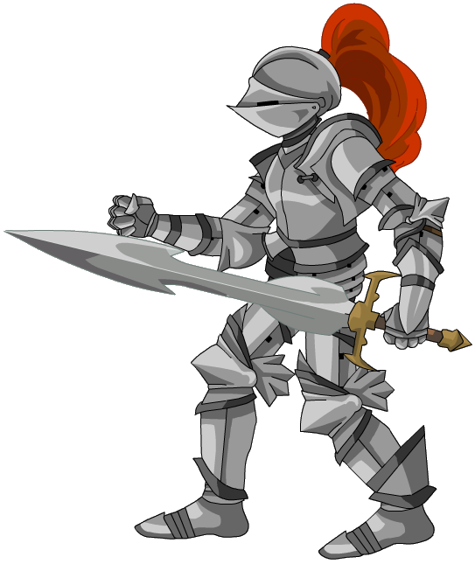
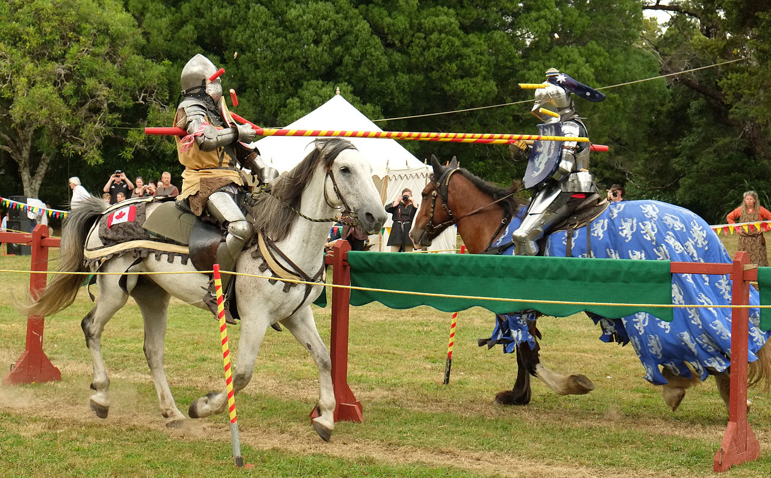
Knights
Make your own armour / swords / shields.
Have pretend sword fights! – Be careful!
Make a horse out of a brush
Get your toy dragons for a battle

Slide 4
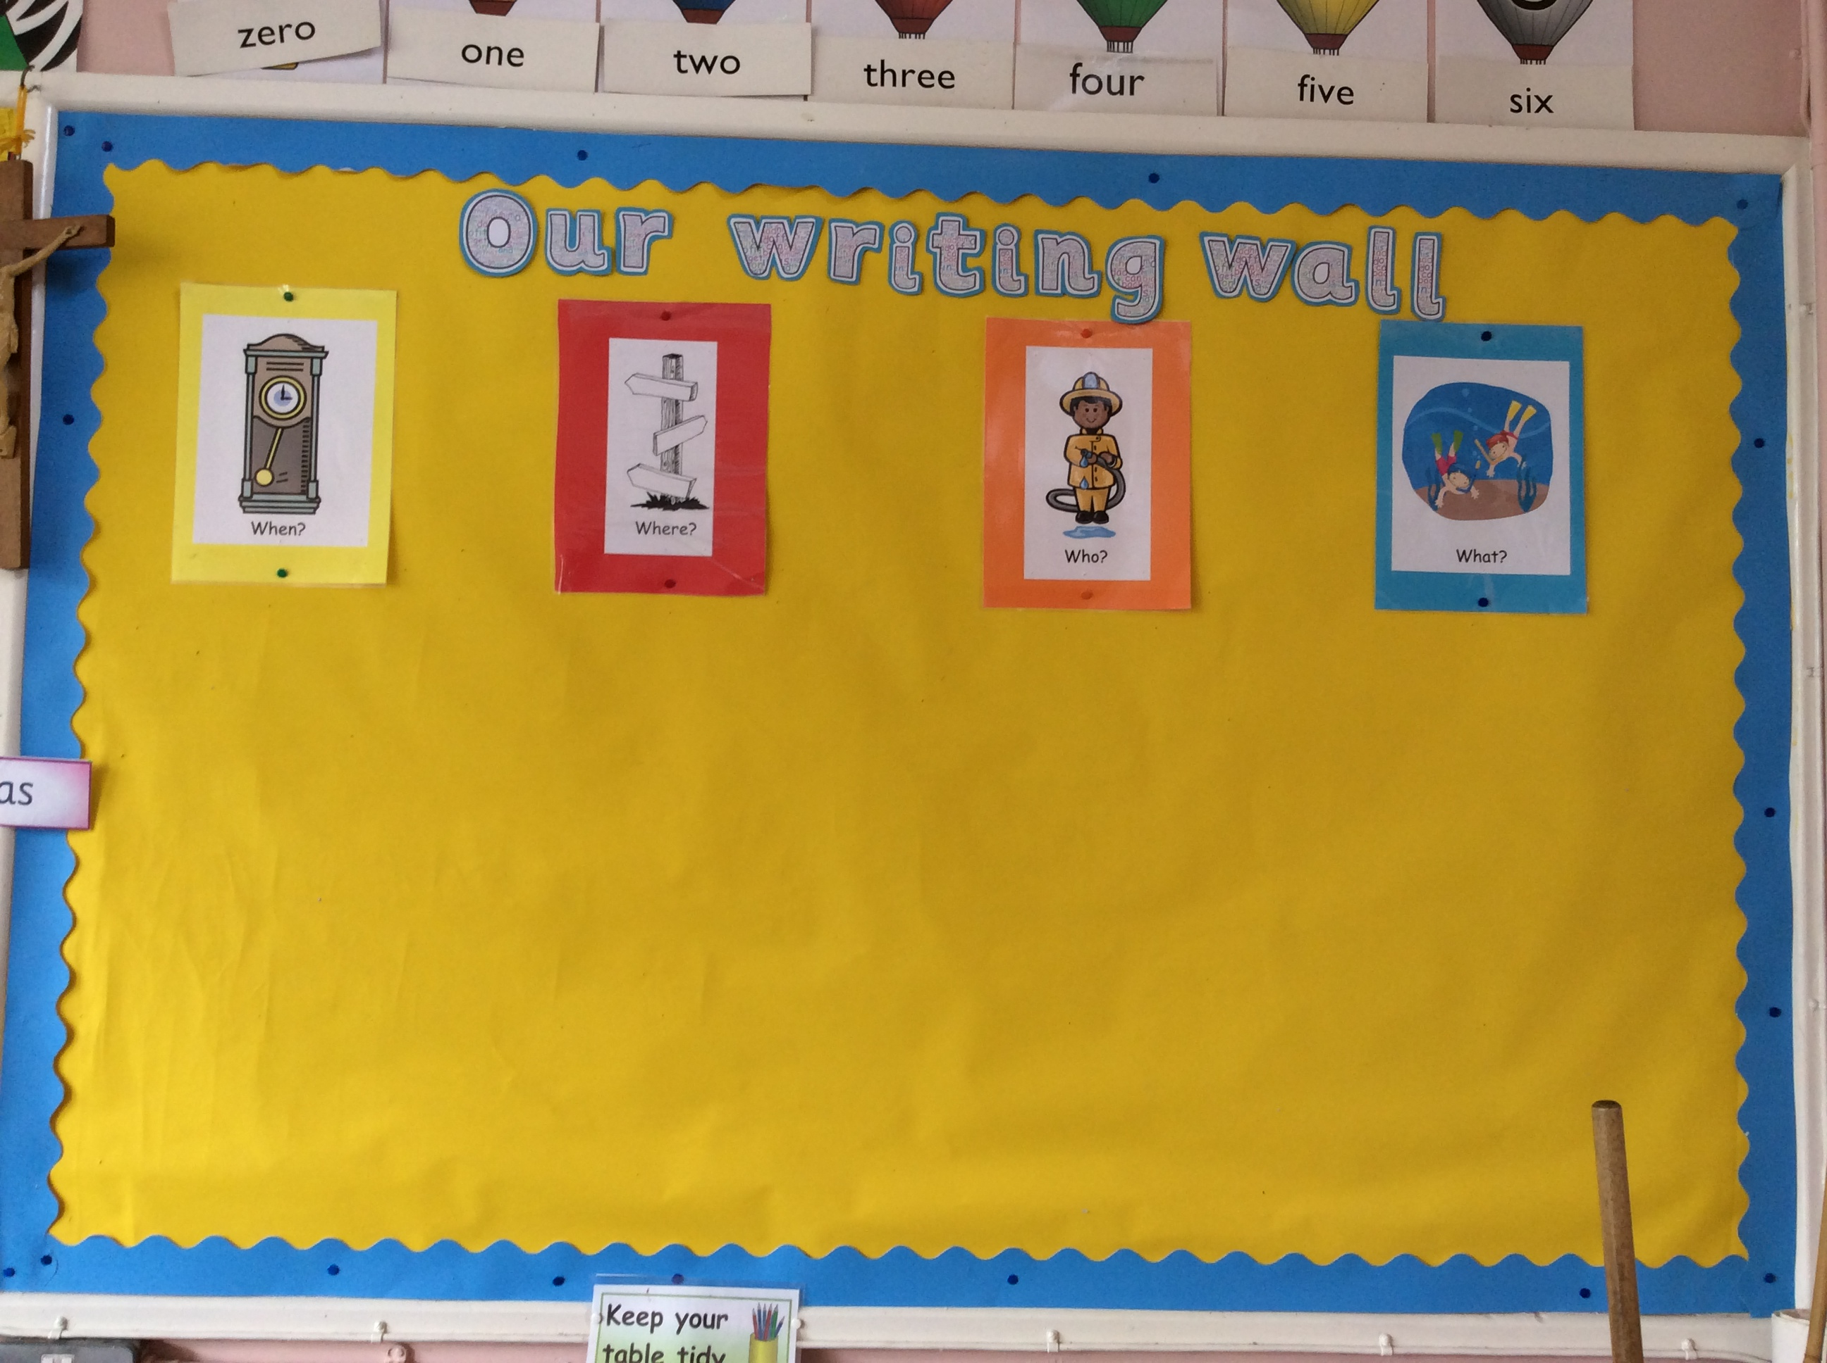
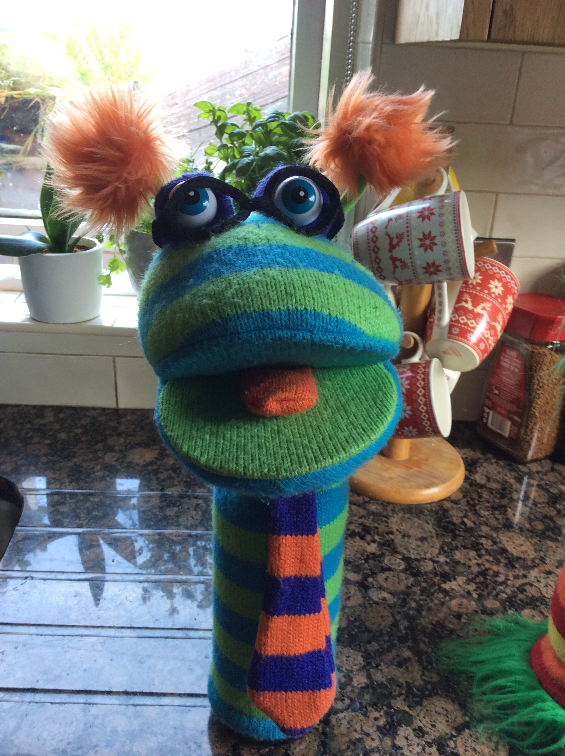
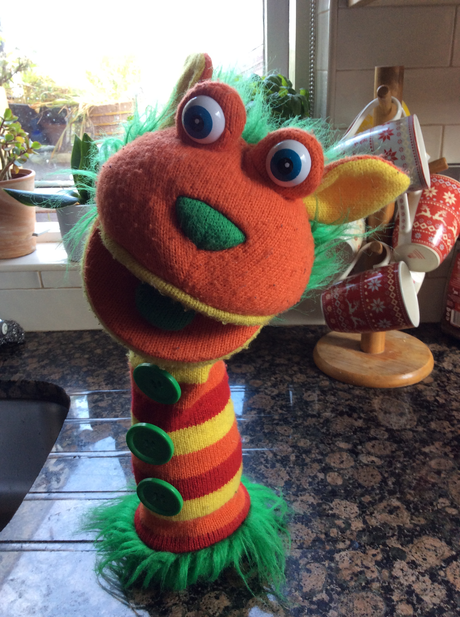
Fantastic work – I hope you had fun! I bet you have loads of ideas for a story now! Let’s write some fiction today!
Remember how we use our writing wall in school to help us organise our ideas?
Let’s work through it together…
… and make a story about a castle.

Slide 5
When did your story happen?
(This is how your story will begin.)
Try to think of your own ideas and then click to see what Wookie and Podge thought of.

Slide 6
Where did your story happen?
(this is the setting.)

Slide 7
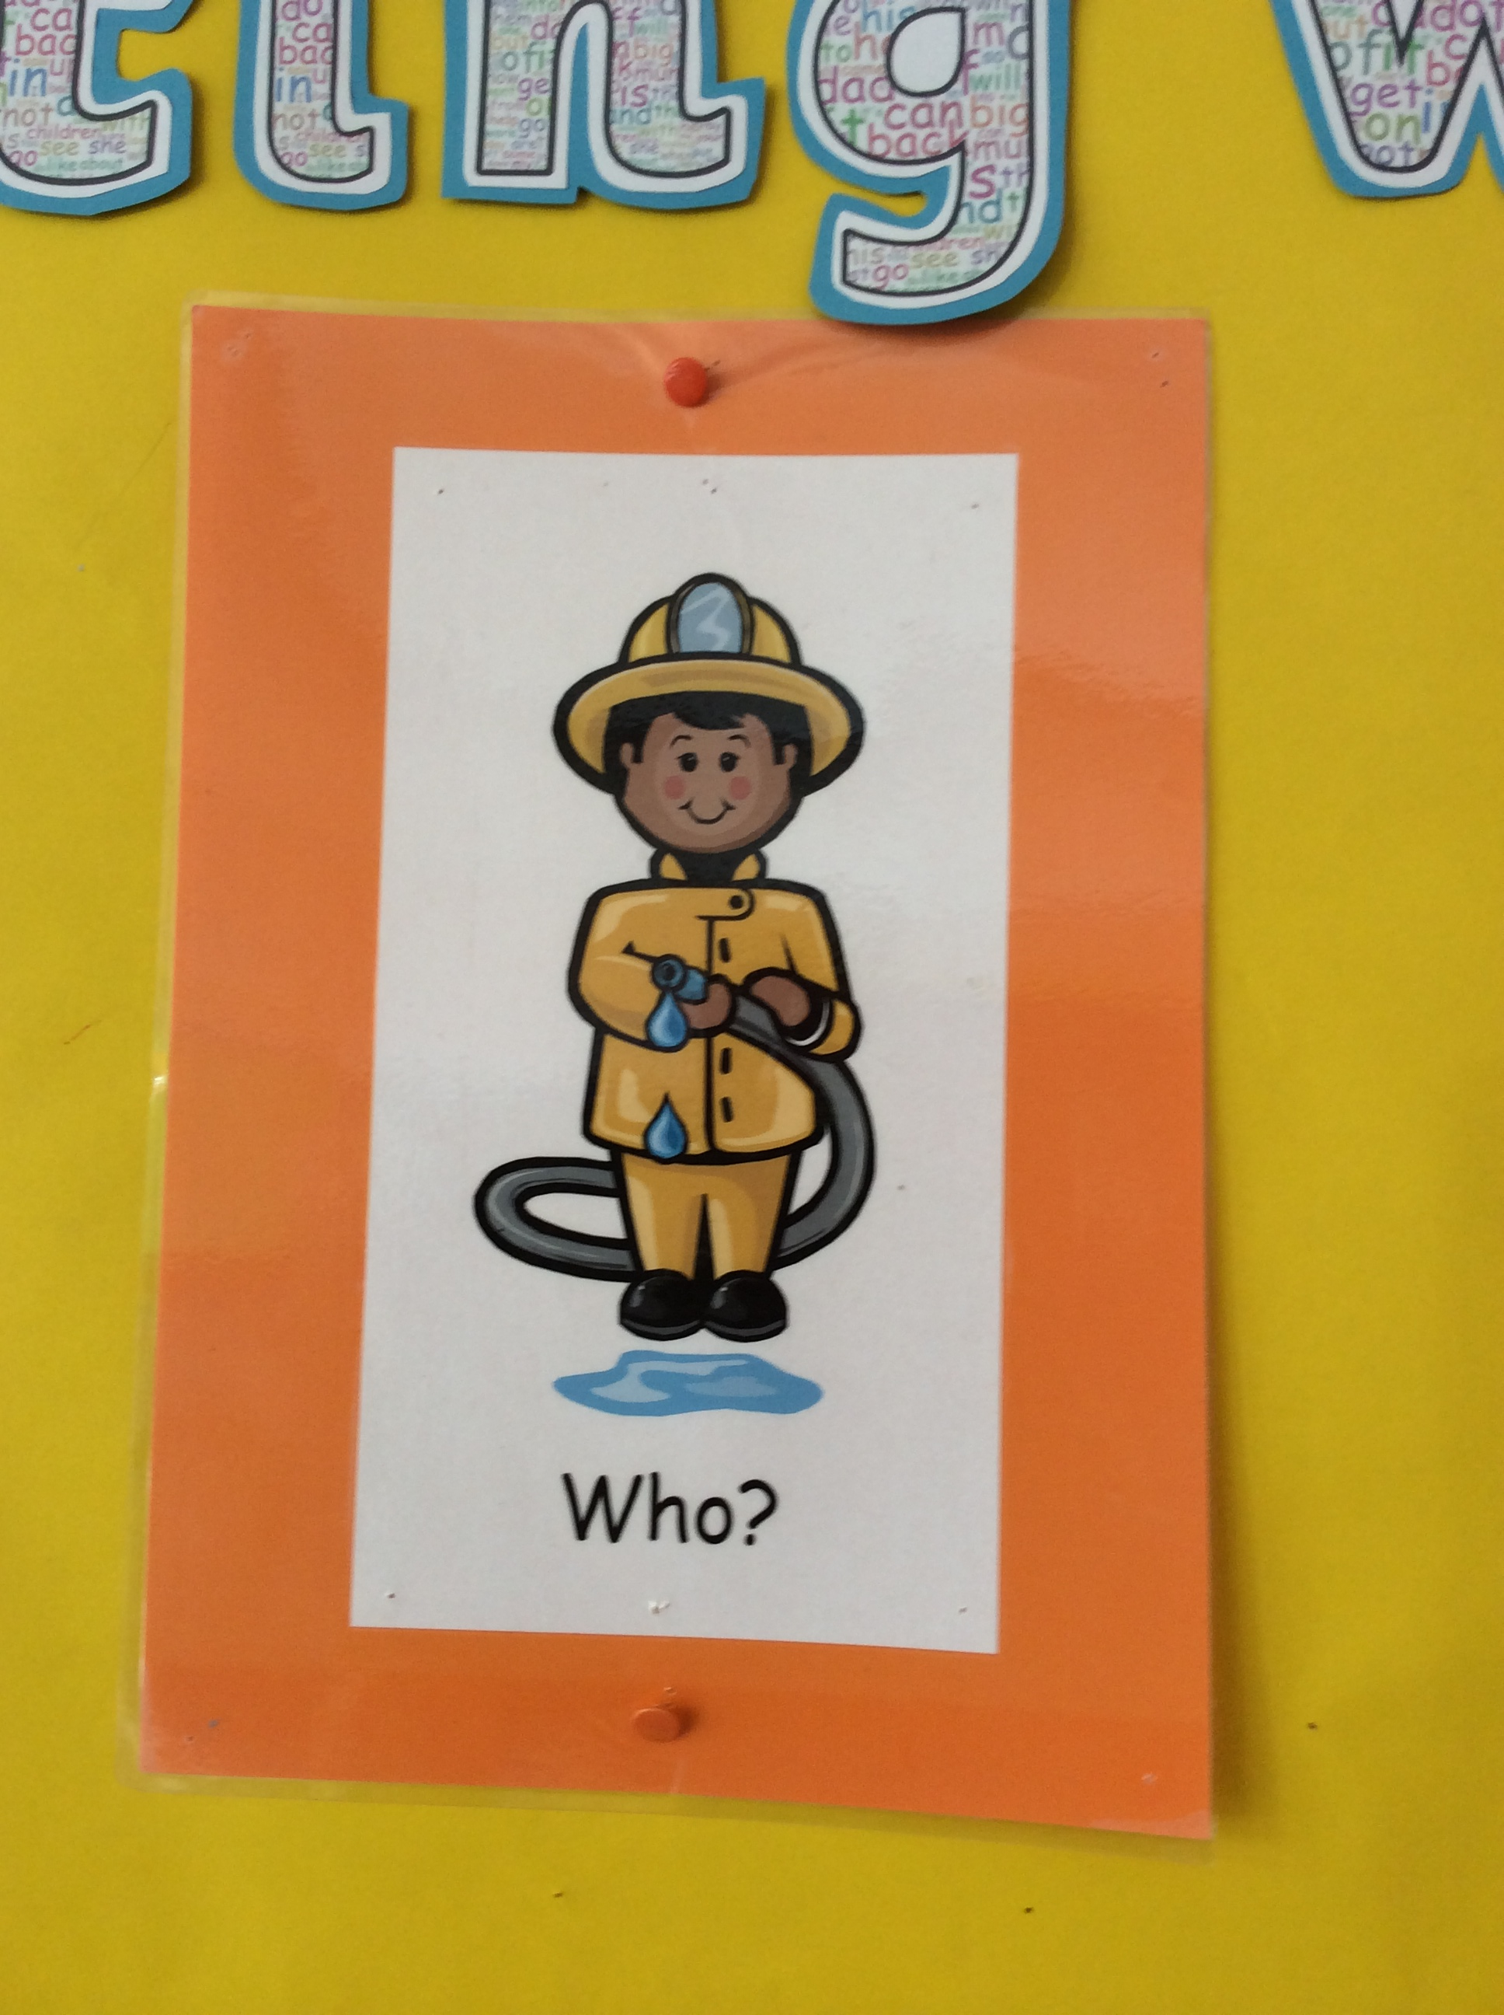
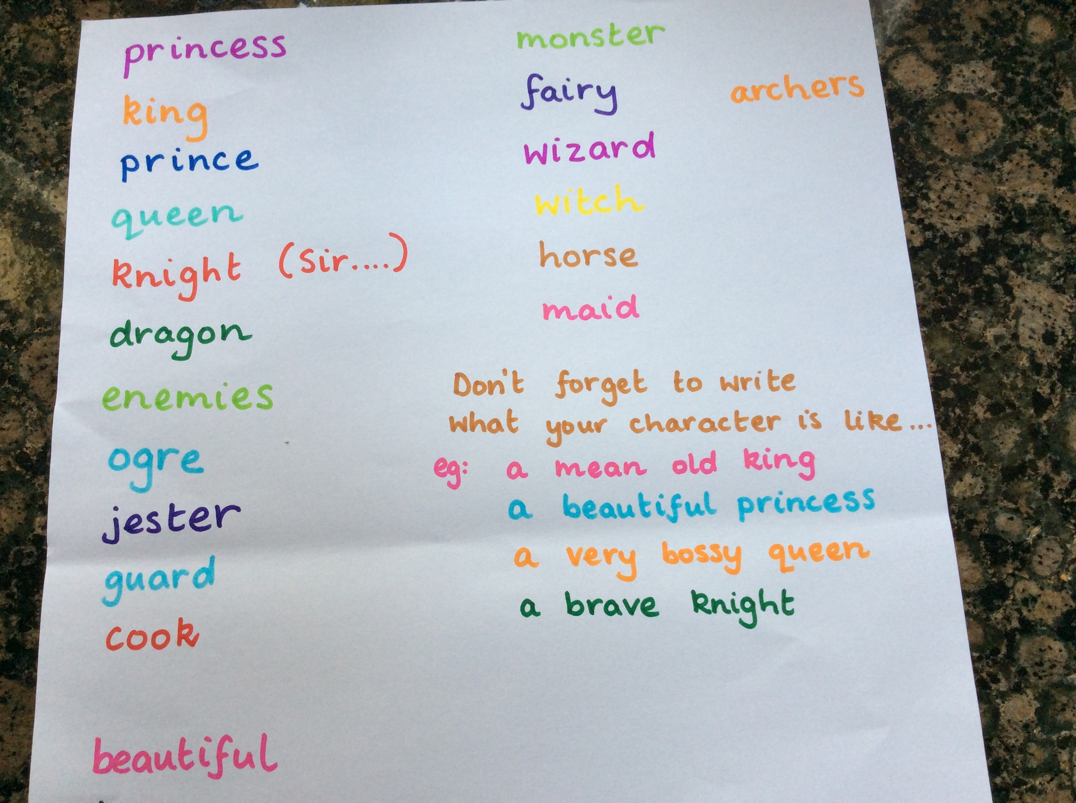
Who is your story about?
(who are the characters?)
Describing words tell you what characters are like.

Slide 8
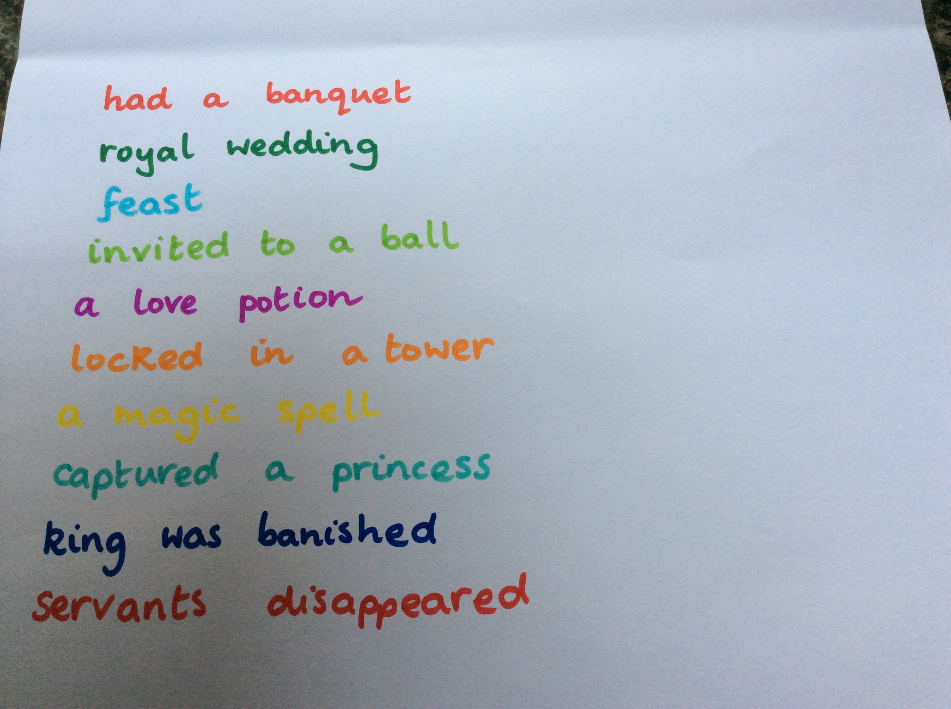
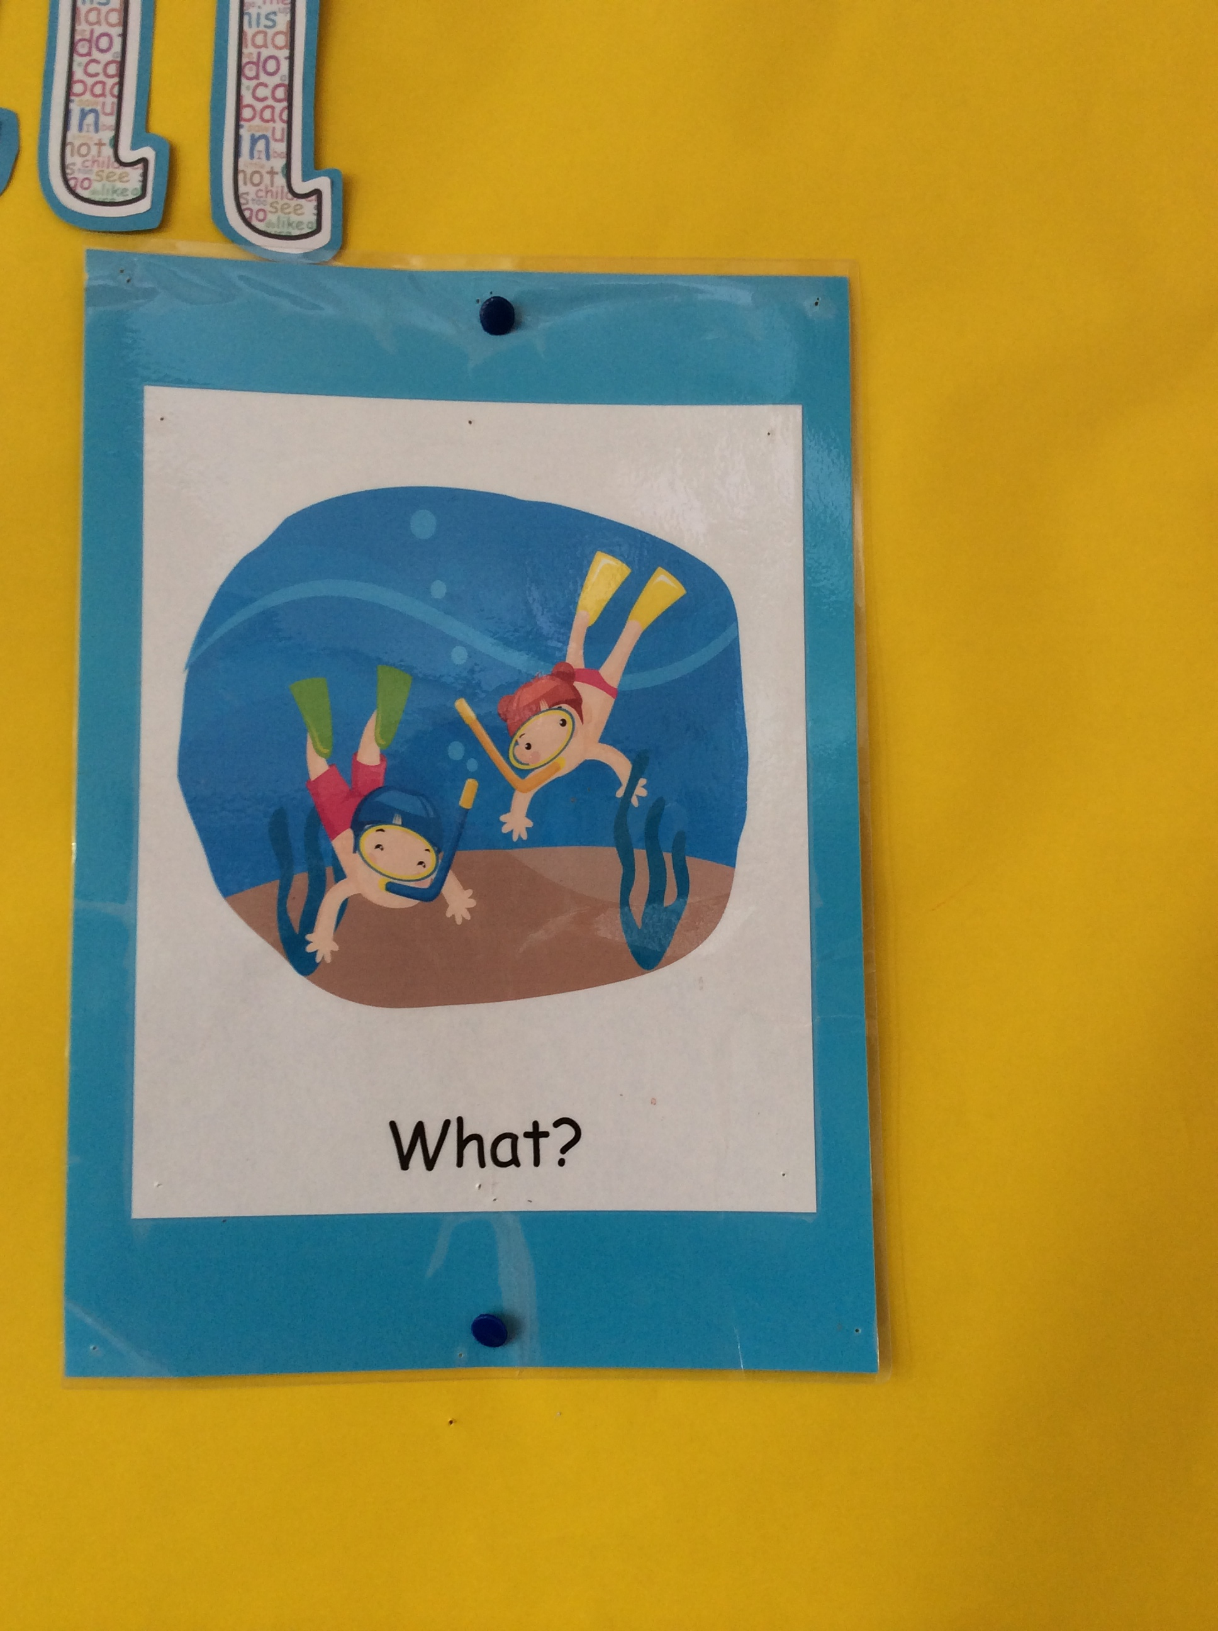
What events happen in your story?

Slide 9
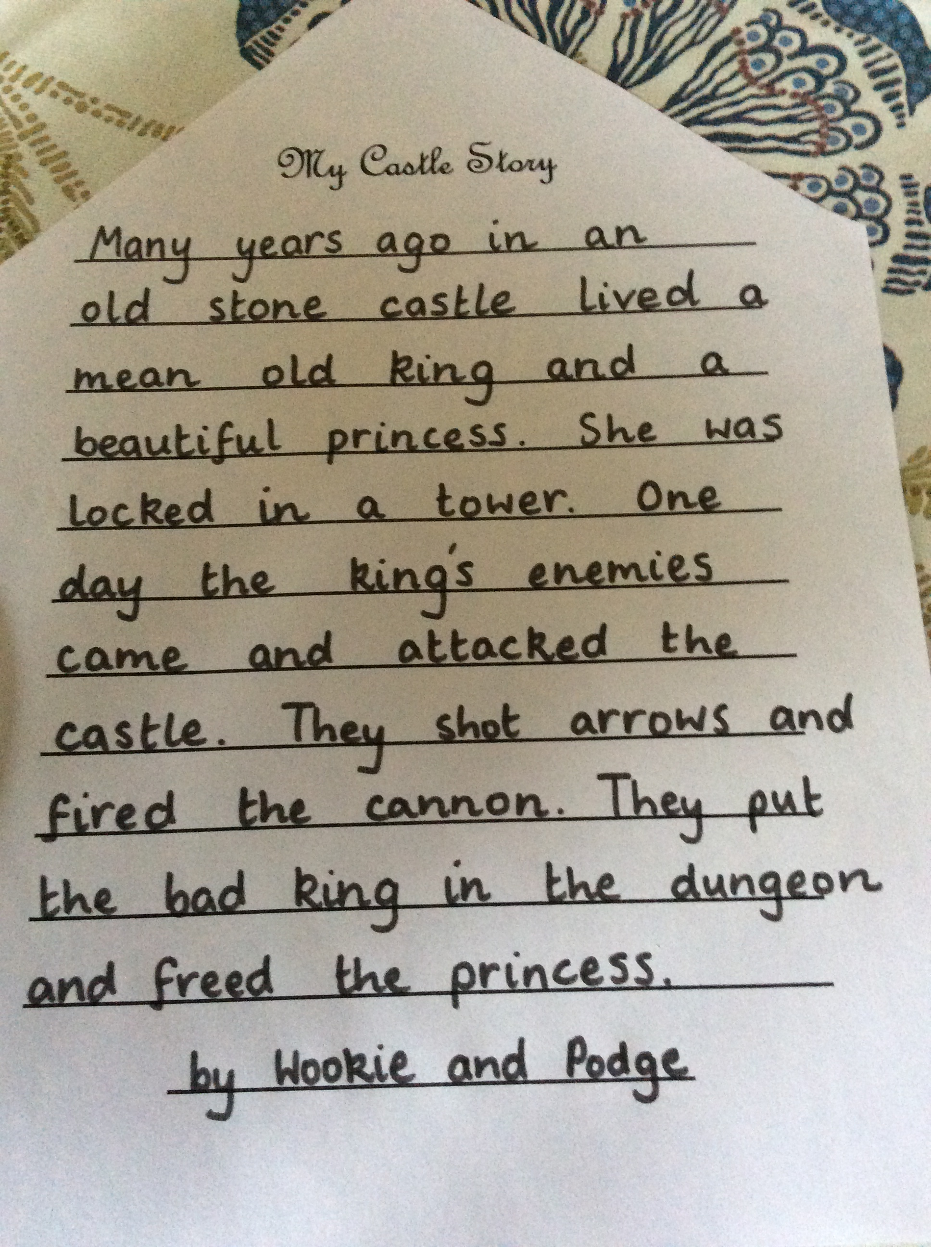
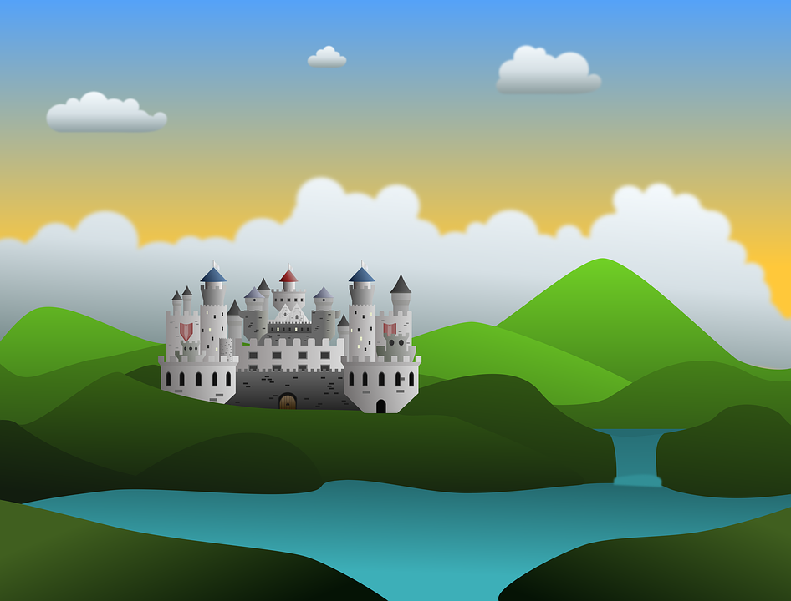
My Castle Story
Now put it all together to make a story.
Then read back over your story and check:
Do all your sentences start with a capital letter and end with a full stop?

