Slide 1
Well done! You are doing great work!
How about some fun science?
Click on the links below to see how to make some cool weapons. These are a lot like the ones that would have been used to attack castles – just a bit smaller and safer!
https://www.beano.com/posts/beano-makes-marshmallow-catapult
https://www.beano.com/posts/beano-makes-pencil-catapult

Slide 2
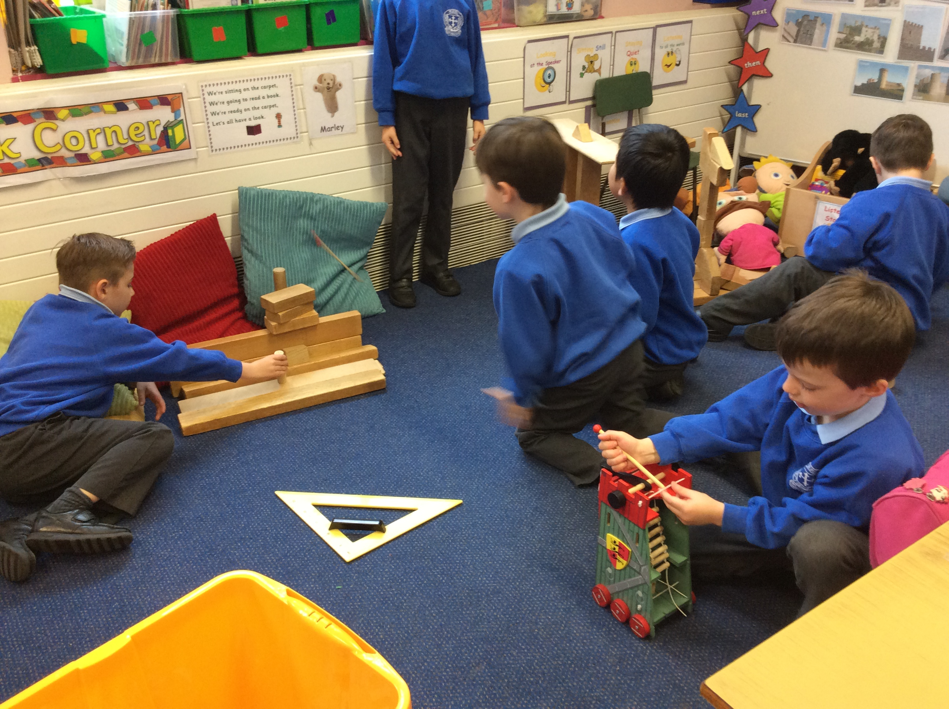
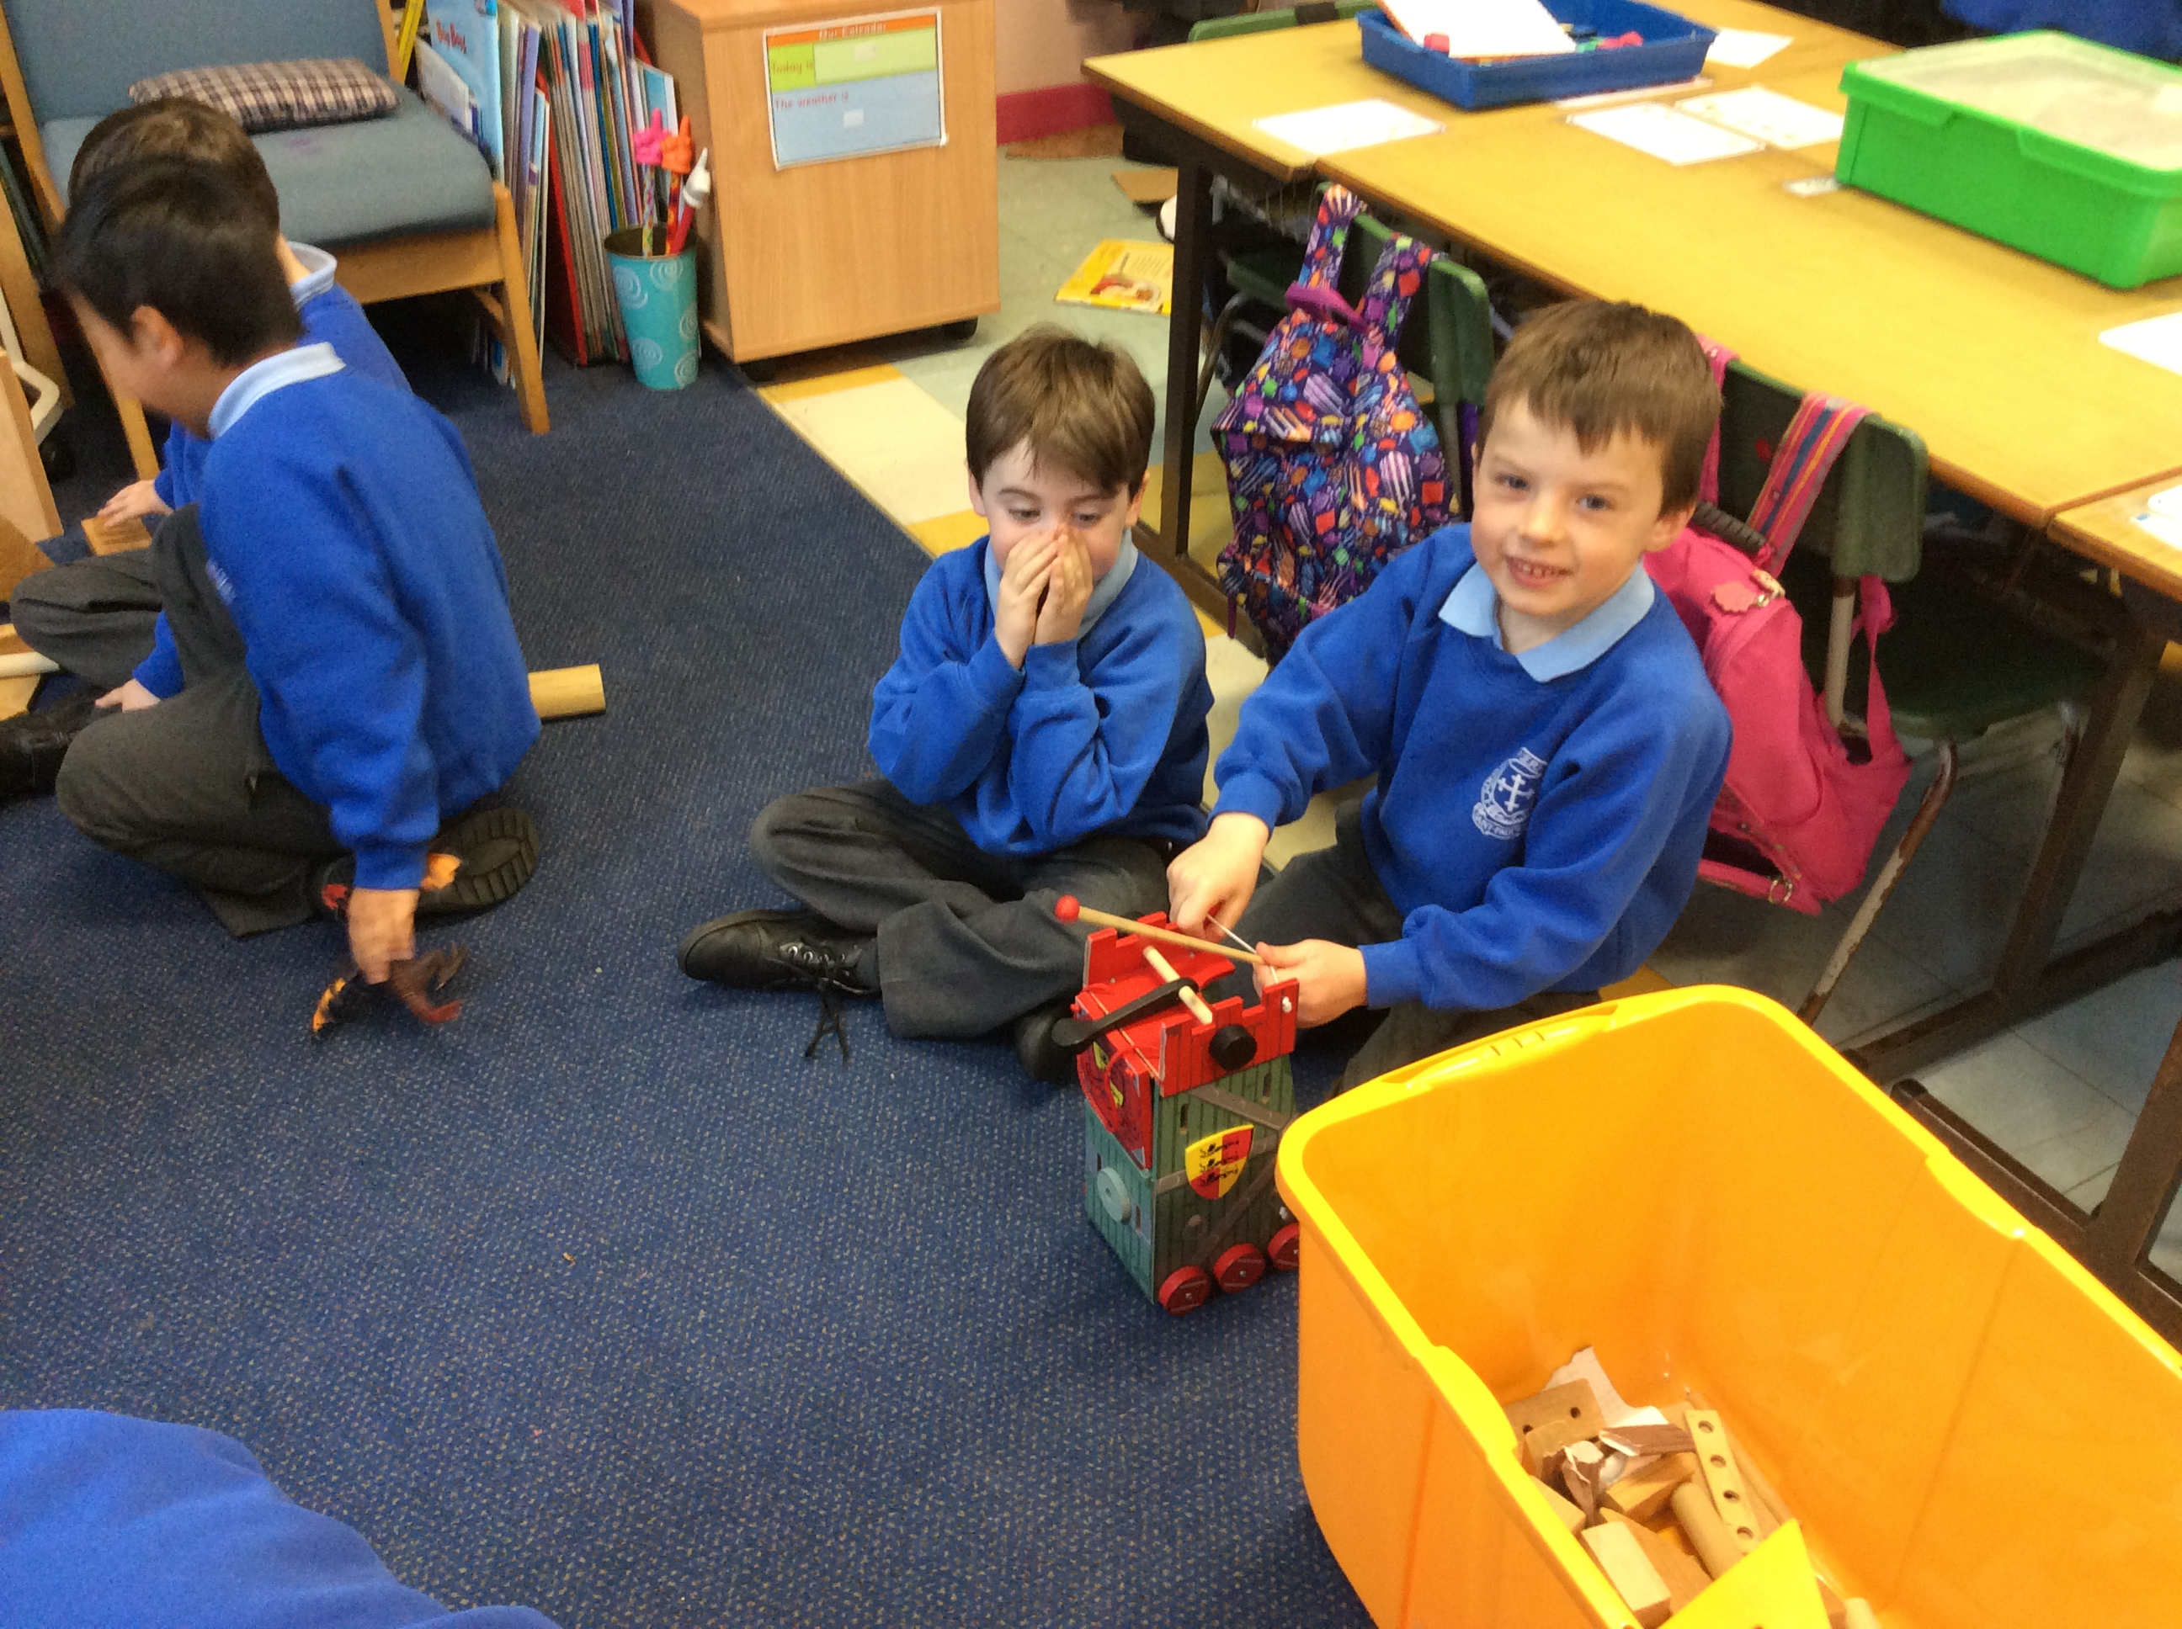
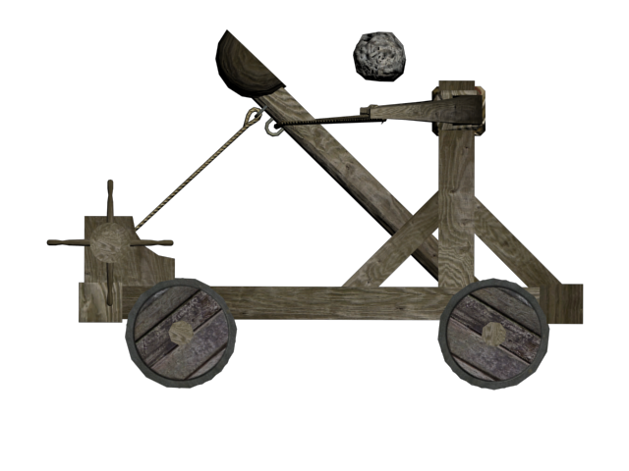
weapons

Slide 3
What about some Art?
This is by Paul Klee.
It is called, Castle and the Sun.
Can you see the castle and the sun?
What shapes can you see?
Can you do some art like this? It can be 2D or 3D.
Have a look at the next page for some work from last year’s P2s.

Slide 4
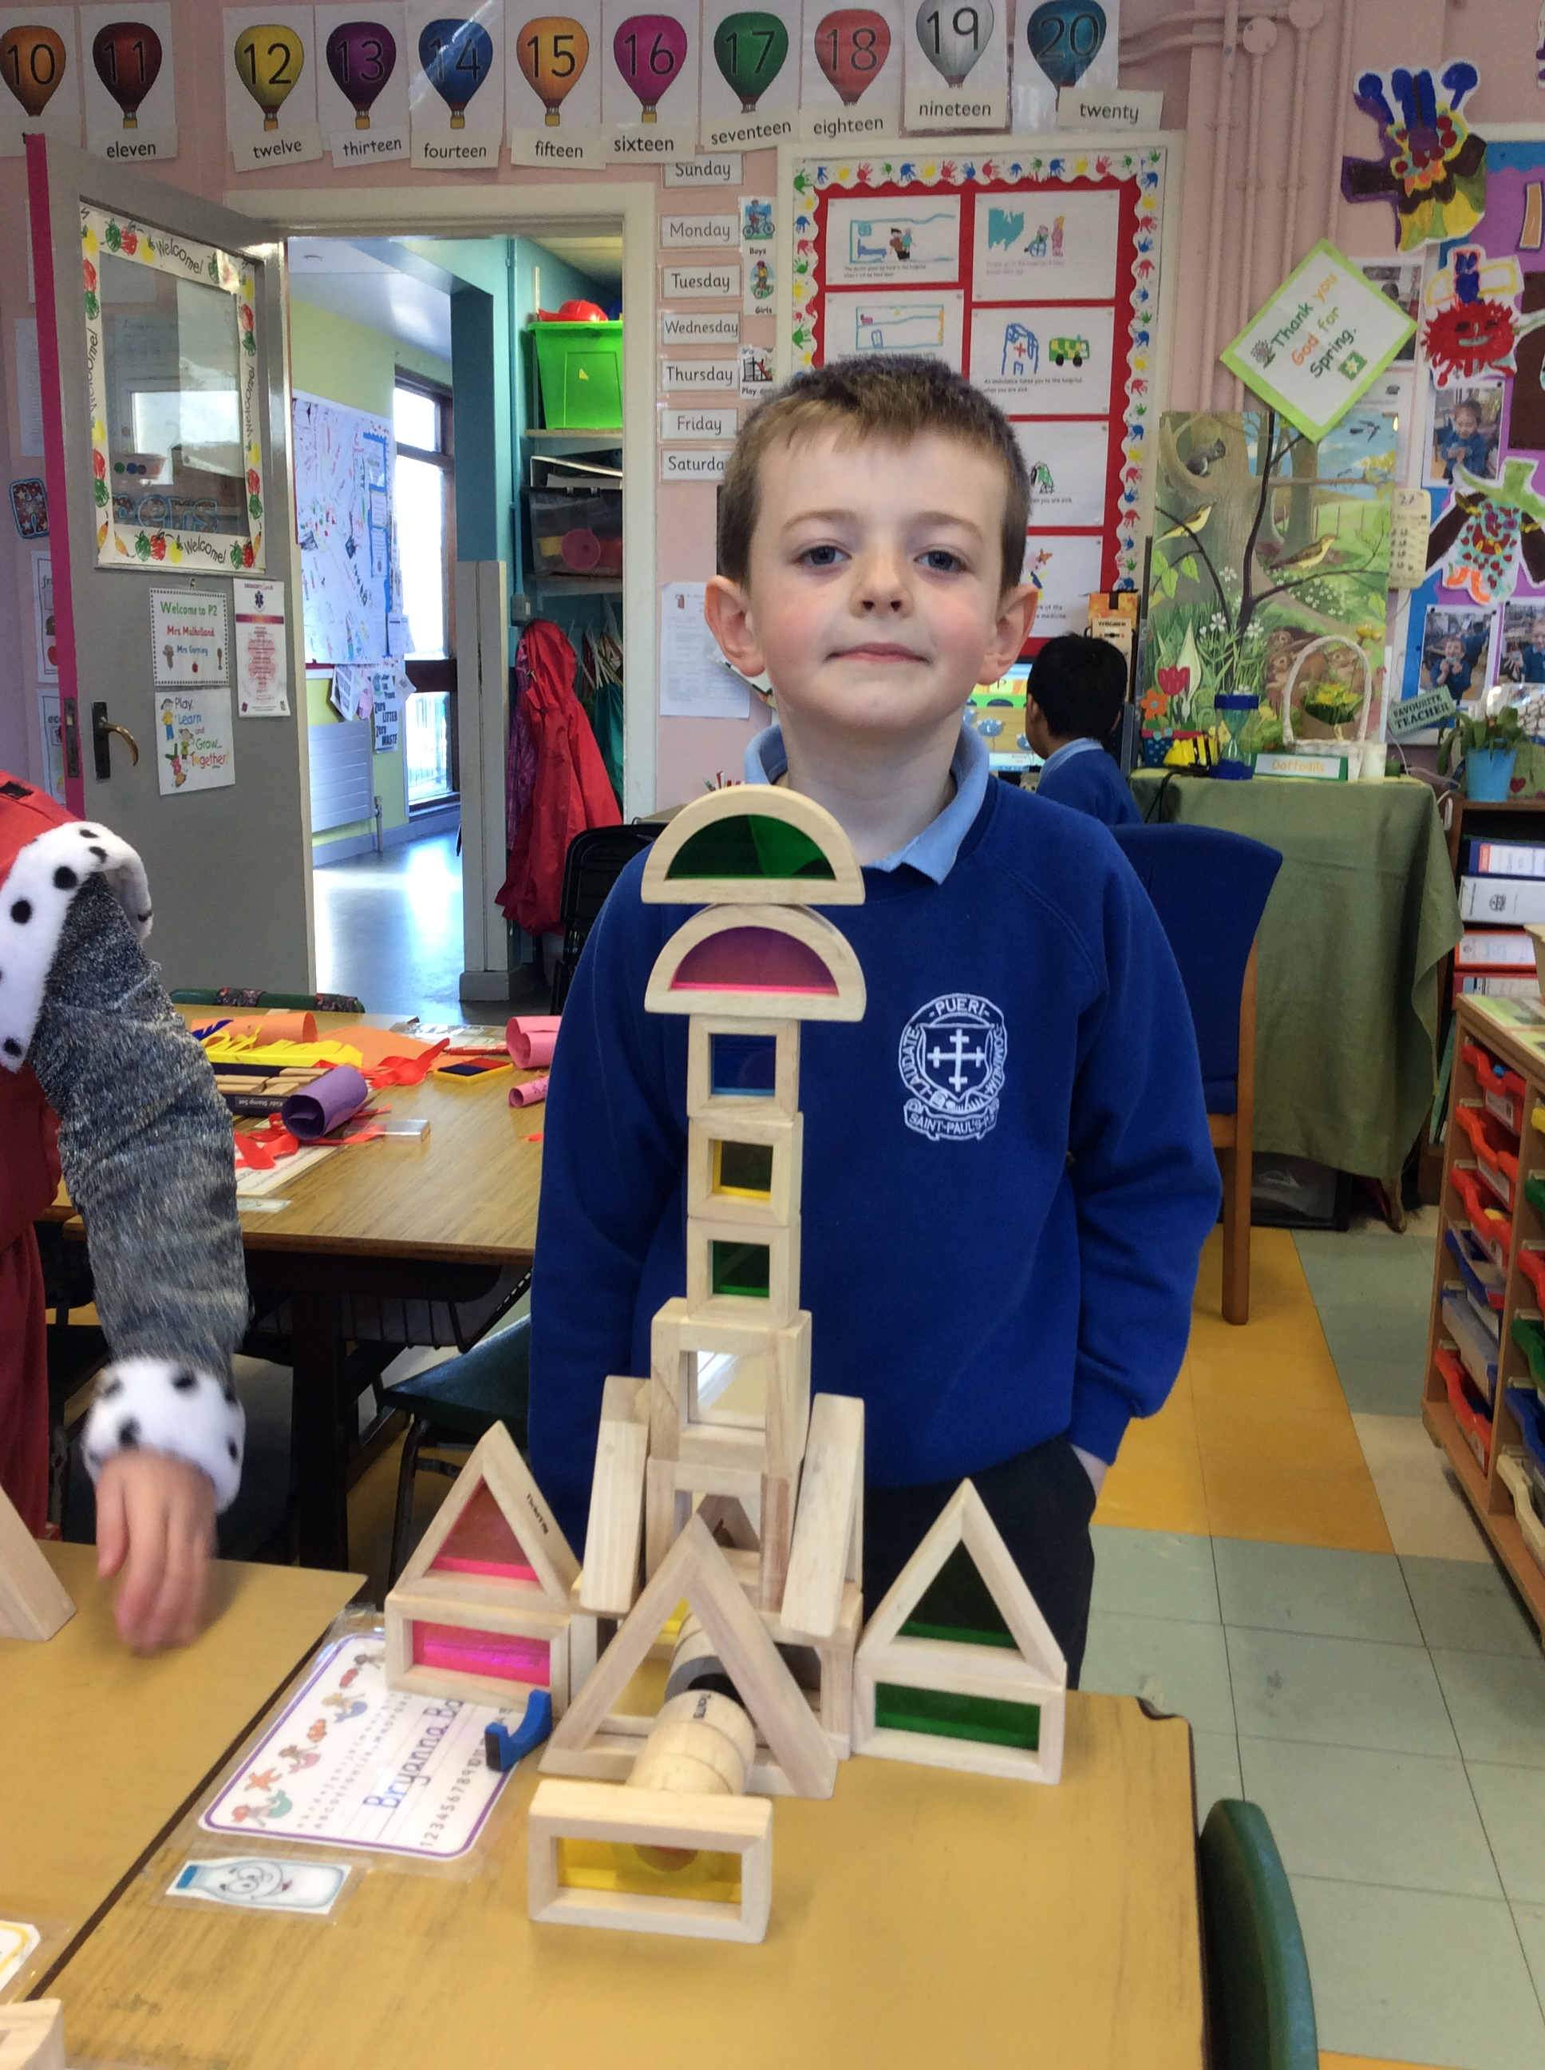
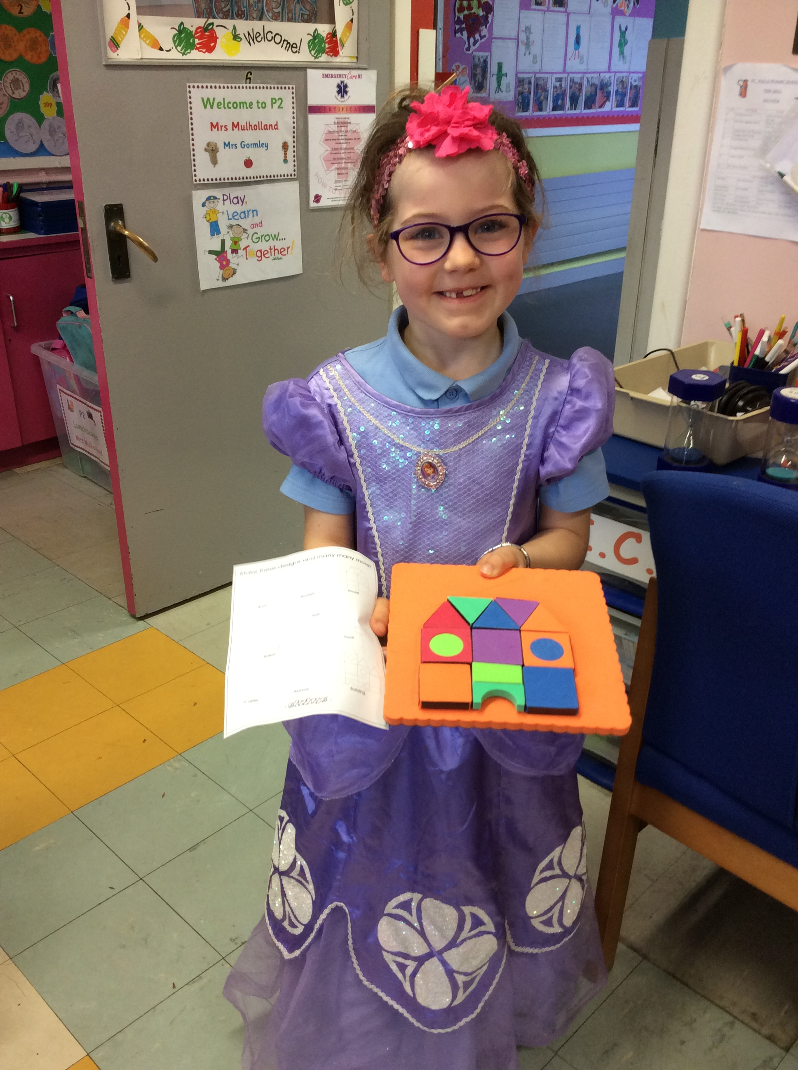
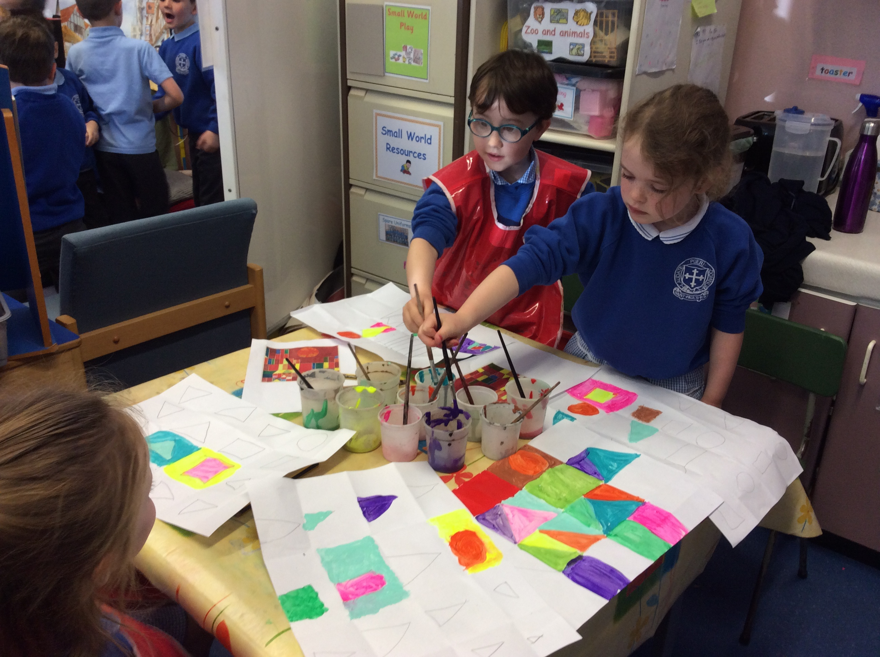
If you want to, you can send Teacher a picture of your work by phone or email.

Slide 5
Number bonds to these are super important! Here are some songs and dances to help you remember them.
https://www.youtube.com/watch?v=jZi-6_-Uhwc
https://www.youtube.com/watch?v=lD9tjBUiXs0
https://www.youtube.com/watch?v=UD_RUVLPvTY
https://www.youtube.com/watch?v=OvbWuiYn-Uk
https://www.youtube.com/watch?v=t8U_zZ-rW1E

Slide 6
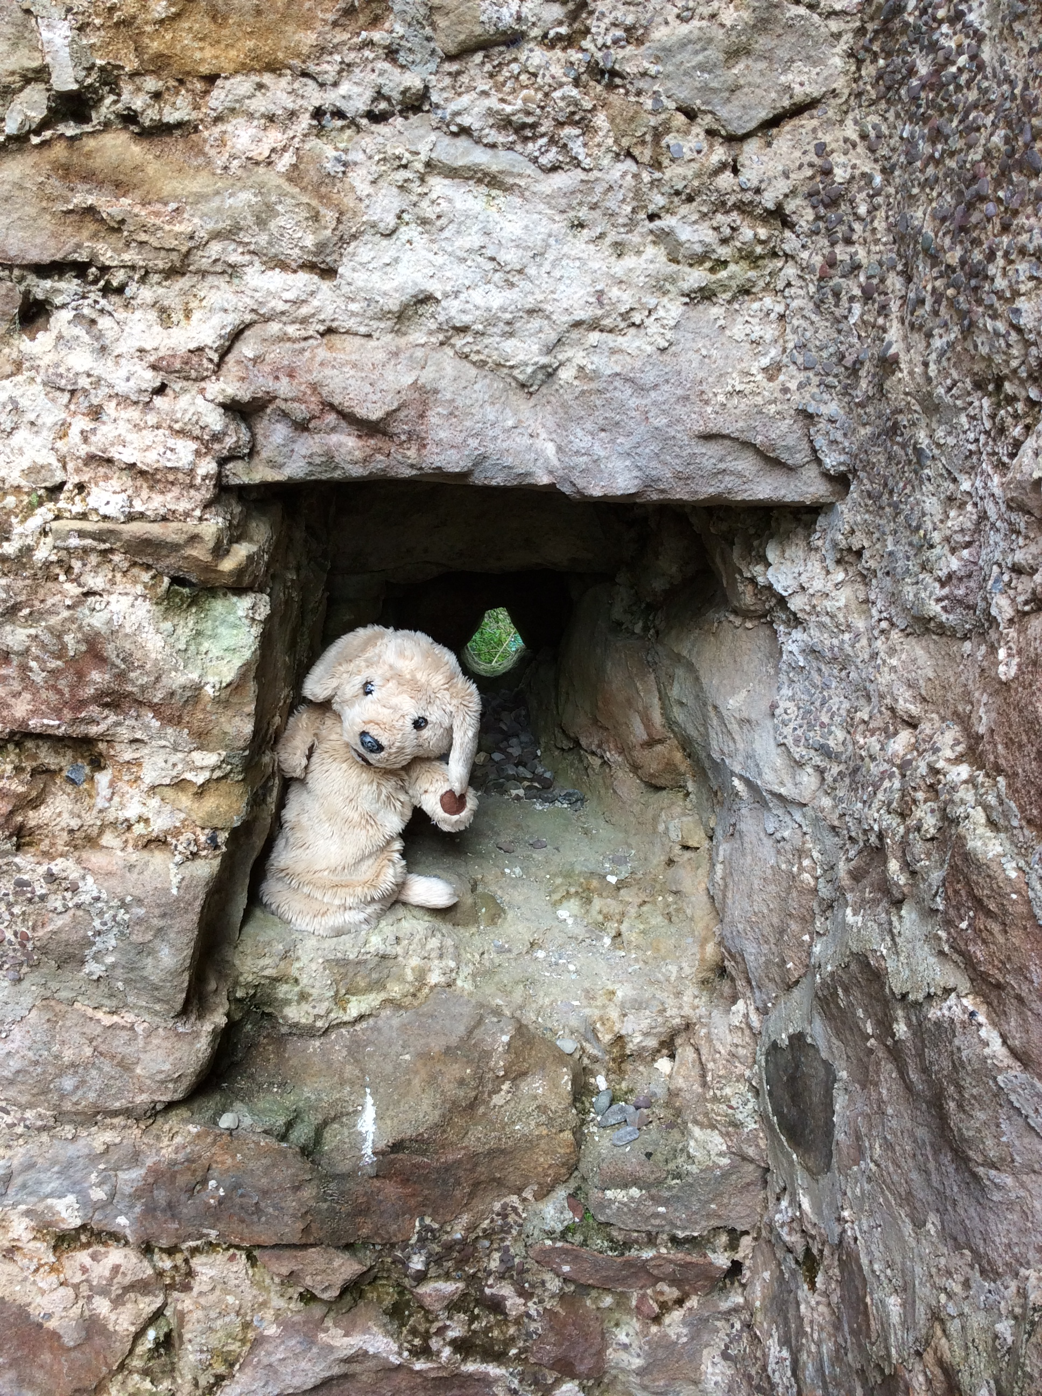
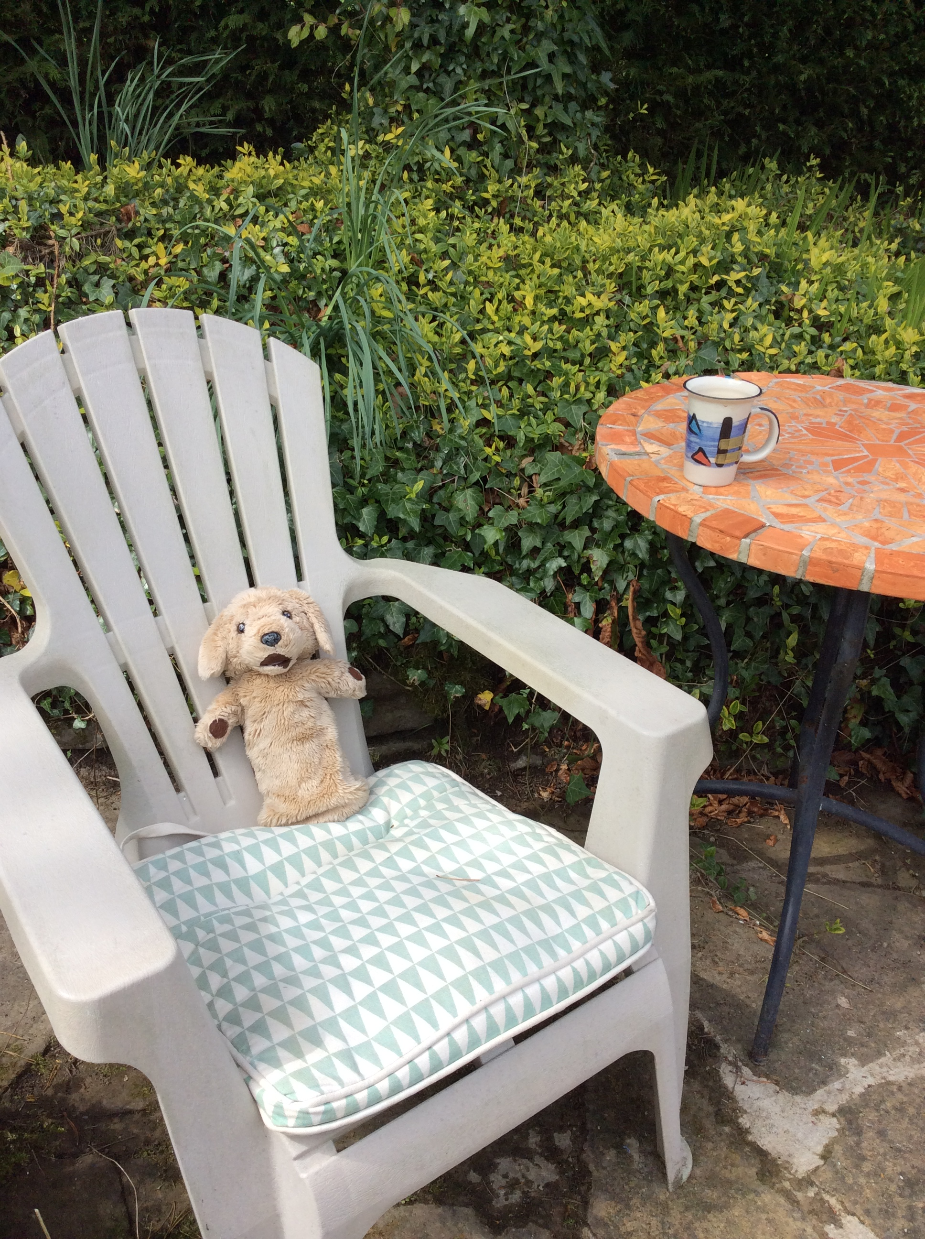
Amazing Work!
Bye everyone, Miss you all. Thank you for working hard.
Now it’s time for a little rest and a treat.

Slide 7
Overview of Learning for Parents This is normal school work for May. Theme: Castles – Please remember, this is only included for your information. Please feel welcome to pick and choose as you see fit for you and your child and to get in touch if I can help in any way. | Literacy Read stories and non fiction books about castles. Answer simple comprehension questions. Use books as a starting point for developing creativity. Reinforce understanding that a line of writing is not always a sentence. Write stories based on castles. Make up own characters through roleplay to include in stories. Use capital letters for names. Assemble information from reading non-fiction books. Write non chronological reports about castles. Write letters to princesses, diary entries, draw pictures | Maths Focus on addition and subtraction of numbers which total ten. Continue with sorting, classifying and recording work. Use specific shape and space language to sort and describe eg: straight, curved lines Subtraction within 10p/£10 Find totals and change from up to 20p and using the 10p coin. Add 10 and a unit to make teen numbers. Be confident in number bonds to 10 Say whether a number is more or less. How many more or less? Learn about symmetry. Focus on problem solving. | PDMU Unit5 I am Learning to… Develop a sense of what is fair for everyone. Begin to take responsibility for what they do. Realise why it is necessary to have rules in school, class, the community. Begin to contribute to class and school council. PATHS Unit 8 learn about Advanced Feelings; Jealous, Furious, Guilty, Generous. Emotion sharing
World Around Us Find out information about castles from a variety of sources. Look at castles in our local area. Find out a little about the history of local castles. Make models of castles from cardboard junk. Learn about forces in terms of pushes and pulls. Make marshmallow trebuchets using elastic band energy. | Play Dramatic: roleplay in our homemade cardboard box castle. Dress up as kings, queens, servants, knights etc.. and make up stories about medieval life. Use small world castle, people, dragons, siege tower, trebuchets etc.. to make up stories with friends to write about. Learn about symmetry by folding and cutting paper. Make shields, swords, armour, model castles, crowns and own props from junk, tinfoil etc.. Build castles from blocks. Invesigate Paul Klee’s painting Castle and the Sun and make own interpretations. Draw and paint pictures of princes and princesses, knights etc.. to help come up with characters for stories. | RE – Grow In Love Learn that May is a month when we especially pray to Our Lady. Pray Hail Mary every day. Learn about the Miracles of Jesus; The loaves and the fishes. Jesus calms the storm Jesus heals the blind man | TSPC Being Creative Managing Information Working with Others Thinking, Problem solving and Decision making Self Management This month we will focus in particular on solving problems.

