Slide 1
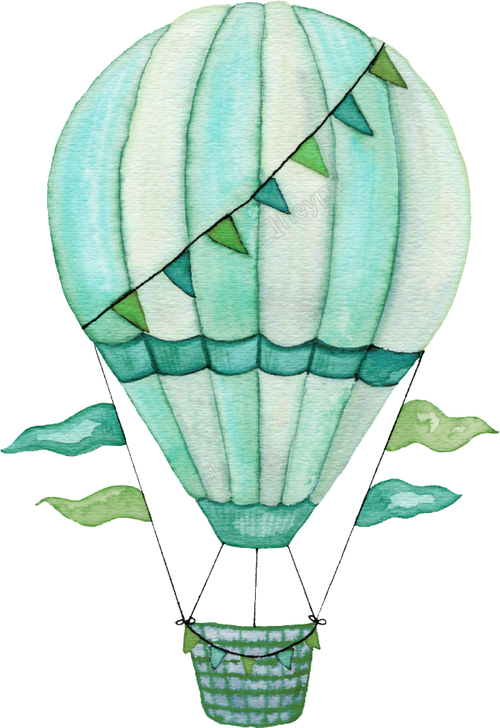
P1 June Homelearning
UP UP AND AWAY!
Maths and Numeracy

Slide 2
June P1 learning overview

Slide 3
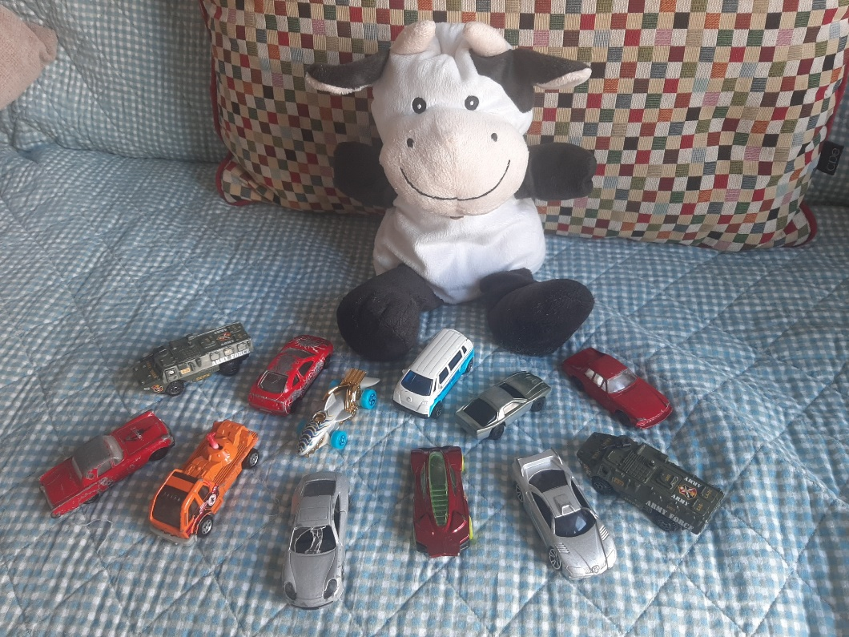
Maths and Numeracy
In June Daisy is learning to count sets from 11-20
It can be tricky to remember the ‘teen’ numbers- don’t worry, just keep practising.
Can you count sets of objects up to 20? Try using your toys when you are playing. Daisy has been working on her counting skills too.
I have 12 cars

Slide 4
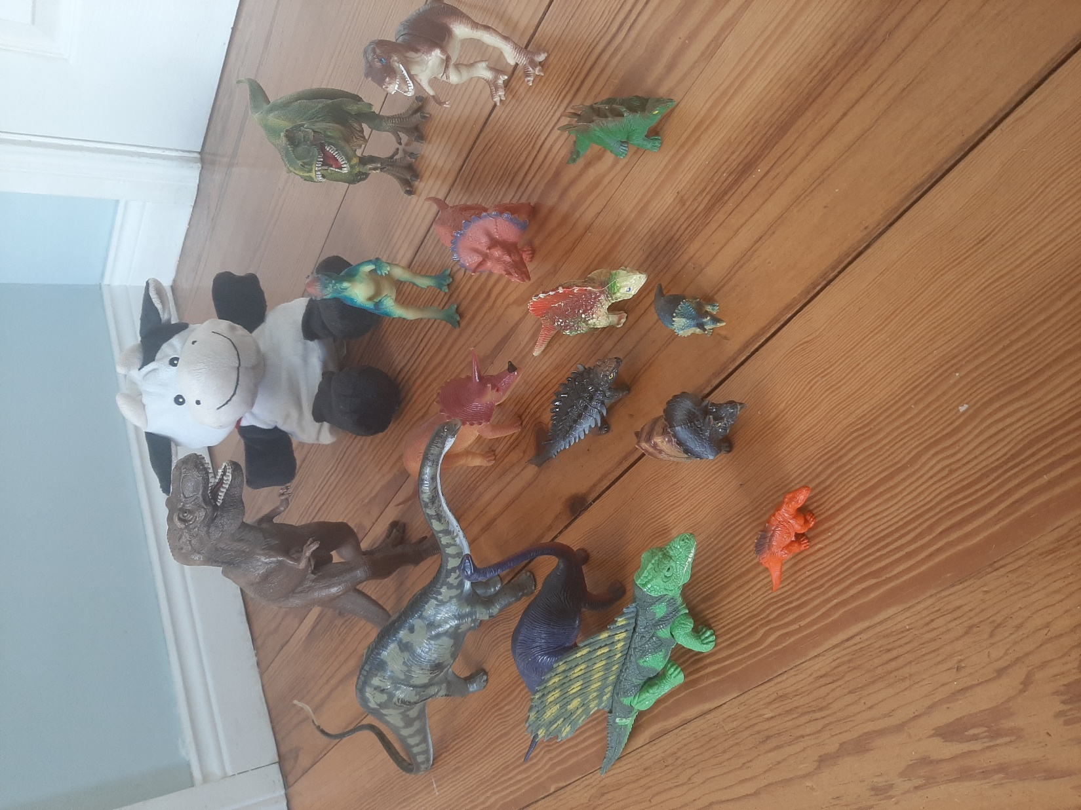
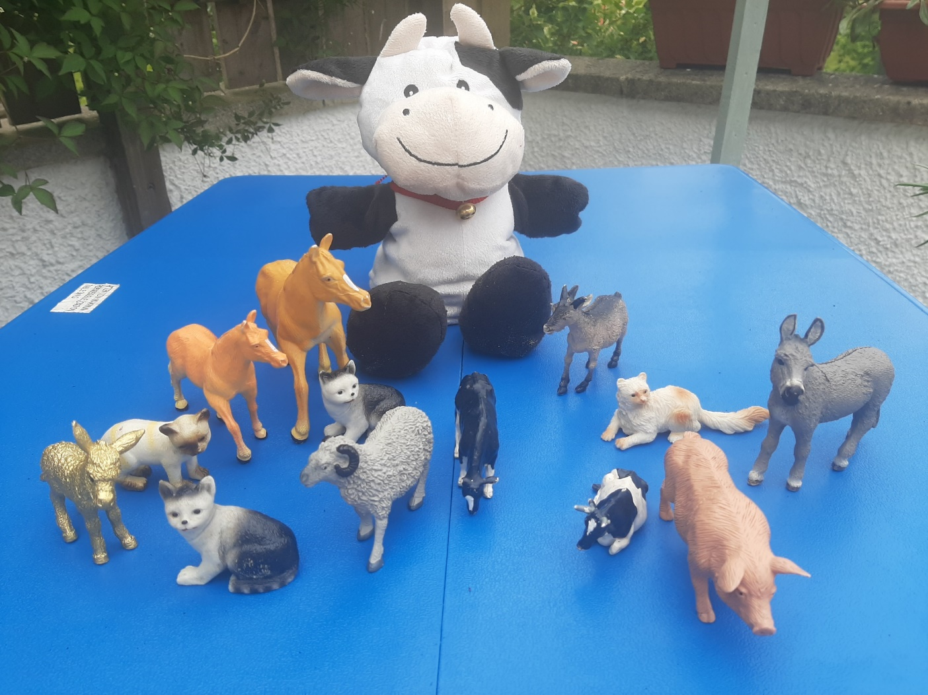
I have 15 dinosaurs
I have 13 farm animals

Slide 5
Maths and Numeracy
In June Daisy is learning to add doubles up to 5+5
https://www.twinkl.co.uk/resource/T-GO-03-doubles-up-to-10
https://www.youtube.com/watch?v=Ik_-OAgzD-8

Slide 6
Ladybird doubles to 10 worksheet
Here is the link if you wish to print it off….
https://content.twinkl.co.uk/resource/43/10/t-c-254575-ladybird-doubles-to-10-activity-sheet.pdf
Practise doubling on your fingers…
In class we hold up our fingers and say.
Double 1 is 1 add 1. 1 add 1 makes 2.
Double 2 is 2 add 2. 2 add 2 makes 4.
Double 3 is 3 add 3. 3 add 3 makes 6.
Double 4 is 4 add 4. 4 add 4 makes 8.
Double 5 is 5 add 5. 5 add 5 makes 10.

Slide 8
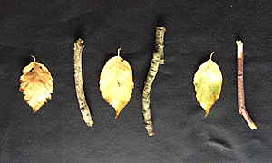
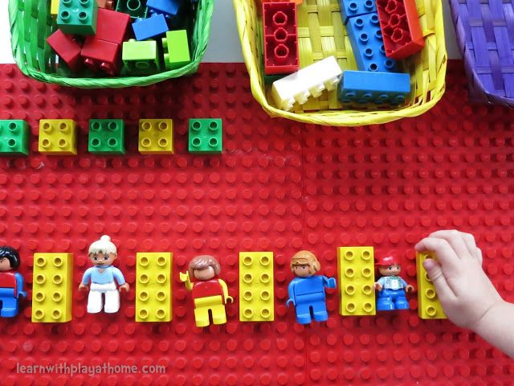
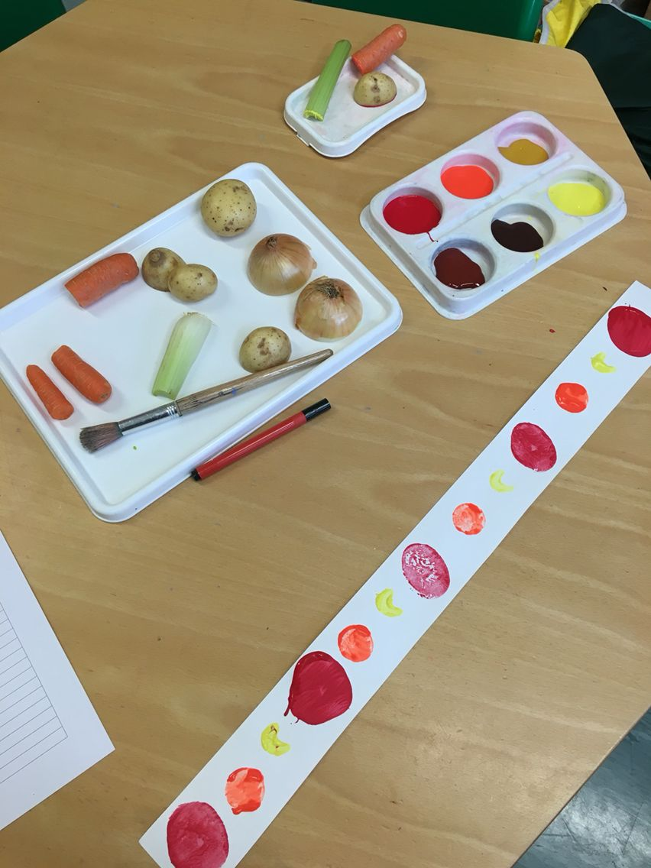
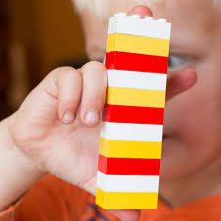
Maths and Numeracy
In June Daisy is copying and repeating patterns….

Slide 9
Daisy has a go on her own!

Slide 10
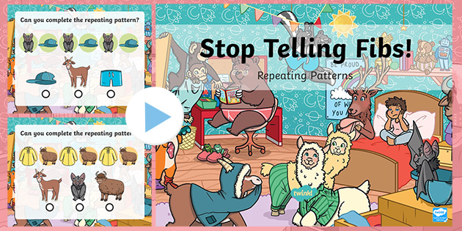
Some nice repeating pattern activities….
https://www.twinkl.co.uk/resource/curly-caterpillars-repeating-pattern-powerpoint-t-m-31772
https://www.twinkl.co.uk/resource/eyfs-stop-telling-fibs-repeating-patterns-powerpoint-t-tp-7419

Slide 11
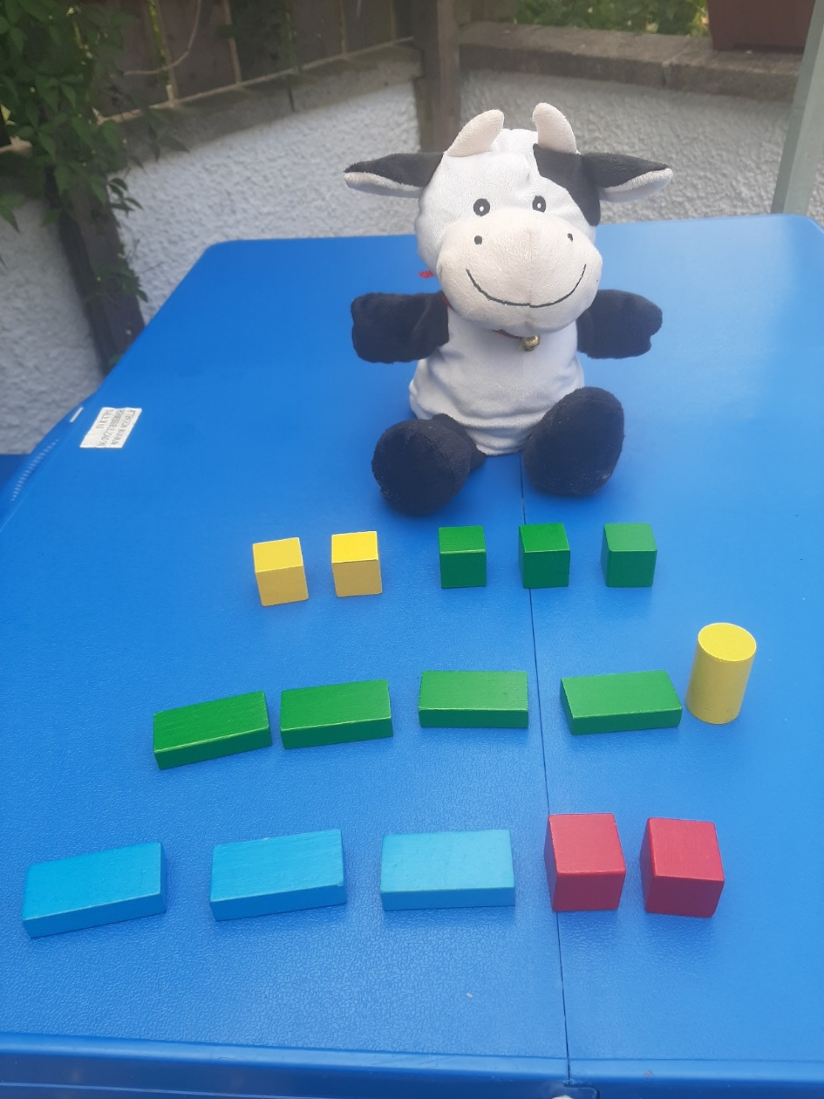
Daisy is making 5…
Can you make 5?
Can you make up number sentences using + and -?

