Slide 1
June Learning for P2 Literacy
On the Move – let’s plan a great day out. We can design our own holiday park.

Slide 2
Holiday Brochures
Nature trail
Follow a route around this country park and notice all the attractions. What would you do on a day out here?
Where would you park?
Where would you have lunch?
Can you see the blank signs?
What do you think should be written on them? Can you write any signs?
Wildlife pond
Picnic area
playpark
Petting zoo
carpark
Ticket office

Slide 3
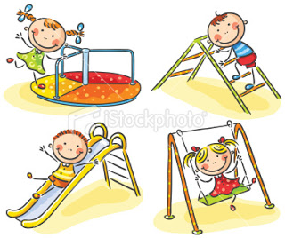
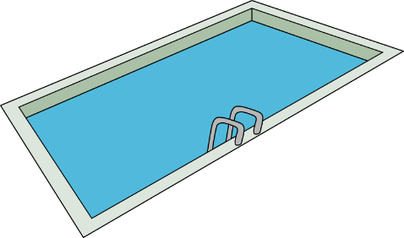
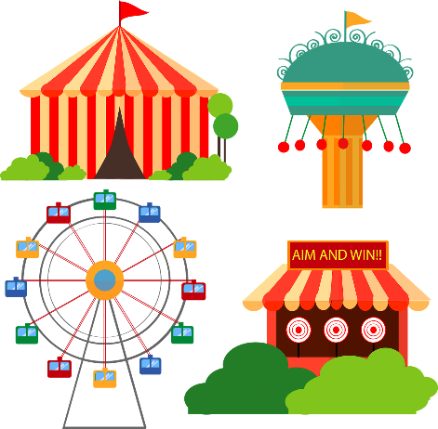
Brilliant work so far! Now let’s design our own. What would you love to have if you could design your own holiday park?

Slide 4
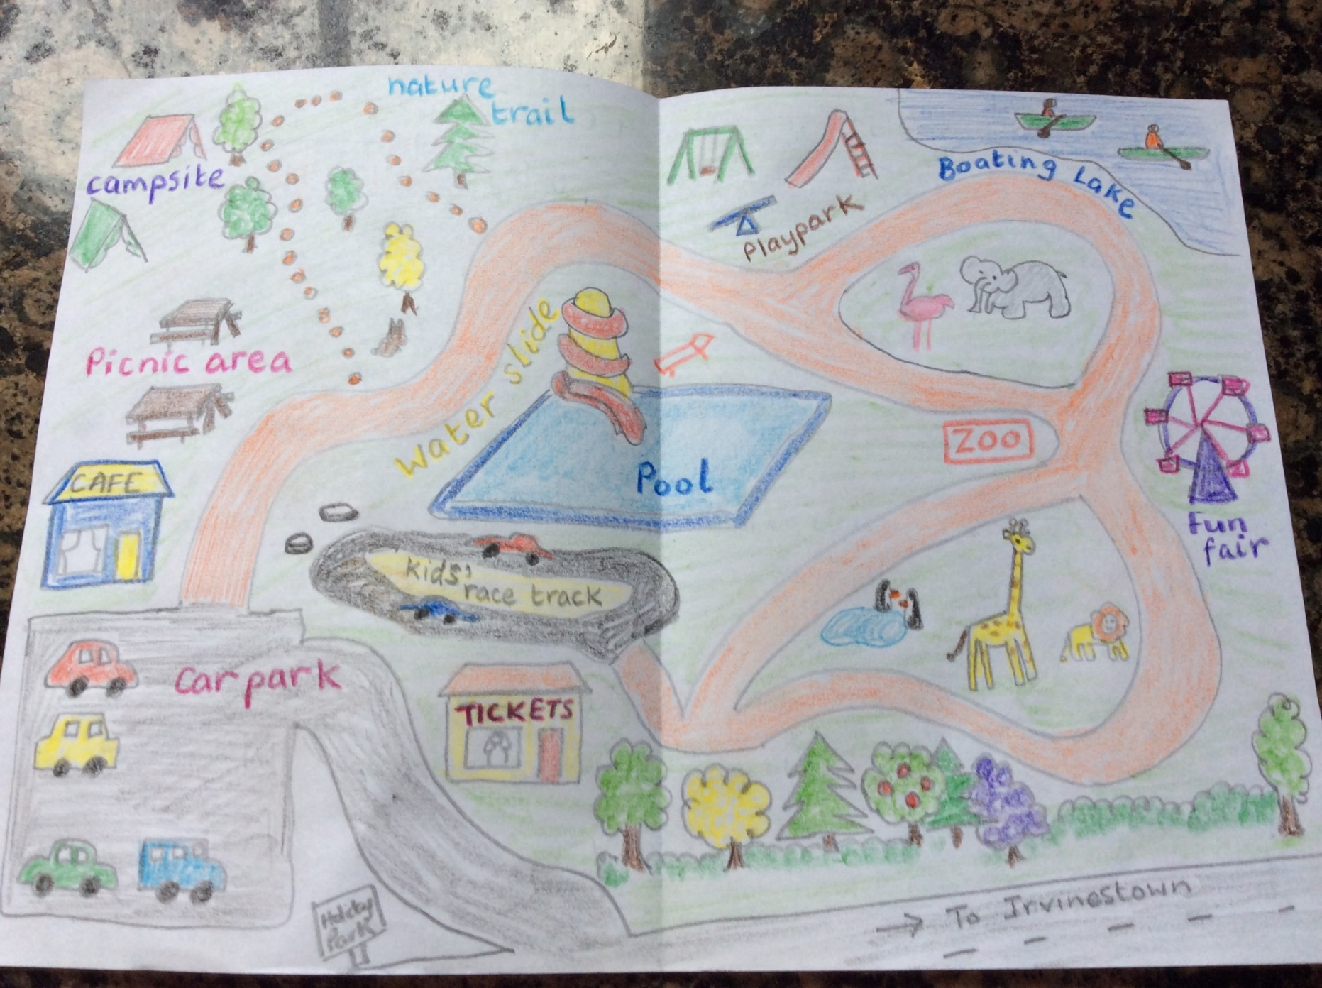
First, get a piece of paper and fold it in half like a card. On the double page spread on the inside is where you can draw your map.
Start off with the path through your holiday park, then draw in all the attractions you would like.
Then label it with signs so people know where to go.
Here’s Marley’s one.

Slide 5
Now, the front cover. What is your holiday park called? Give it a name at the top.
Write some sentences telling people what you can do there. Here are some helpful words and phrases. Read the next 2 pages before you start.
a picnic
lunch at the cafe
have
You can
on the playpark
down the water slides
go
swimming
on a nature trail
see
wild animals
wild squirrels
feed / pet / ride
the ducks
horses

Slide 6
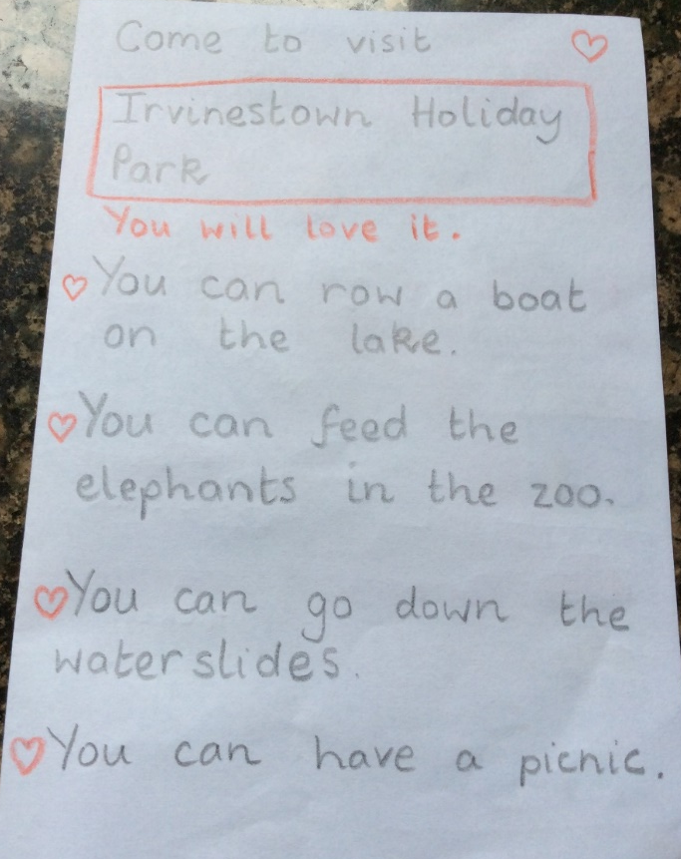
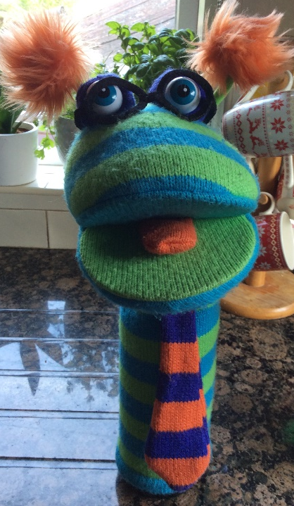
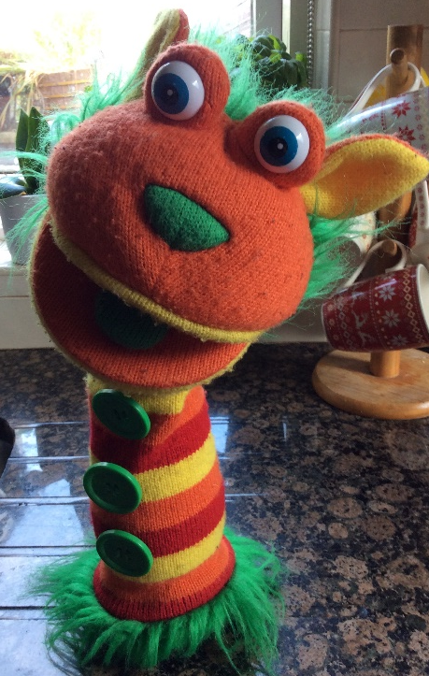
Here’s Marley’s front cover. What could he do to make it better do you think?
Maybe make it more colourful, with a nice picture or coloured writing?
Maybe try to make his sentences more interesting with exciting words.
Brochures are designed to make people really want to visit the place. It’s called Persuasive writing – trying to persuade people to visit this park.

Slide 7
Can you think of any good words to put into these sentences to make them sound even better?
You can row a boat on the lake.
You can go down the water slides.
beautiful
peaceful
exciting
fast
Now make your own front cover that will make people want to visit your holiday park. Remember to use persuasive language – words that make it sound really great and maybe a colourful picture. If you would like to send Teacher a picture of your brochure, she would love to see it.

Slide 8
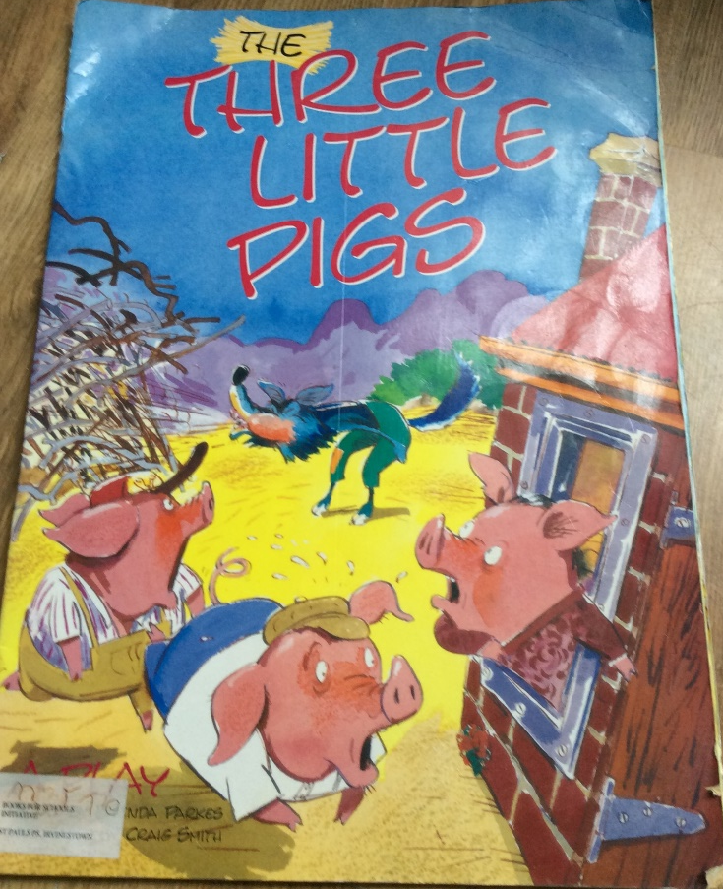
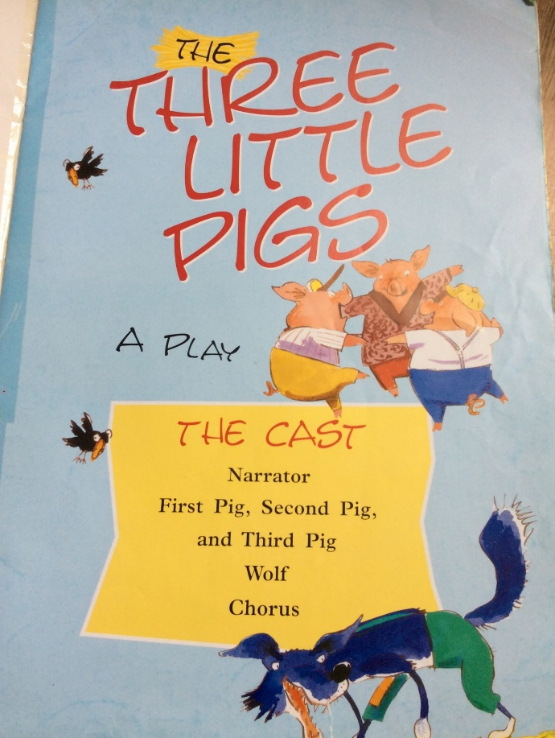
Brilliant work so far! Now it’s reading time.
Every June, we read plays in P2. You’ll have to get people in
your family to help you. Look at the first page where it says Cast. That’s how many people you’ll need. Decide who reads which part.

Slide 9
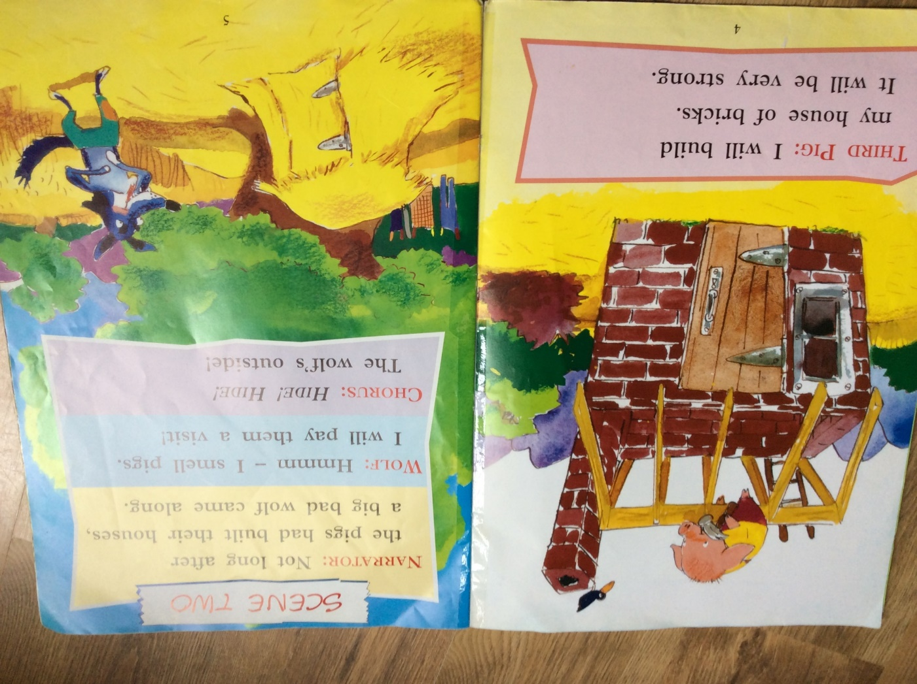
In a play, when a character speaks, it doesn’t say things like, he said or she said. They just put the person’s name at the beginning with 2 dots like this: (it’s called a colon)

Slide 10
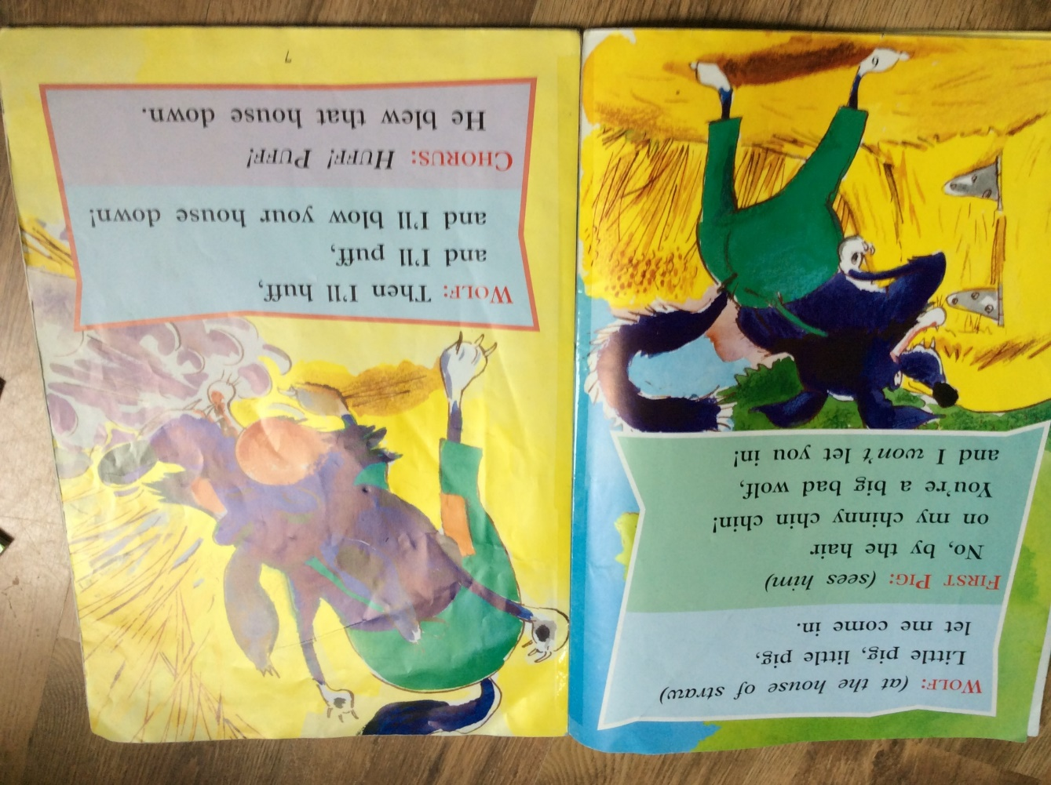

Slide 11
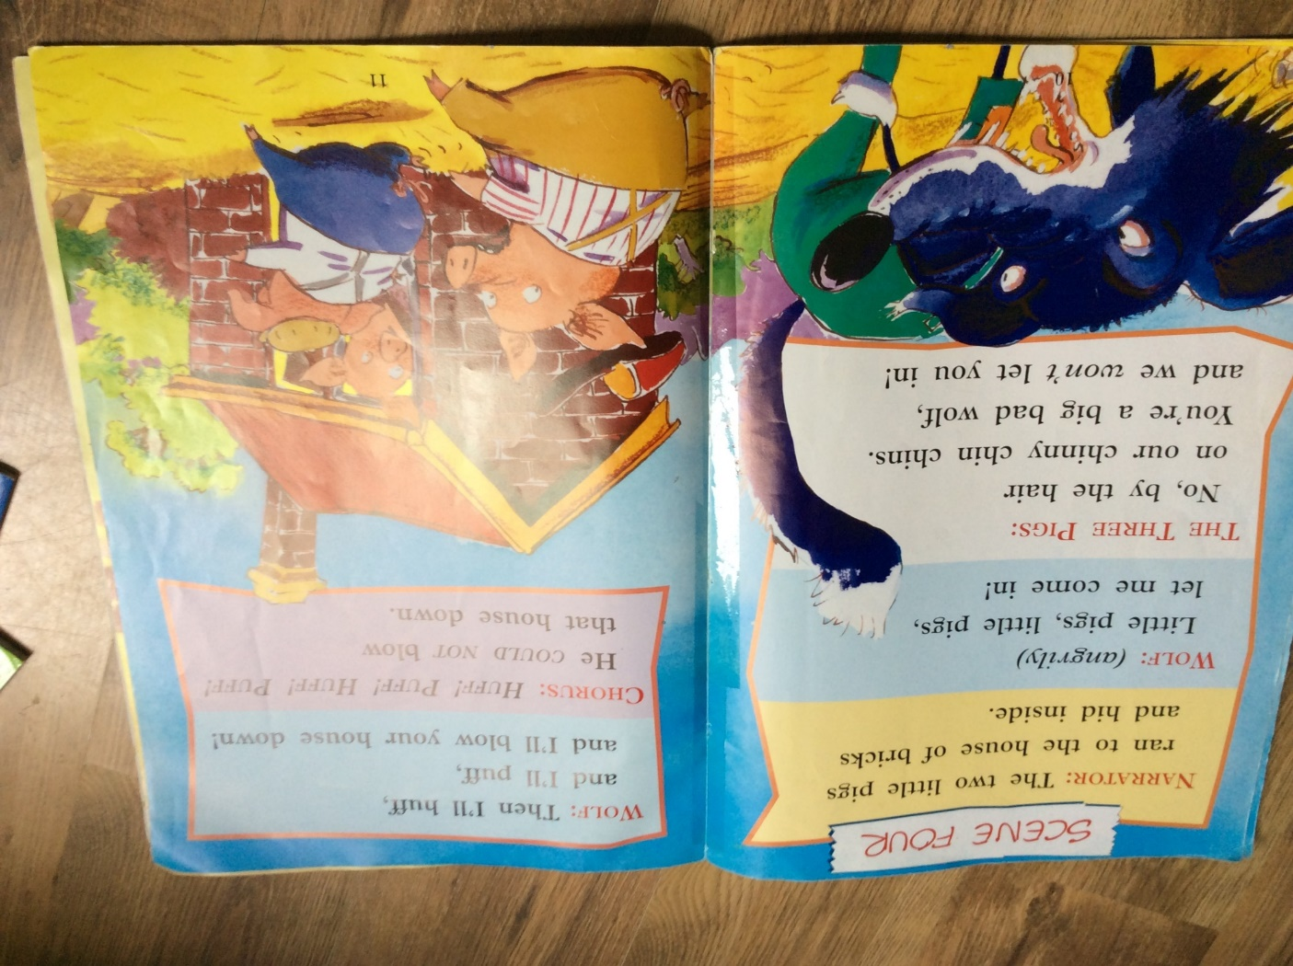

Slide 12
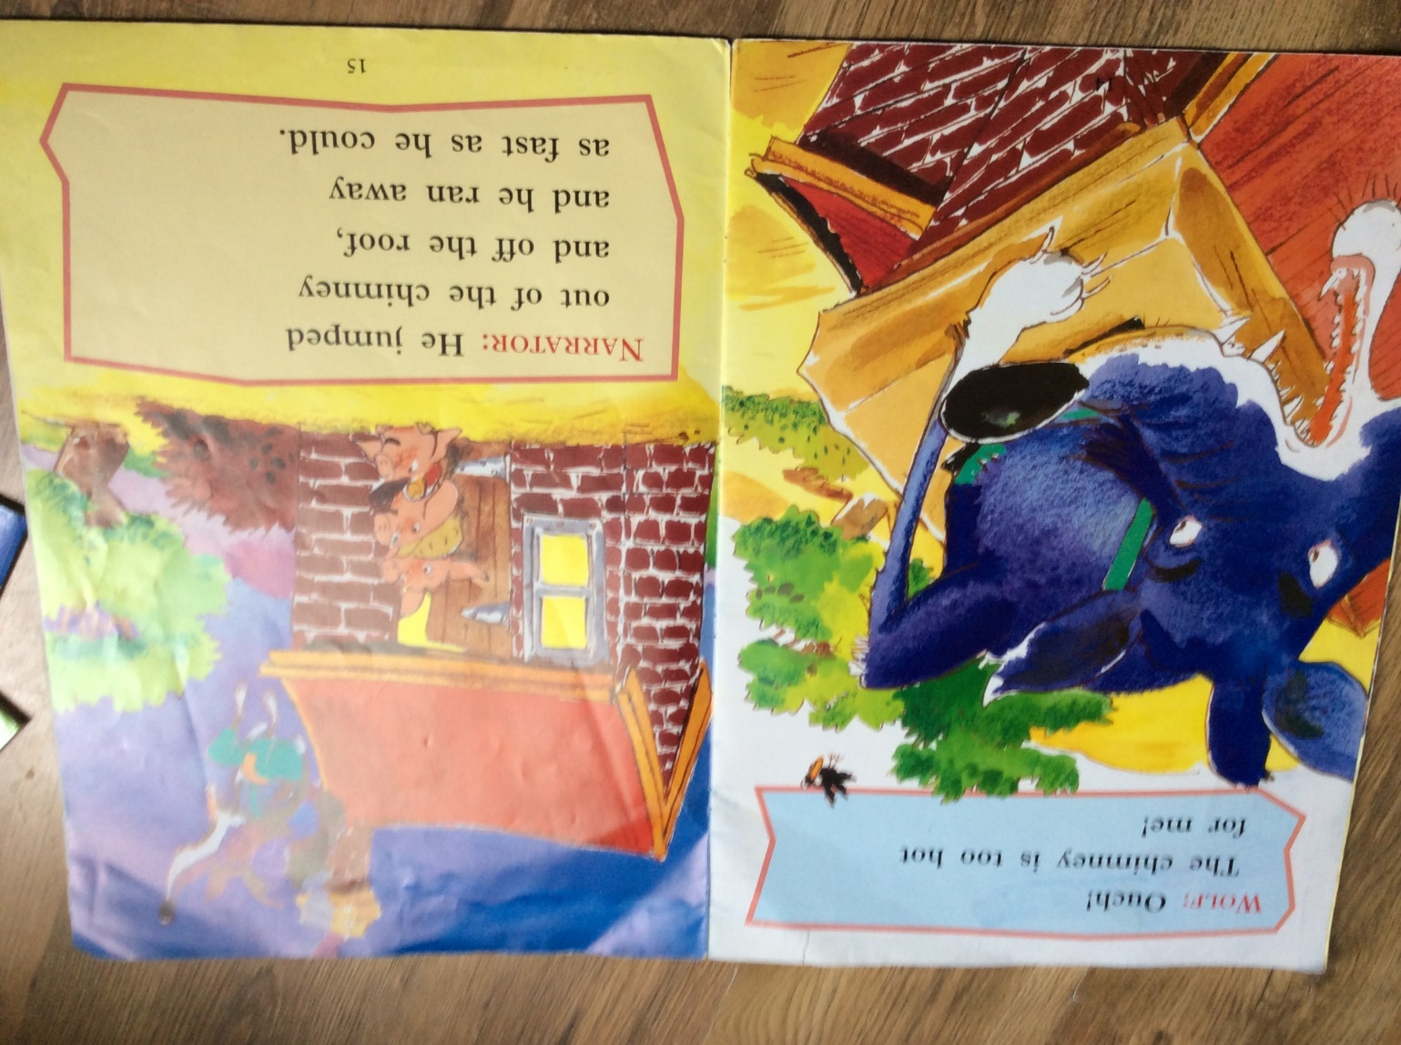
Now that you’ve practised reading the play, read it again and try to do voices for the characters. I hope you have fun. If we were at school we would make up our own plays in groups with our friends. Well done for your hard work!

Slide 13
June: P2 overview of the learning that would usually take place in school in the month of June. As usual, please don’t feel that you have to replicate this, but read through the 3 slideshows and choose activities that are manageable for your home life and things that you and your child will enjoy. Please don’t hesitate to get in touch if you require further information or support.
Overview of Learning for Parents June Theme: On the Move/ Let’s Investigate | Literacy Persuasive writing: children will write brochures to attract visitors to a fictional holiday park. Recap on punctuation marks: , ? ! . and their impact on how the reader uses their voice. Be encouraged to read with more expression, taking into account some punctuation. Read playscripts and understand some features. Act out simple playscripts in small groups. Read digital texts. Read about some scientists. | Maths Become confident with numbers 1-20 Read and write number names to 20 Count in tens Be introduced to numbers to 100 Use patterns of similar calculations Identify near doubles, using doubles already known Begin to bridge through 10 when adding a single-digit number Develop mental confidence when adding or subtracting Use mental strategies to solve problems set in 'real life' | PDMU Begin to recognise similarities and differences in families in the community. Understand that everyone is of equal value and worth, and it is acceptable to be different. Transitioning to P3
World Around Us How do things change? What kind of changes happen/ have happened or might happen? How can we make change happen? How do things work? What sources of energy are in my world? How and why are they used? Explore magnetic force and experiment with magnets. Can they find a use for this? Explore substances and experiment to make reactions and see what happens. Investigate colours, light and mixing colours. Use a torch and a prism to make a rainbow. Record ideas. | Play Dramatic: roleplay in science lab. Children will experiment with vinegar, lemon juice, bicarbonate of soda, salt, sugar, water, food colouring and talk about different reactions which occur when they are combined. Make up imaginary inventions and discoveries. Games to help with numbers to 100 Investigate magnets and their uses. Investigate which materials are magnetic. Make art from metals. Explore the use of negative space in art. Experiment with mixing colours and use torches to investigate some effects of light and colour. ICT – Build runs for the robot mouse and programme it to follow directions to the cheese. | RE – Grow In Love Learn about John the Baptist and his relationship with Jesus. Understand why we are baptised. Learn about the sacrament of Baptism. Grow in Love Prayer Service to close the P2 year. | TSPC Children will work in groups, with partners and individually to plan and carry out experiments they choose themselves. They will have access to a range of scientific materials and choose their own investigations. We will discuss their results together and possible scientific implications for what they have discovered.

