Slide 1
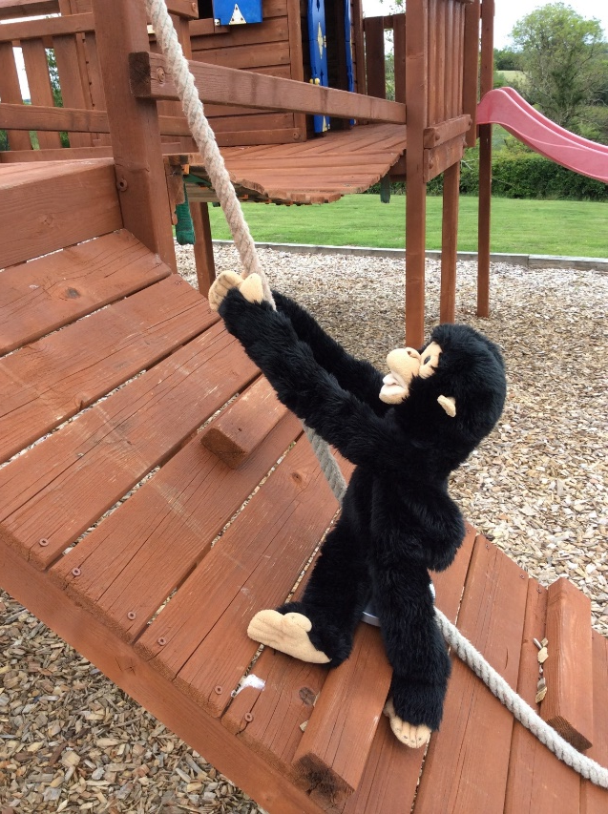
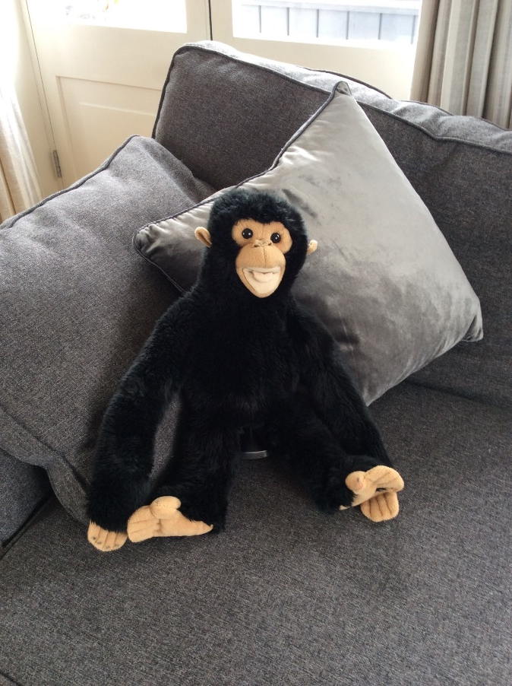
June Learning for P2
Science: On the Move
Get off the sofa Chippy! We’re going on the move to learn all about forces.

Slide 2
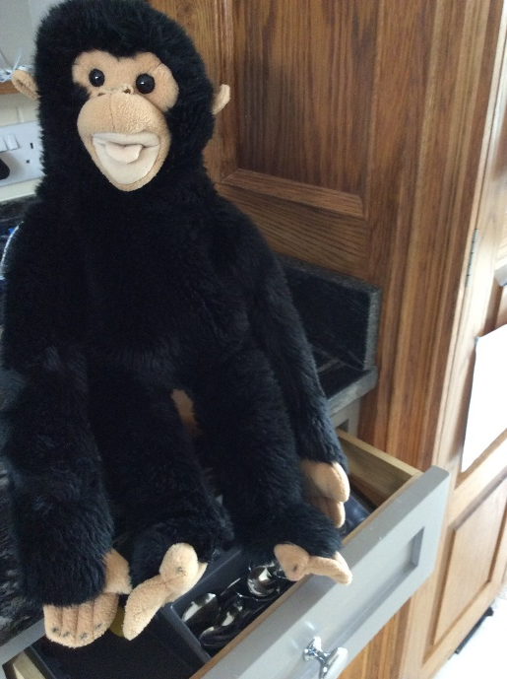
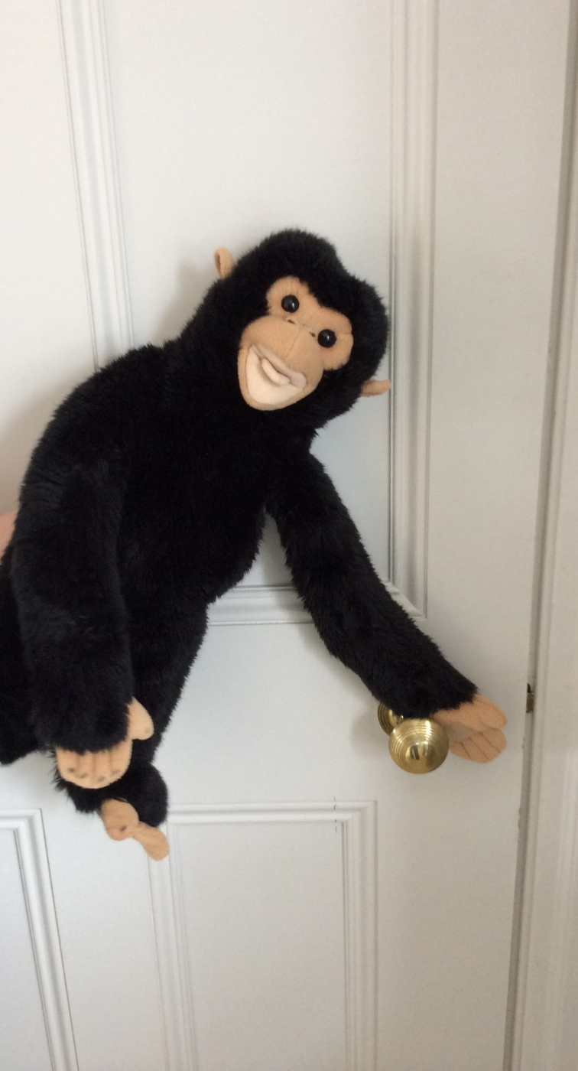
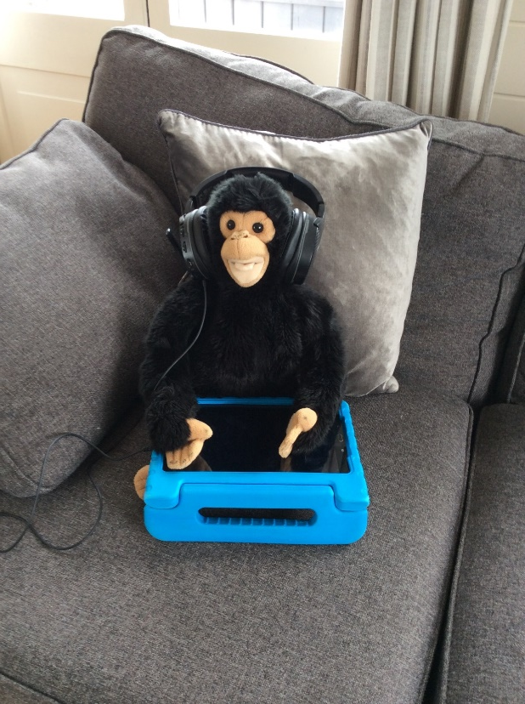
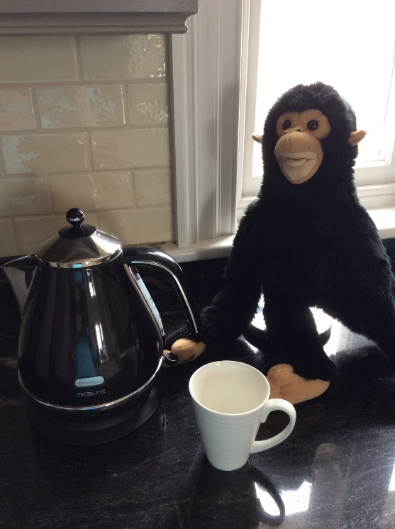
Pushes and Pulls at Home
Pull open the drawer.
Push the door closed.
Push the buttons on games and controls
Pull on the tap.
Push the switch on the kettle.

Slide 3
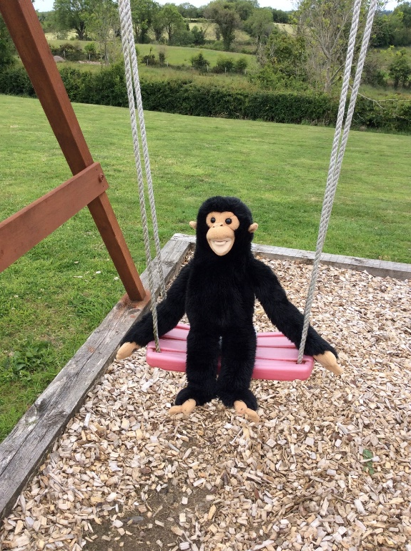
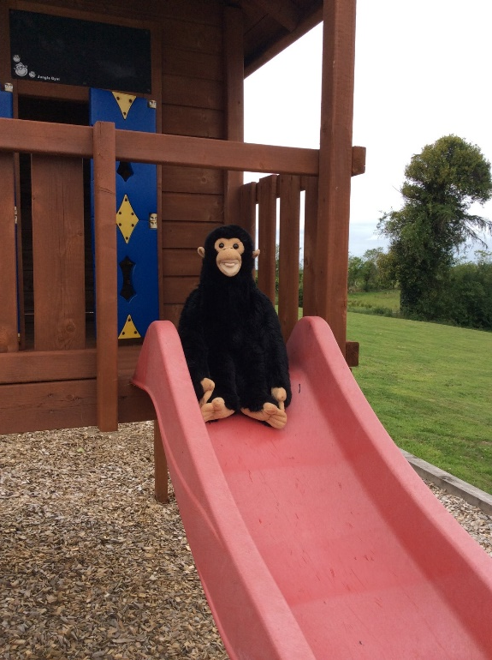
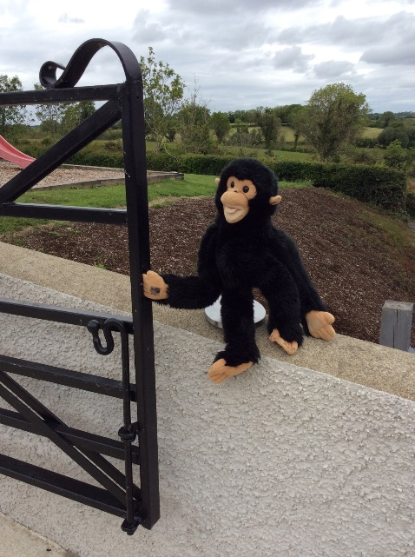
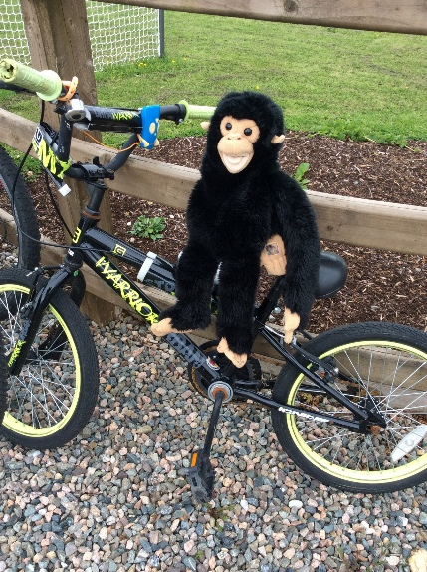
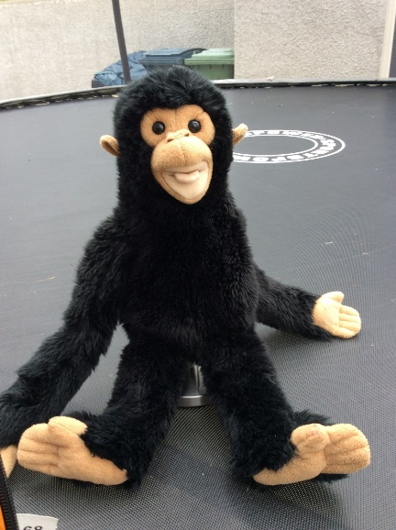
Moving Forces – Pushes and Pulls
Can you spot what Chippy is doing in these pictures? Pushes or Pulls?

Slide 4
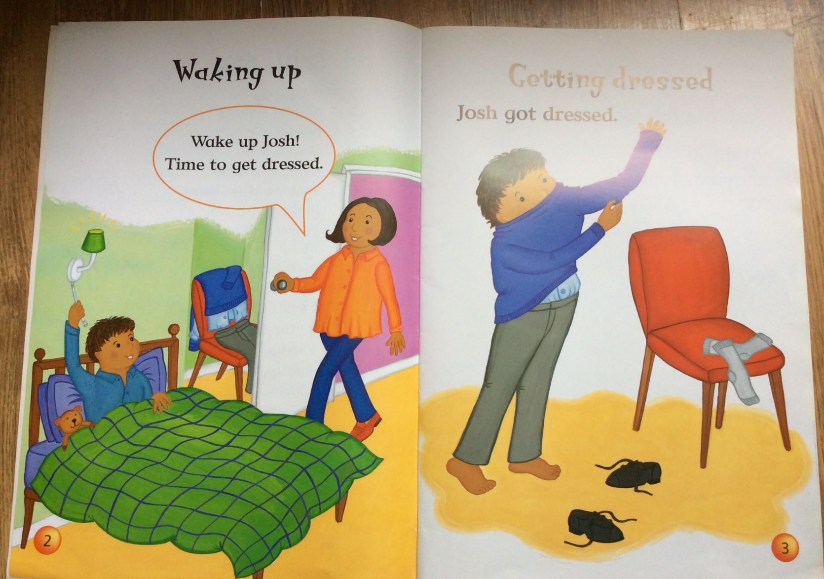
Spot the forces being used in these pictures in our big book.

Slide 5
Magnets
Do you have any magnets in your house? Maybe on
the fridge? If you do, you can do this experiment with
Marley and me.
Go around your house with the magnet checking what it sticks to.
Does it stick to:
The fridge?
The cooker?
A radiator?
The bathroom sink?
The kitchen sink?
The wall?
A window?
Do you notice anything about the things it sticks to? What are they made of?

Slide 6
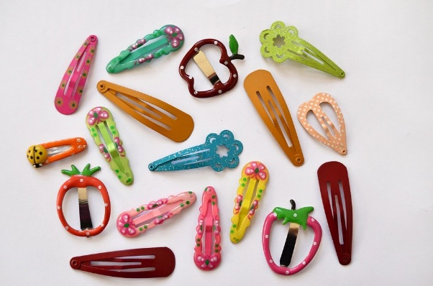
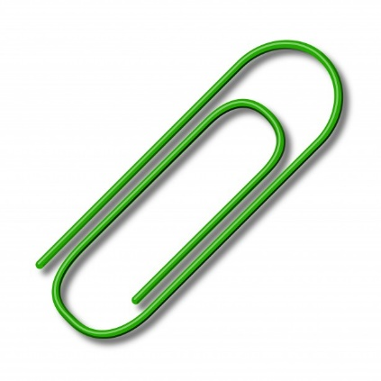
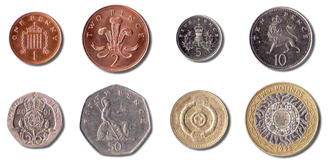
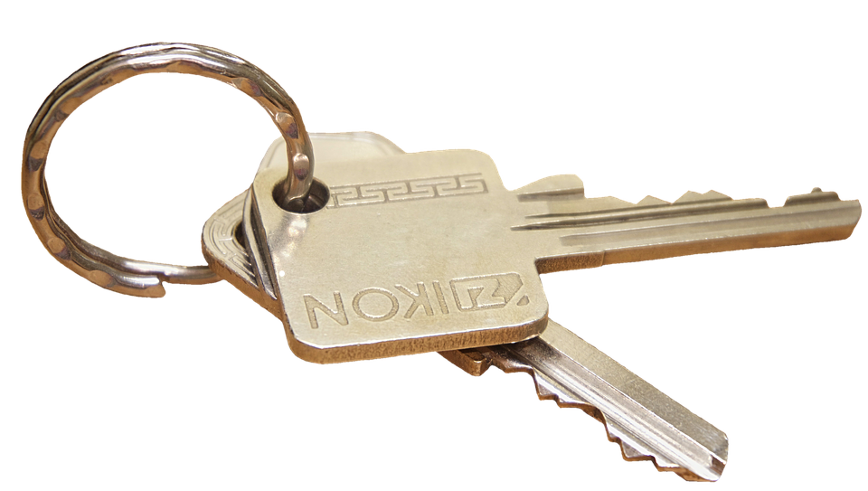
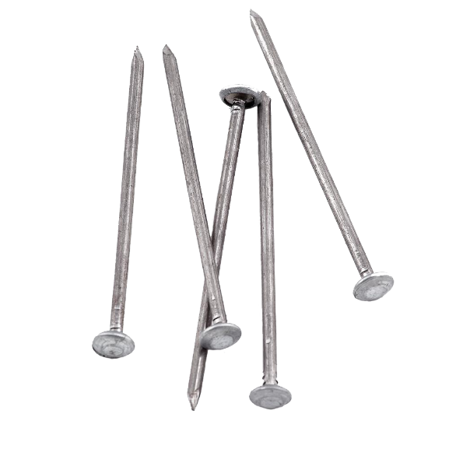
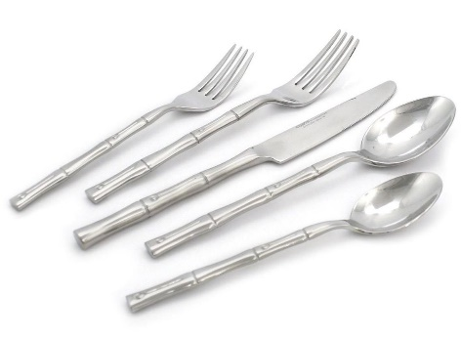
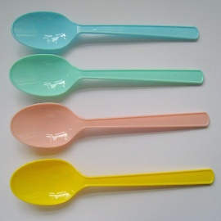
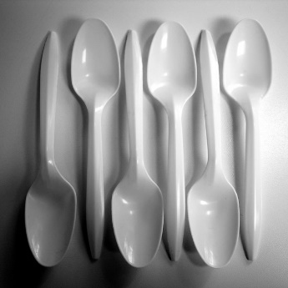
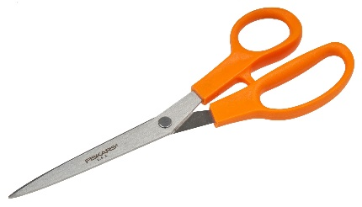
Magnets are attracted to metal objects that contain iron. This is called Magnetic Force.
Go and find as many of these objects as you can in your house or try other objects. We’ll test them to see if they’re magnetic.

Slide 7
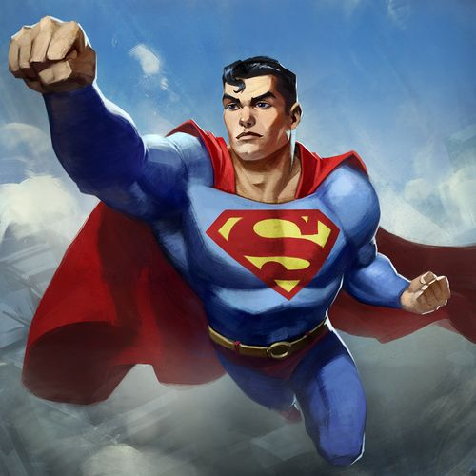
Great work so far! Now let’s make a table to show the results of our experiment.
Object | Was it magnetic? Yes or No
Paper clip | Yes
Door key
Metal spoon
Plastic spoon
5p coin
1p coin
£1 coin
Super work P2s!
https://www.youtube.com/watch?v=s236Q1nuWXg

Slide 8
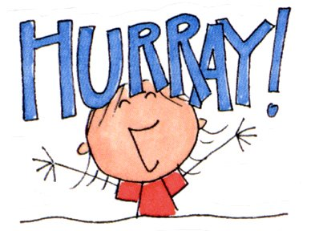
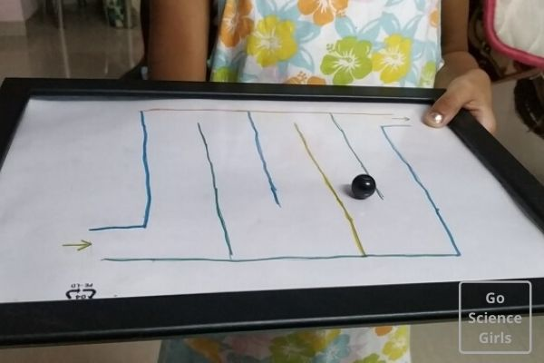
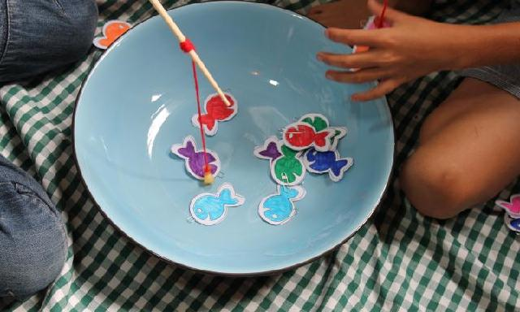
Now for Playtime!
Let’s use what we’ve learned to make some fun games.
https://www.youtube.com/watch?v=t4Q258wbKuM

Slide 9
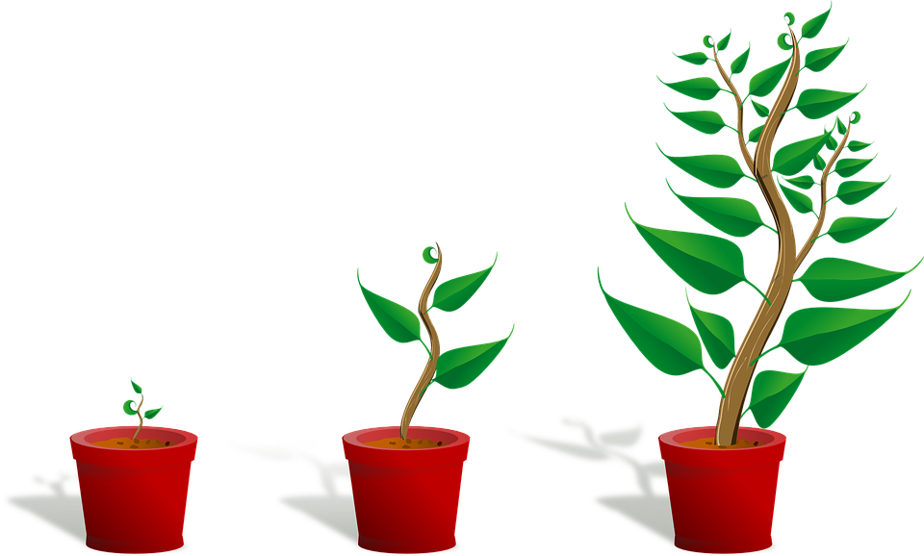
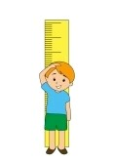
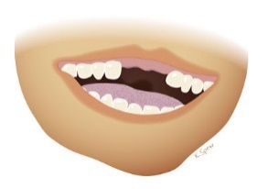
Moving on Up!
Something we always talk about in June is getting ready for P3.
I bet, since I last saw you, you have grown loads.
Have you grown taller?
Have any baby teeth fallen out?
Have any big teeth grown?
You won’t be in P2 when you go back to school. You will be in P3 and your teacher will be very kind. The P3 puppet is called Dinky. The classroom assistants will go with you to P3.
The chairs are blue in P3. The work is a little bit harder but you are older so you will be able to do it and the teacher will help you and the classroom assistants so don’t worry. The whole class is going to P3 together. Mrs Mulholland and Mrs Gormley will stay in P2 and teach the new P2s but you can call in and say Hello if you want to.

Slide 10
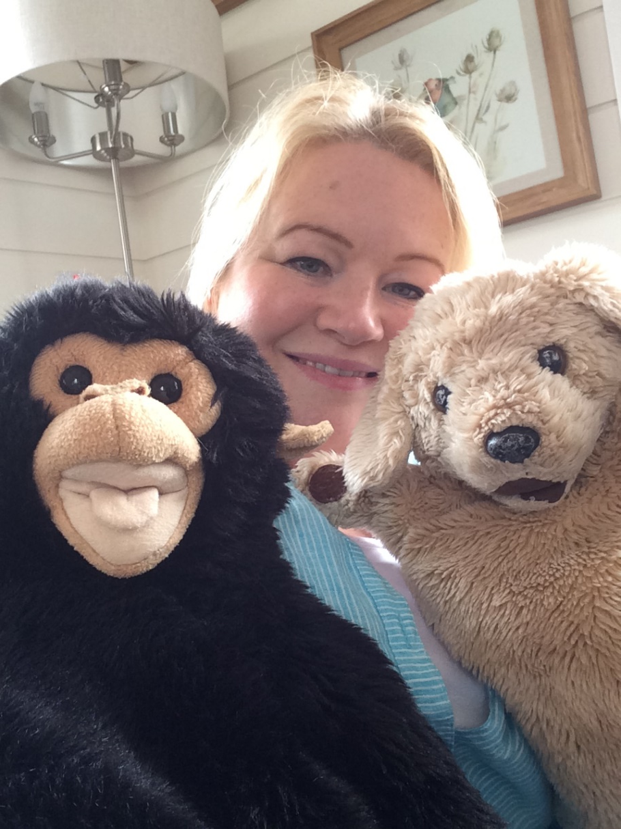
Bye-bye Everyone – Hope you have a great Summer holiday. Be careful and have fun!

