Slide 1
P2 Learning for June
Maths
Moving on up – numbers to 100, adding up to 20

Slide 2
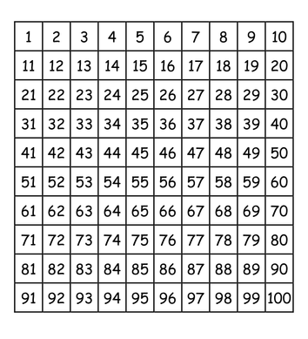
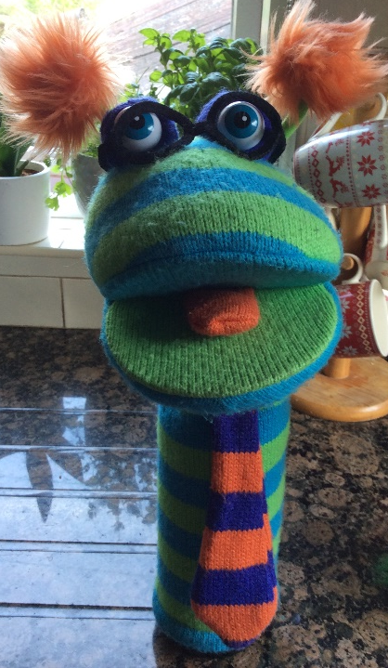
Moving all the way up to
Can you count up to 100?
Look at the number square. Can you see any pattern in the rows or columns?

Slide 3
Let’s play some fun games. Wookie and Podge love number splat!
Get a grown up to call out the numbers for you to splat.
https://www.primarygames.co.uk/pg2/splat/splatsq100.html
https://www.topmarks.co.uk/learning-to-count/helicopter-rescue
https://www.youtube.com/watch?v=VHwlKl5SsHc

Slide 4
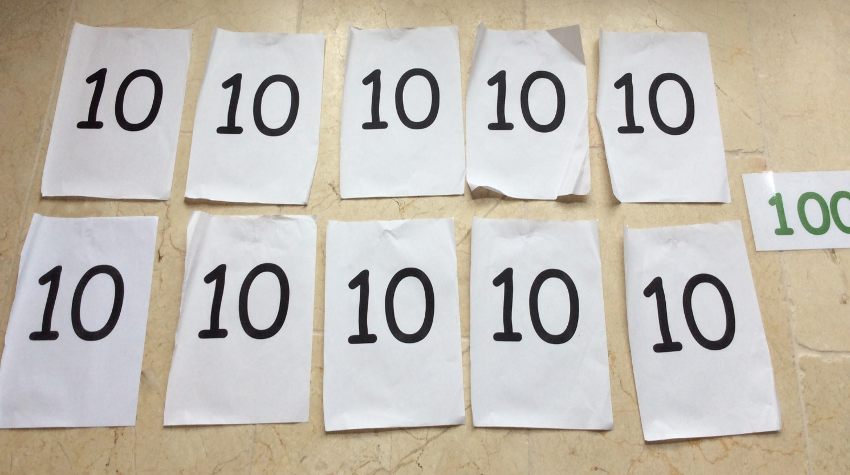
Let’s try counting a different way. Guess how many 10s are in 100?
10 tens in 100
1
2
3
4
5
6
7
8
9
10
https://www.youtube.com/watch?v=W8CEOlAOGas
https://www.youtube.com/watch?v=Ftati8iGQcs&list=PLM95cb_Szq3am4n6jJw127QbBlDivZgIc&index=1

Slide 5
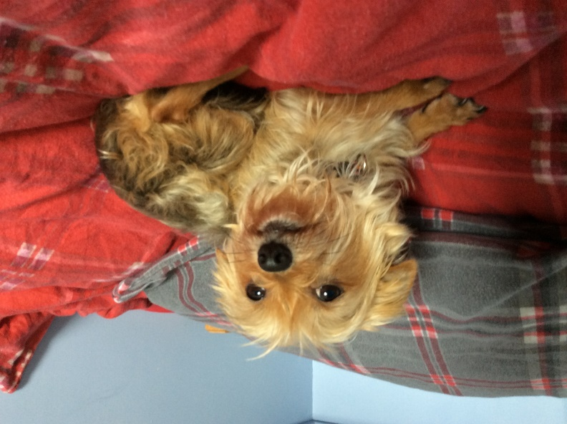
Oh no! Tilly ate some of the numbers. Which ones are missing?
Mrs Mulholland’s naughty dog, Tilly
20
Did you get them right?
Woof! Well done!
90

Slide 6
Now, a bit of revision of teen numbers before we go on (adding tens and units)
https://www.youtube.com/watch?v=uedvwH6Ay18
https://www.youtube.com/watch?v=1W5aYi3lkho
https://www.youtube.com/watch?v=RnsKoxbMbD4
Now, make or print yourself a ten frame – remember we used these last month?

Slide 7
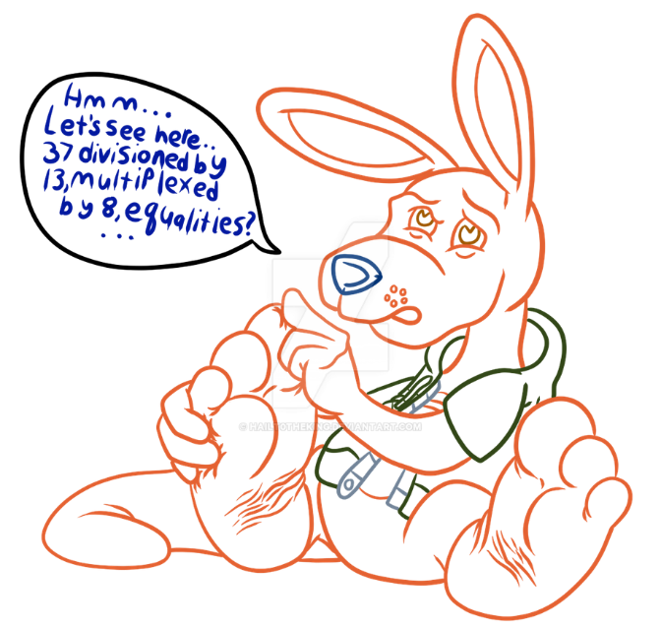
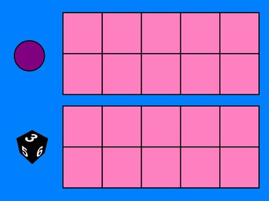
Bridging through 10 (adding)
I know you are all super at your number bonds to 10 now. It’s time to use those bonds to do harder sums.
Say you had to add 5+7 Oh no, not enough fingers!
That’s the 5
There’s 5 spaces left to make 10
There’s some of these for you to try at the back of your addition workbook
7 is made of 5 and 2 more
10 and 2 makes 12 so 5 + 7 = 12

Slide 8
https://www.youtube.com/watch?v=tokmWMfIu8o
https://www.youtube.com/watch?v=q9h4skGoWJ8
Well done P2s!
I’m so proud of how hard you are working at home.

