Slide 1
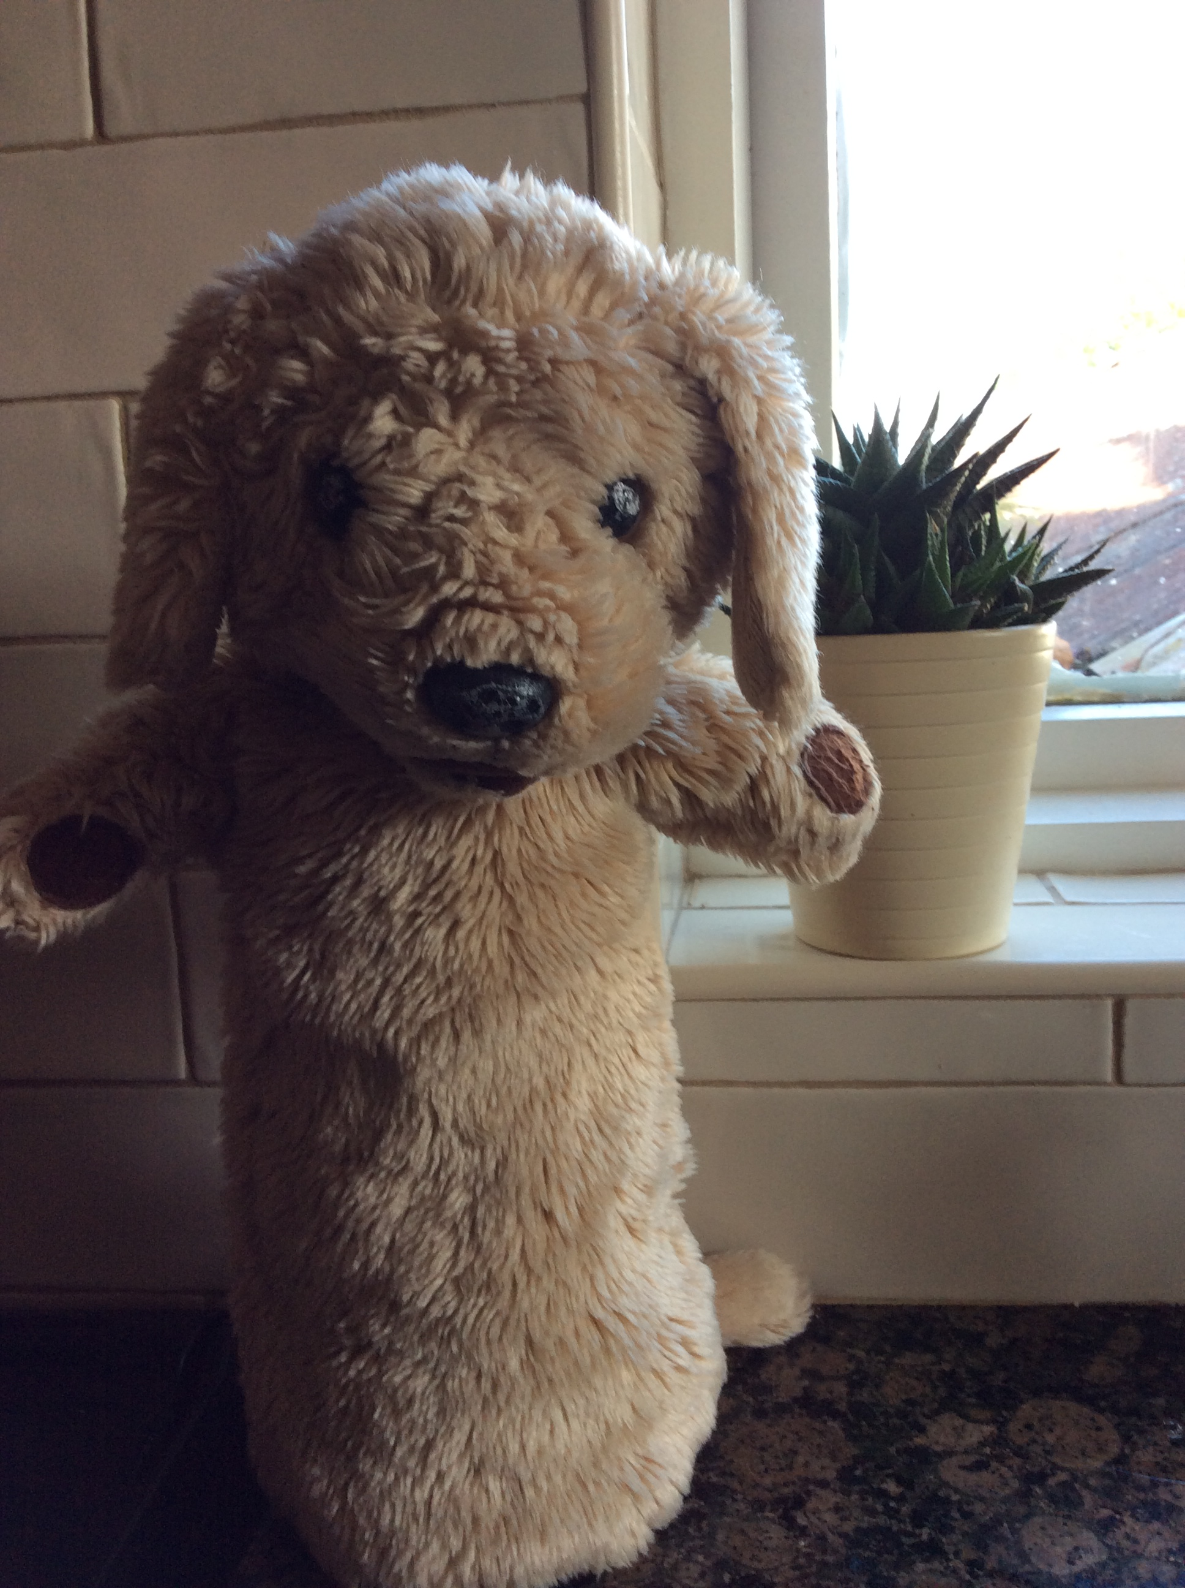
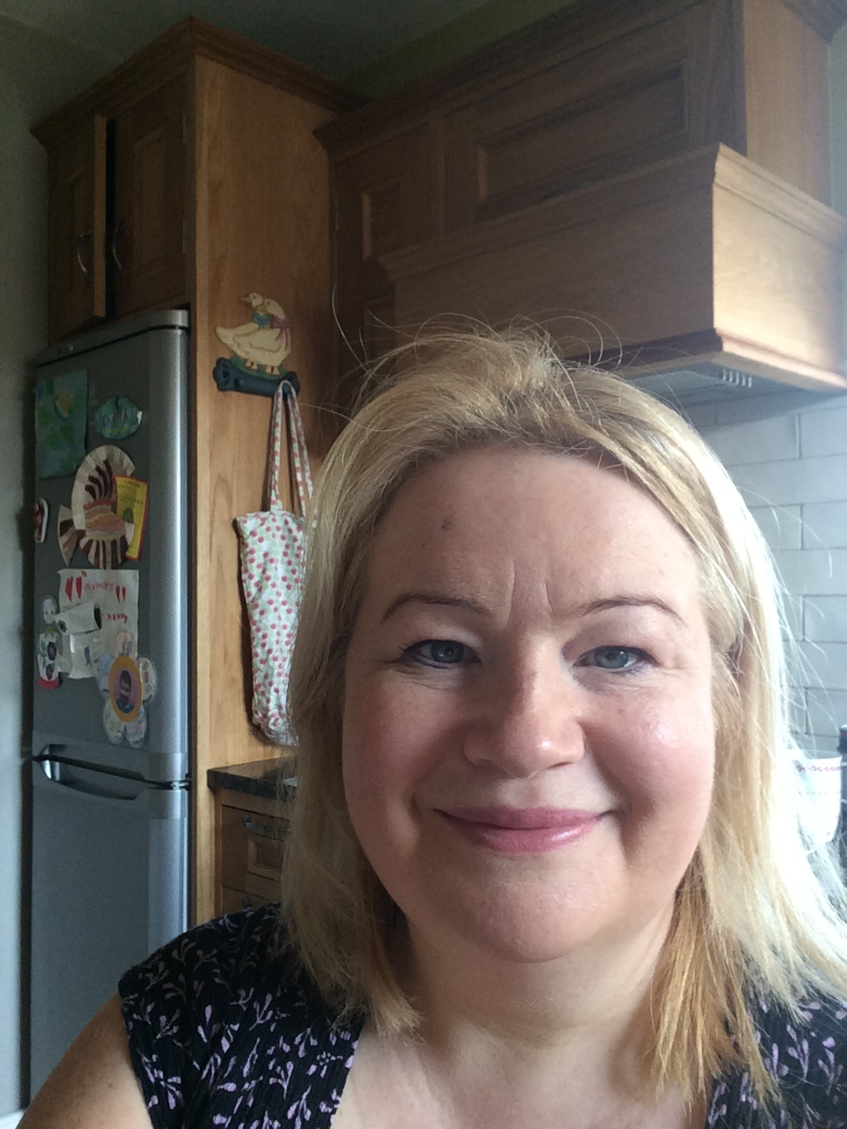
What’s Marley been up to in Lockdown
with Teacher?
I miss all my friends in P2 and all the fun.
I miss school and all the P2s.
… but maybe now I’ll have a nice rest.

Slide 2
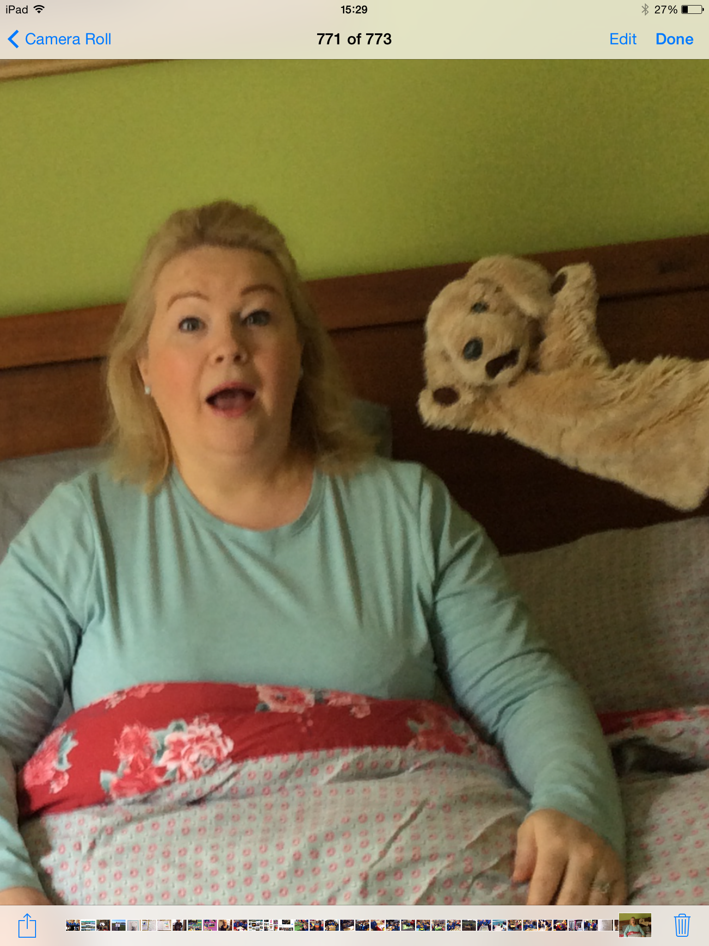
Wake up Mrs Mulholland!! It’s time to get busy!
Marley wakes up Teacher every morning and shouts, “What are we doing today?”

Slide 3
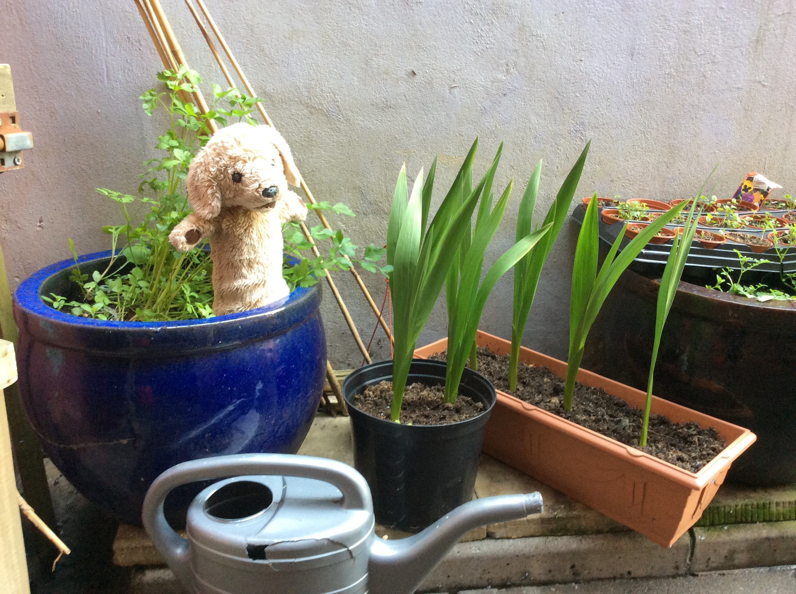
We have to look after the P2 flowers that we planted before we left school. Don’t worry! Marley waters them every day.

Slide 4
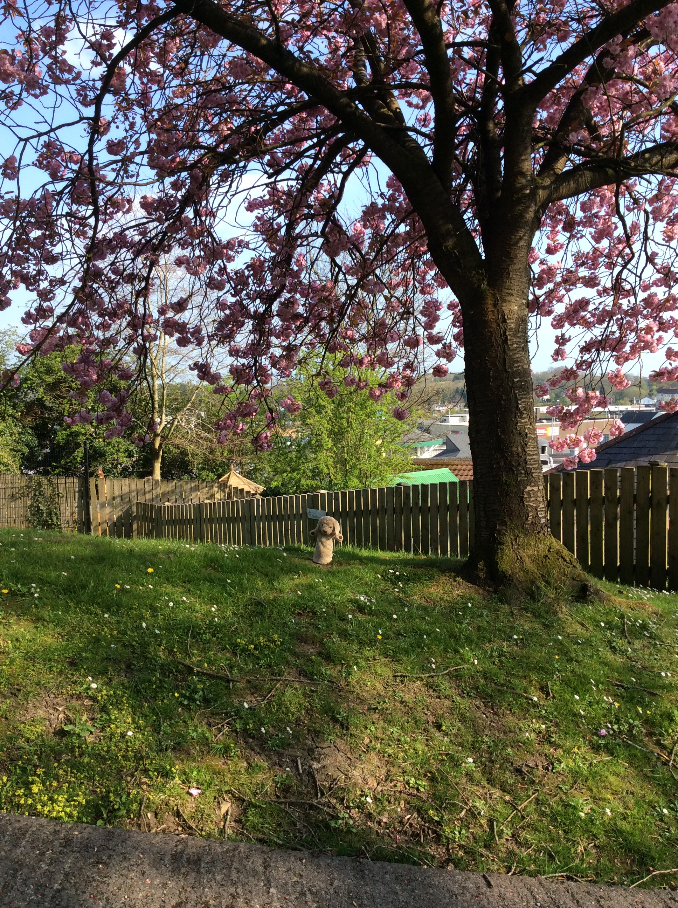
He goes out for his walk every day in the park. Teacher’s dog, Tilly, goes too.

Slide 5
One day we even climbed up a (small) mountain.
If you do something interesting, you can email your photos to Mrs Molloy and she’ll put them on the school website.

Slide 6
Marley does his schoolwork every day.
I like doing the study ladder. If I click on the yellow envelope I can see a message from Teacher.

Slide 7
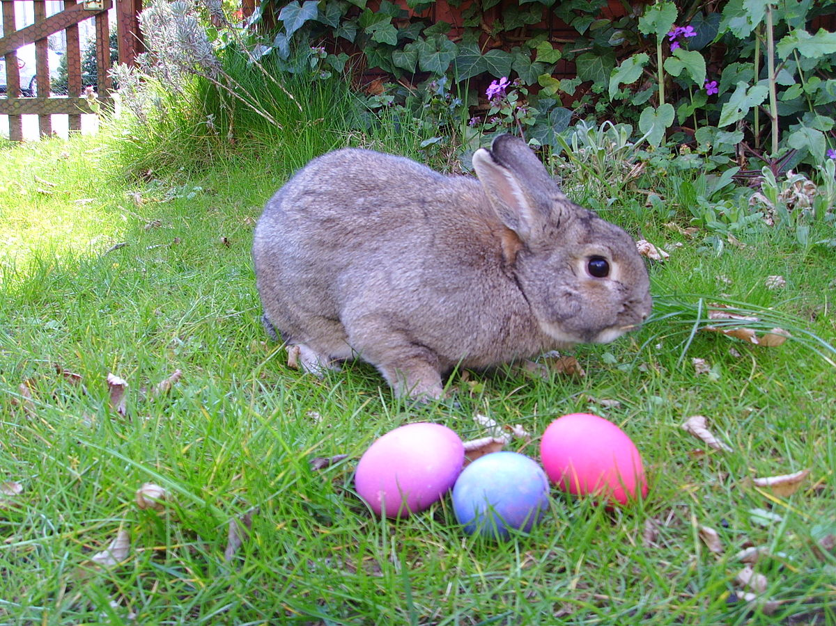
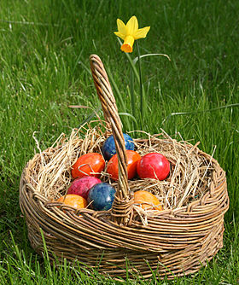
He got lots of Easter eggs!
I hope all the P2s got Easter eggs too!

Slide 8
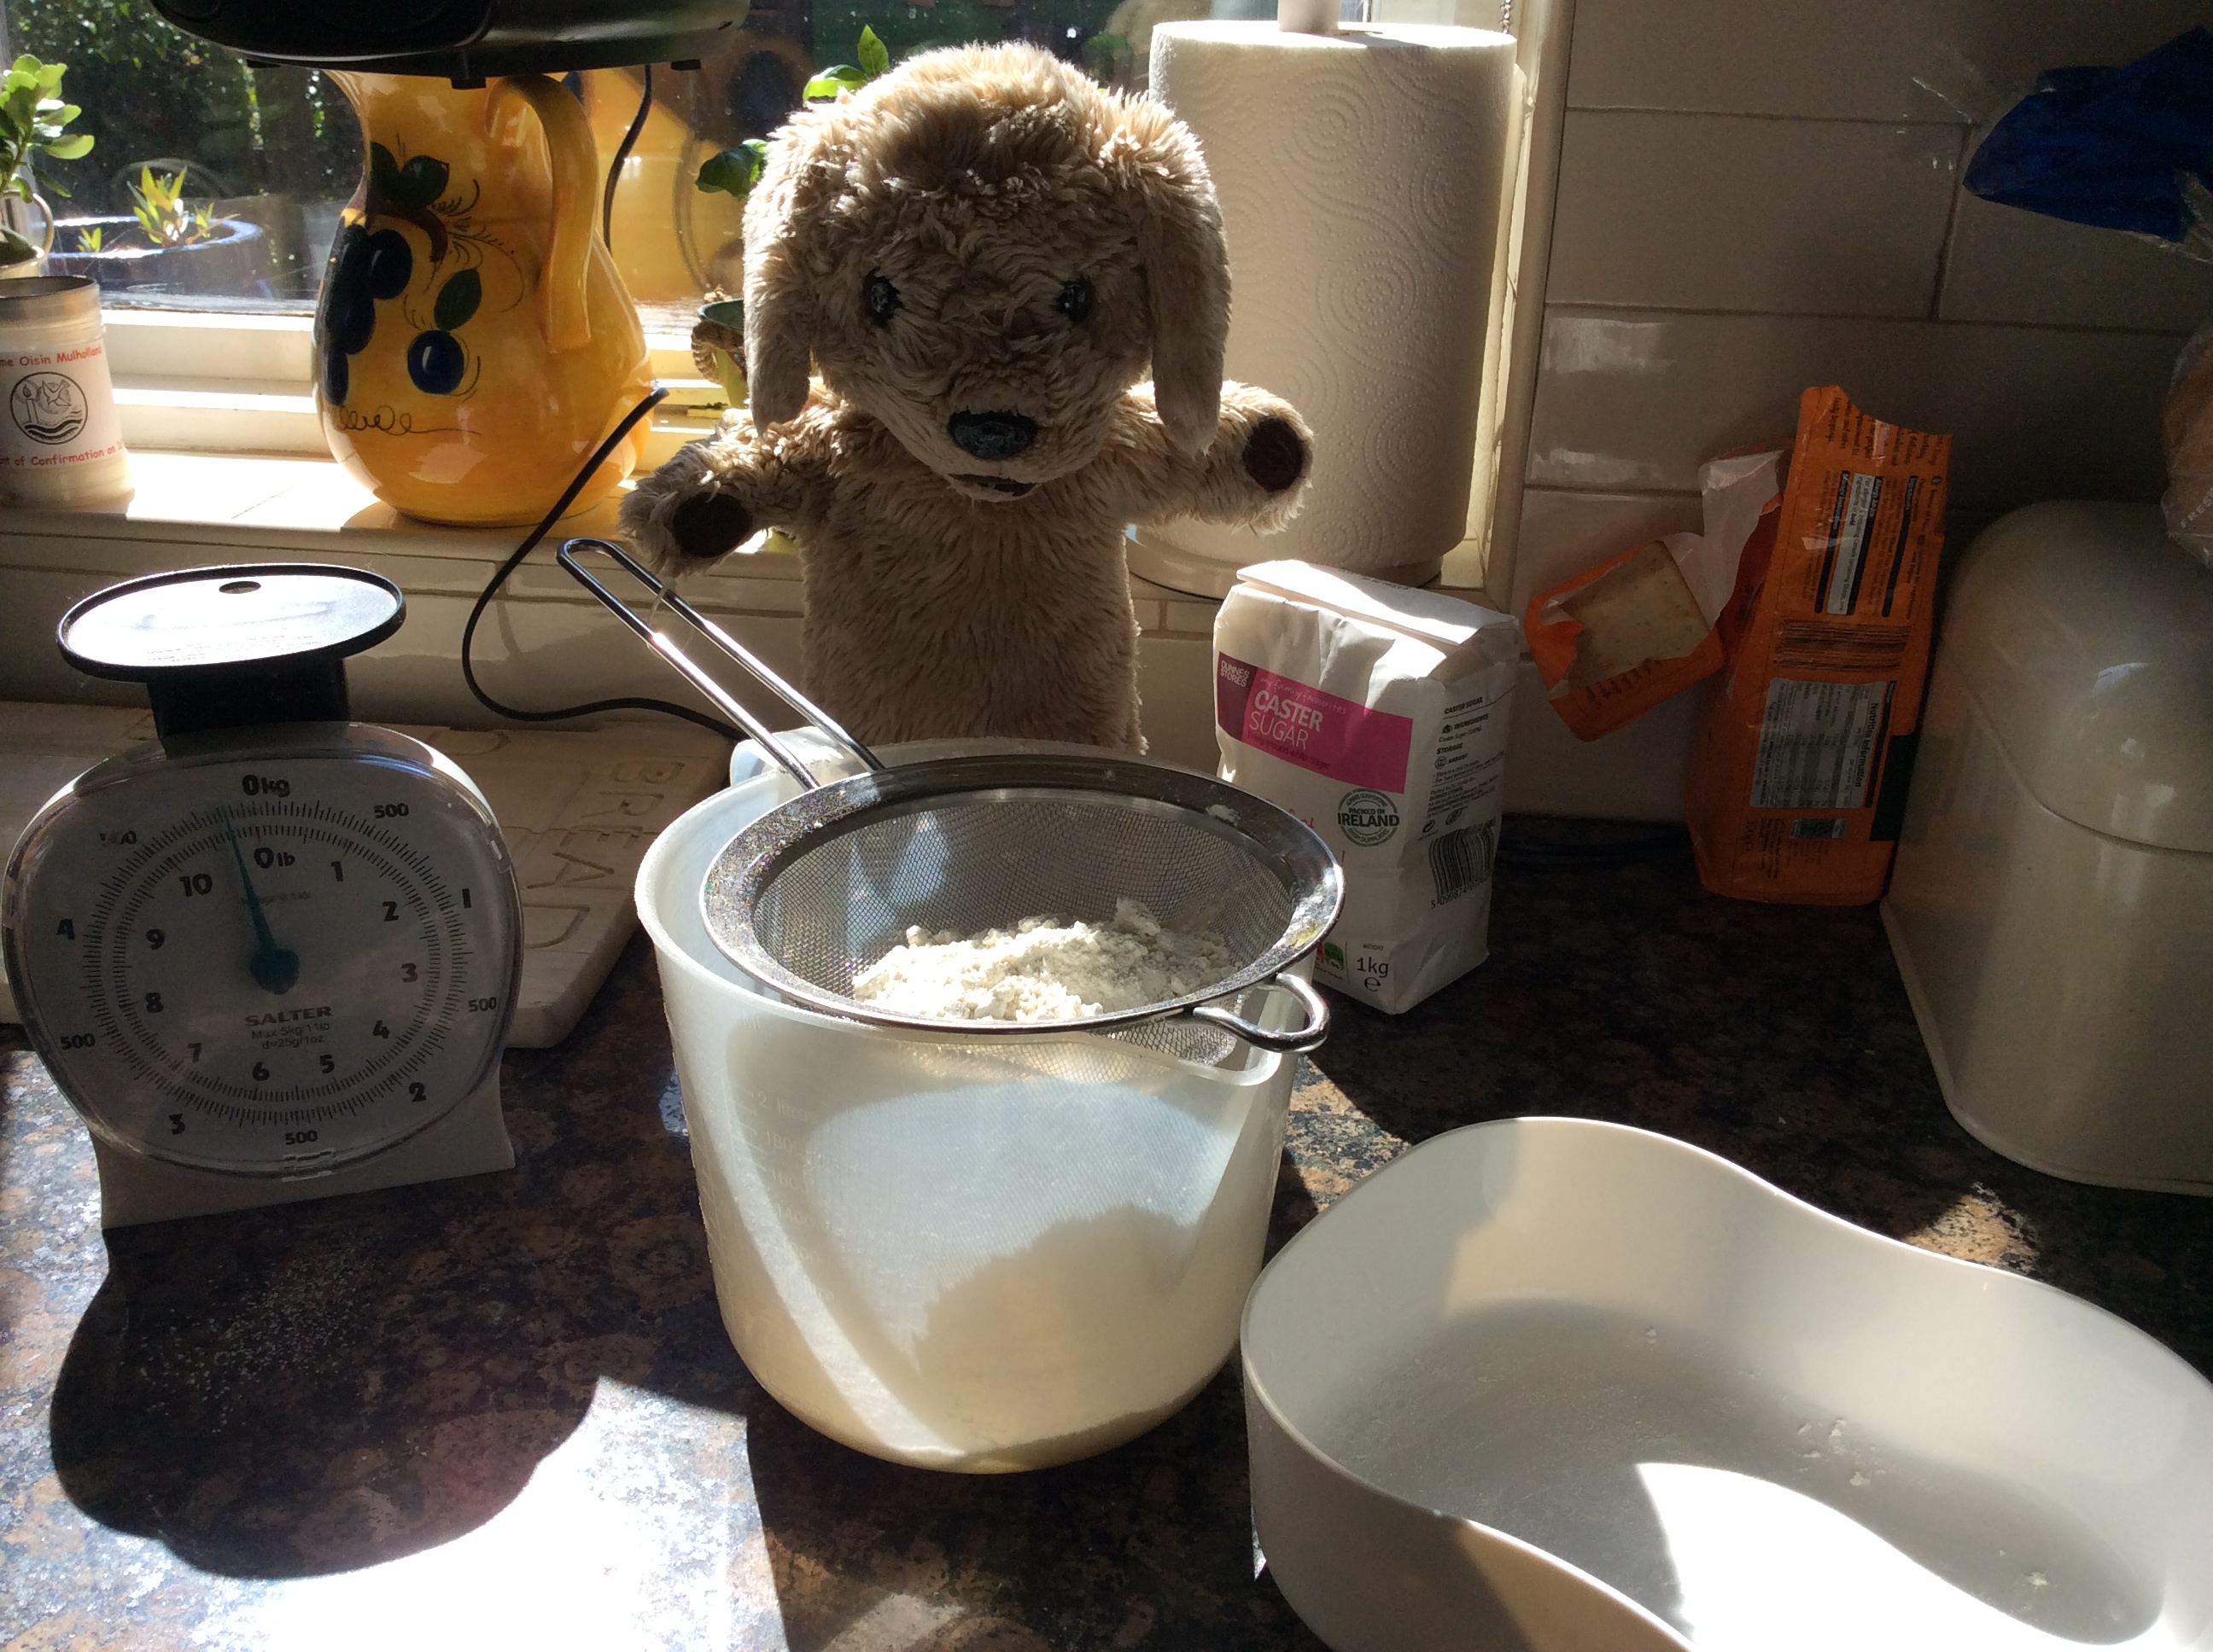
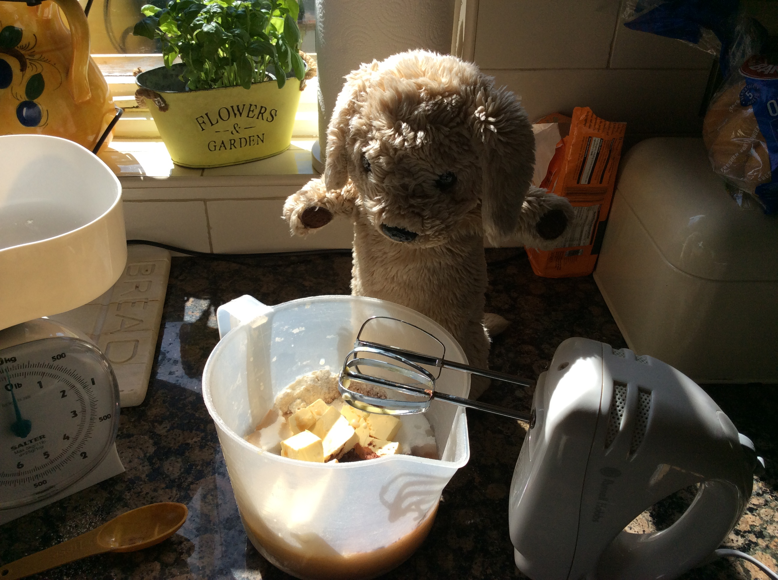
He’s been baking chocolate brownies.

Slide 9
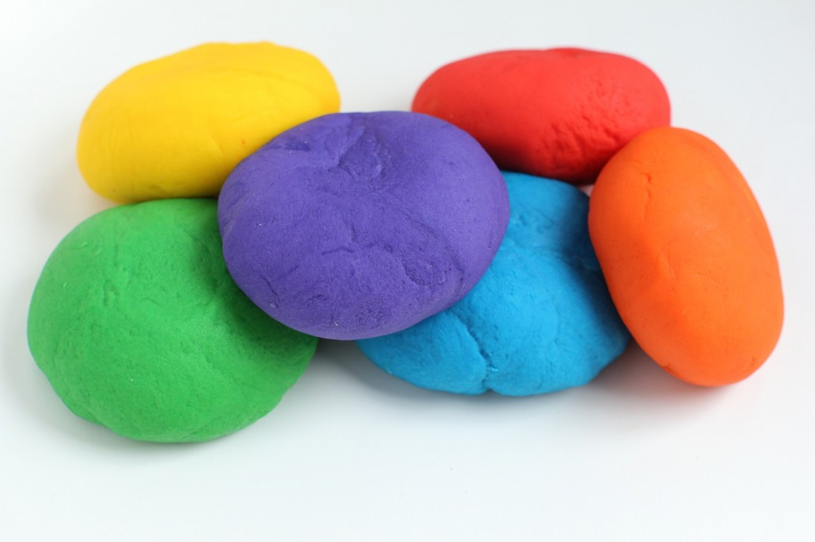
Marley made playdough one day. Here is the recipe in case you’d like to make some to play with at home.
2 cups of plain flour
½ cup of salt
2x sachet / teaspoon of cream of tartar
1 tablespoon of cooking oil
1x tube of food colouring
1 cup of boiling water
Mix the dry ingredients, add the wet ingredients, mix them together (use your hands – it’s easiest) Tip it out on a floured surface and knead it until it is playdough. All the children have done this in school lots of times so they’ll be super helpers!

Slide 10
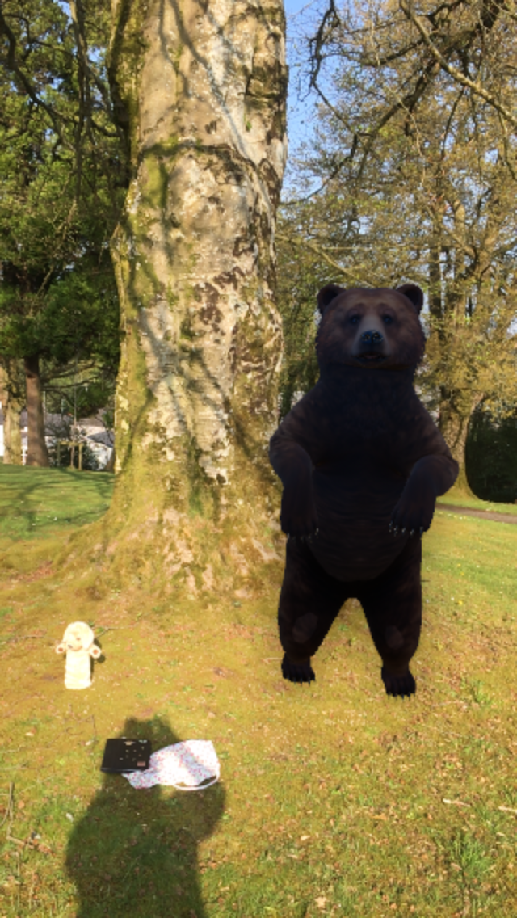
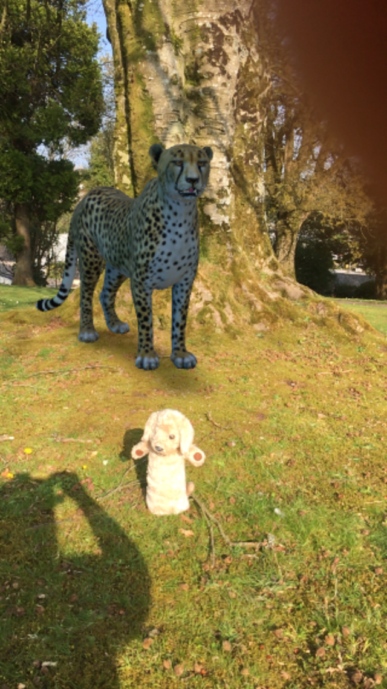
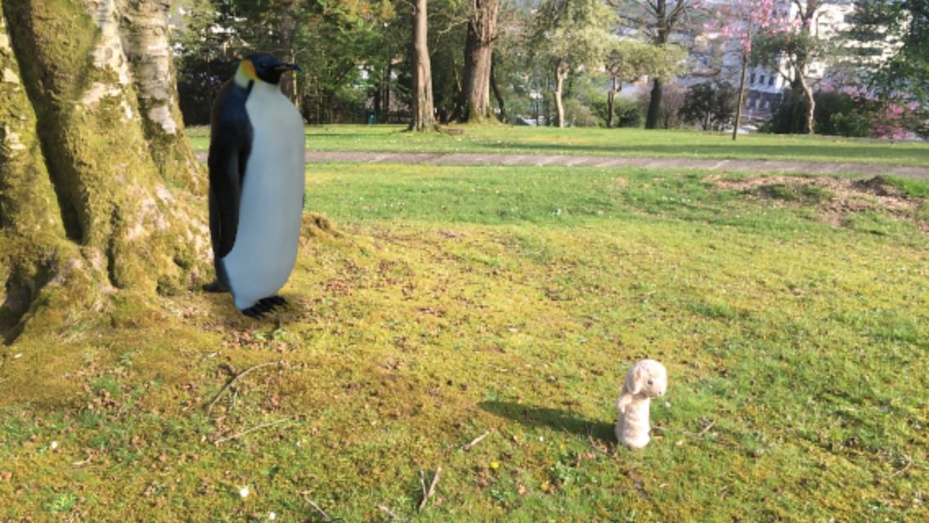
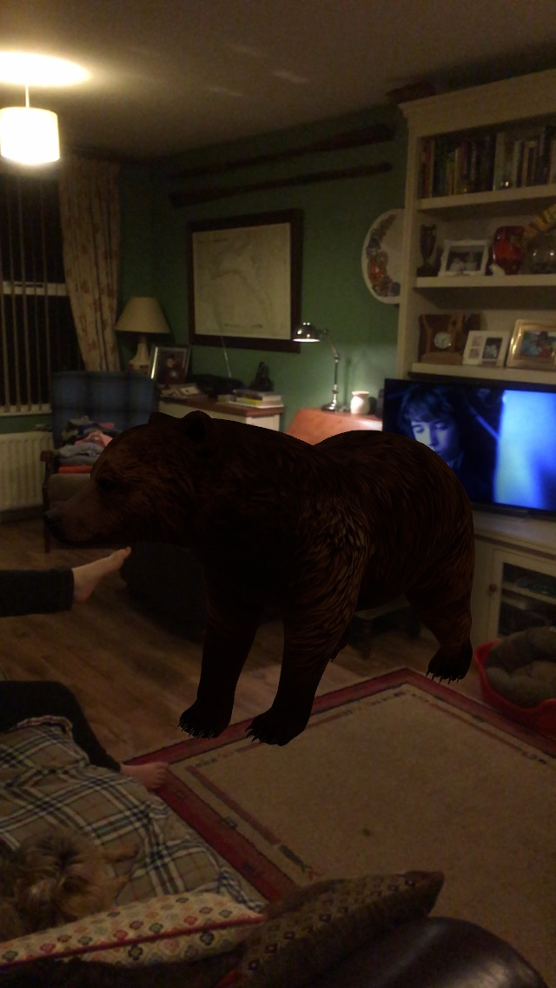
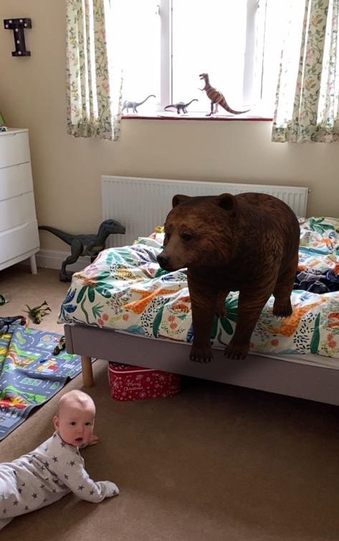
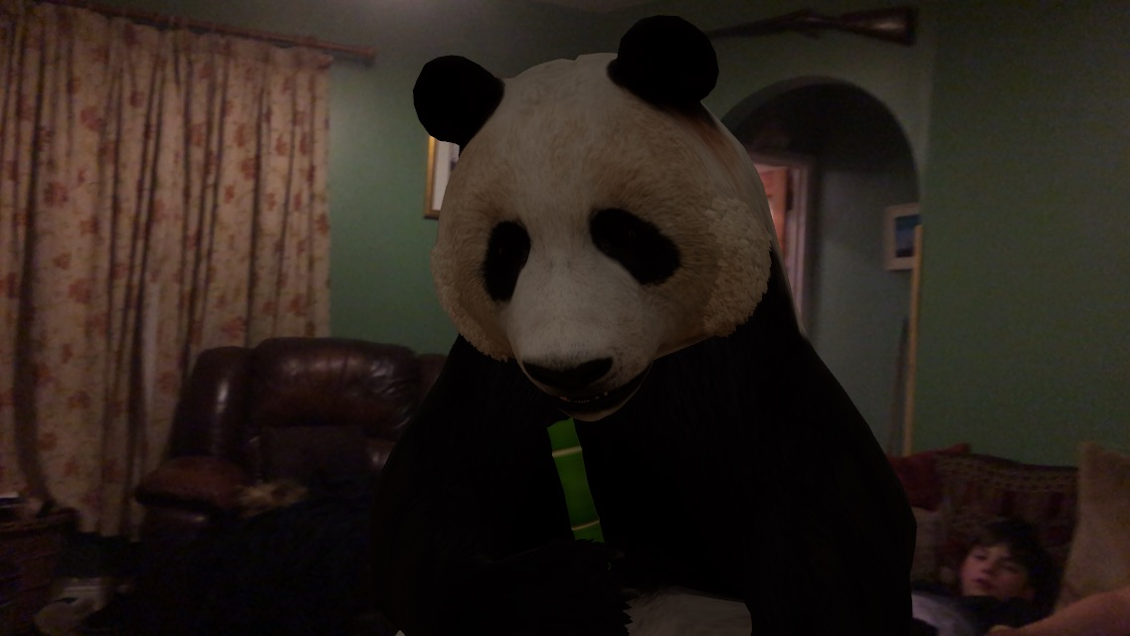
We played with some pretend wild animals.
If you want to try this, Google 3D view animals and they will appear in your home. Marley and Teacher had loads of fun doing this!

Slide 11
He remembers to wash his hands properly like we learned in P2.

Slide 12
Bye Everybody!!
Can’t wait to see you all again soon at school.
Remember you can phone, text or email Teacher if you need anything at all or if you just want to say Hello.

