Slide 1
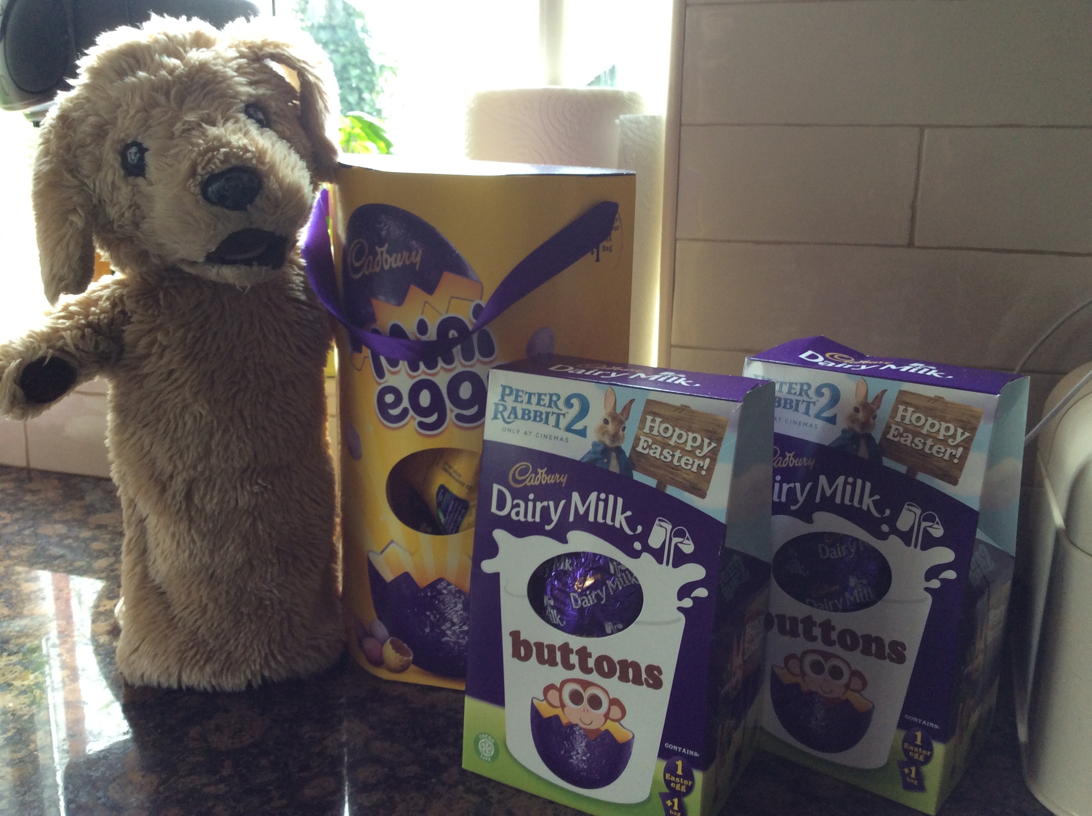
April Learning for p2 Who lays eggs?
Now that the Easter holidays are over, here’s some of the lessons we would have been doing in school this month.
Parents, we would do lessons like these over the month. Don’t try to do them all in one go.

Slide 2
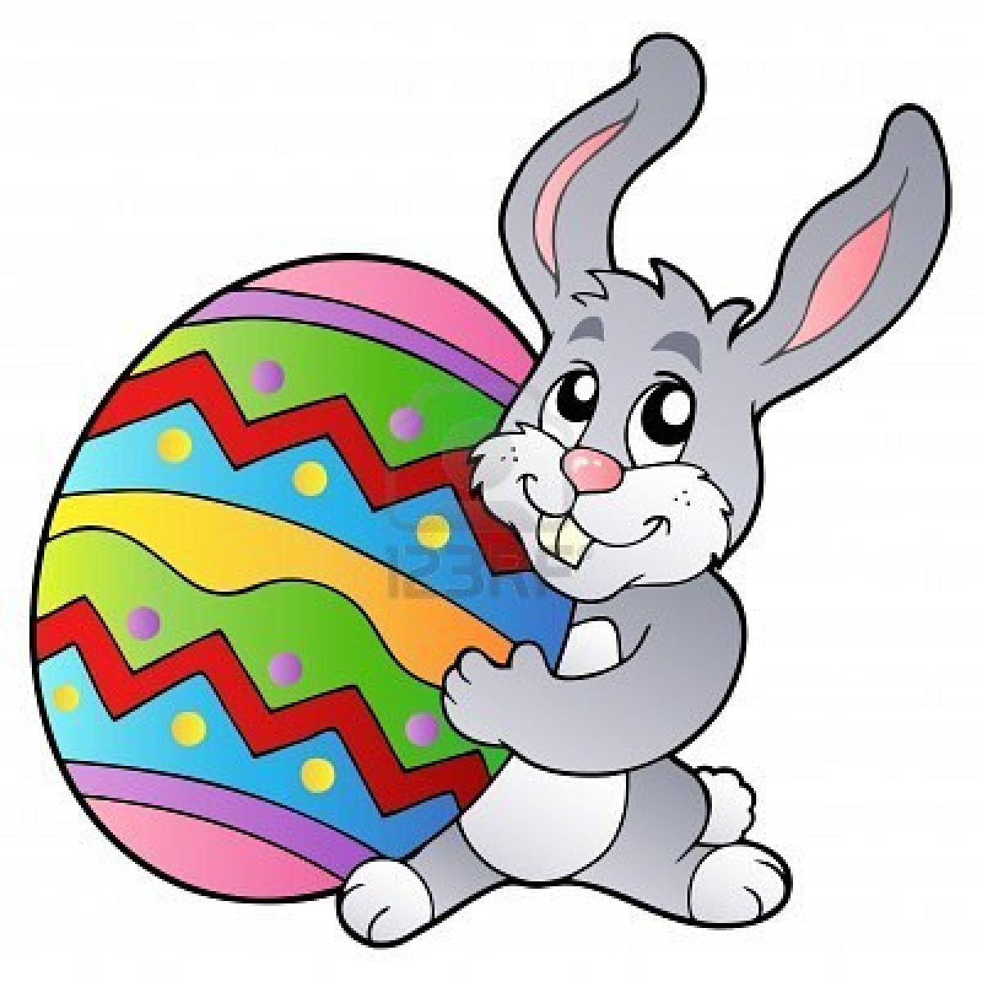
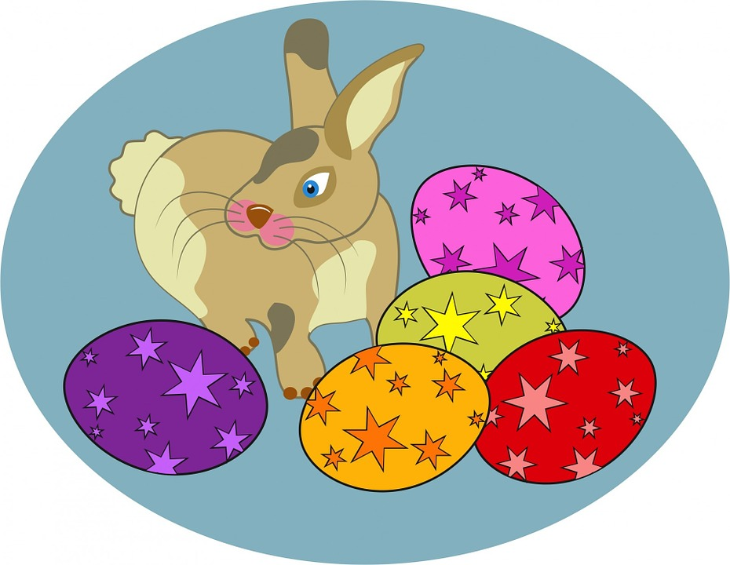
Who lays eggs?
Is it the Easter Bunny?

Slide 3
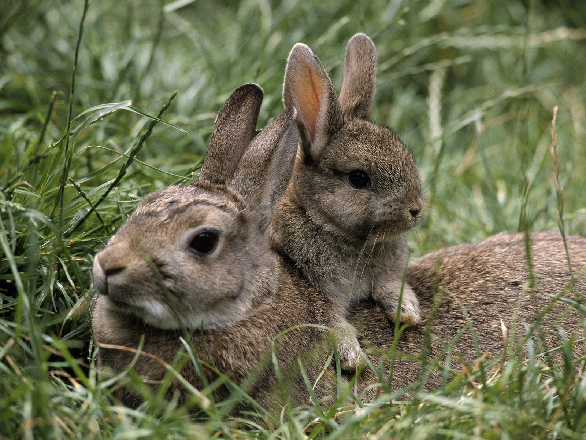
No Marley, Rabbits don’t lay eggs.
Rabbits belong to a group of animals called mammals. Their babies grow inside their mummies’ tummies and are born alive. The mummies make milk for the babies to drink.
Can you think of any other mammals?

Slide 4
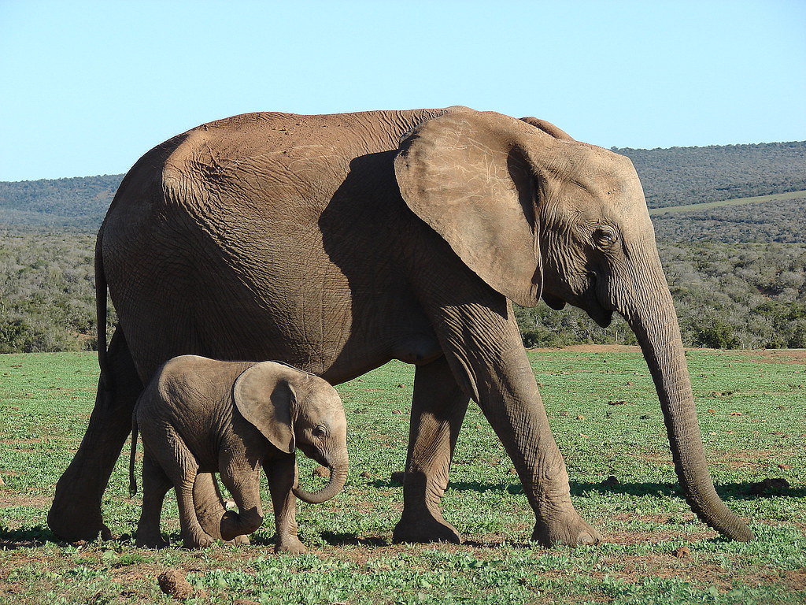
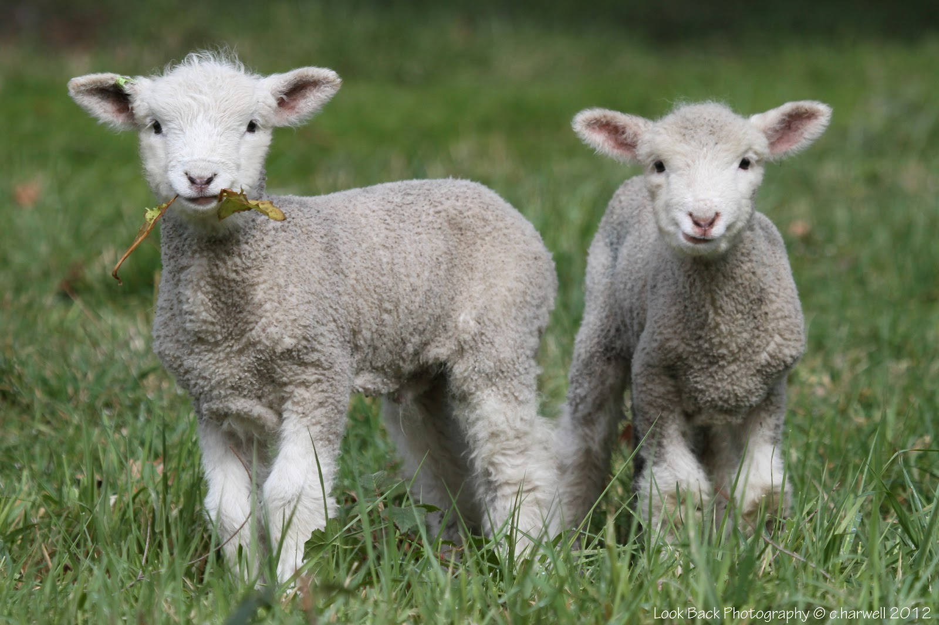
Here is marley’s list. Did you think of any the same?
dugs
cows
shep
humans – yes, you are a mammal too!
elephants
bears
lions
huppos
Oopsie! Marley needs to work on his spelling. Can you find any mistakes?

Slide 5
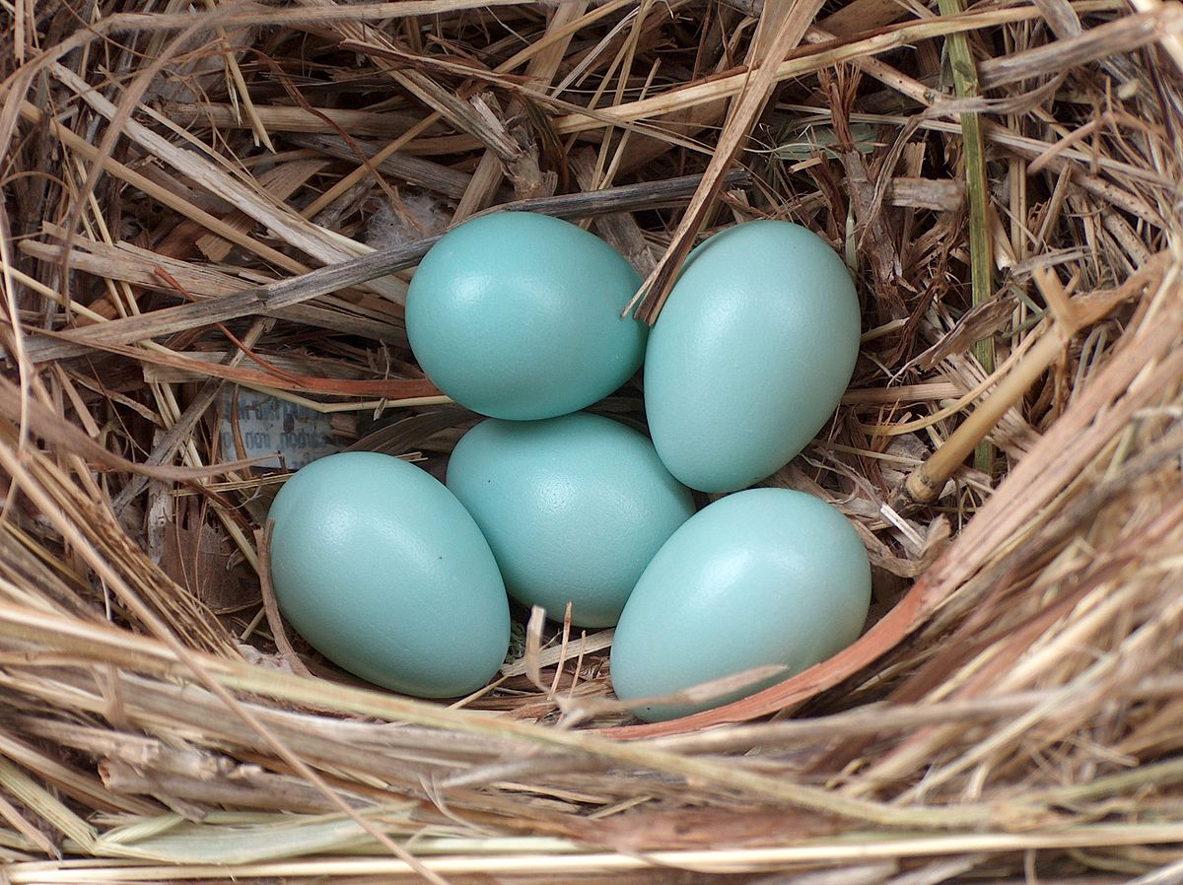
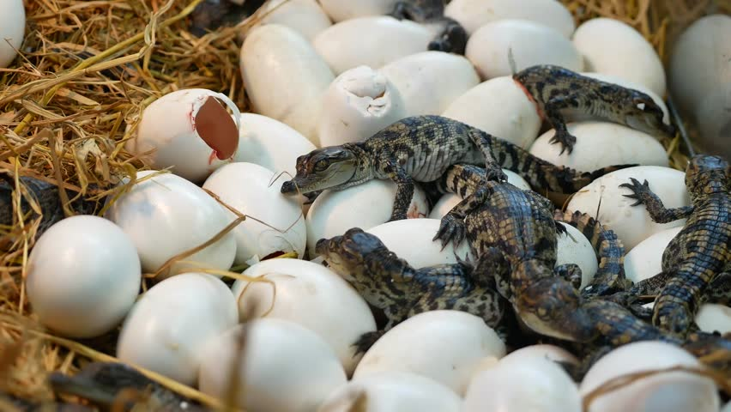
All the other animal groups lay eggs. Can you make a list of all the animals you can think of that lay eggs?
Chickens
Robins
Flies
Spiders
Turtles
Salmon
Cod
Alligators
Toads
Snakes
Penguins
Here is Marley’s list.
ducks
Crocodiles
Butterflies
Frogs
dinosaurs

Slide 6
Animal groups- can you sort your animals into these groups?
ri
fish
birds
Animals who lay eggs
Insects (invertebrates)
Amphibians lay their eggs in water. Their babies are born able to breathe in water, then they change.
Reptiles lay their eggs on land. Some of them can swim but the babies are NOT born in water.
amphibians
reptiles

Slide 7
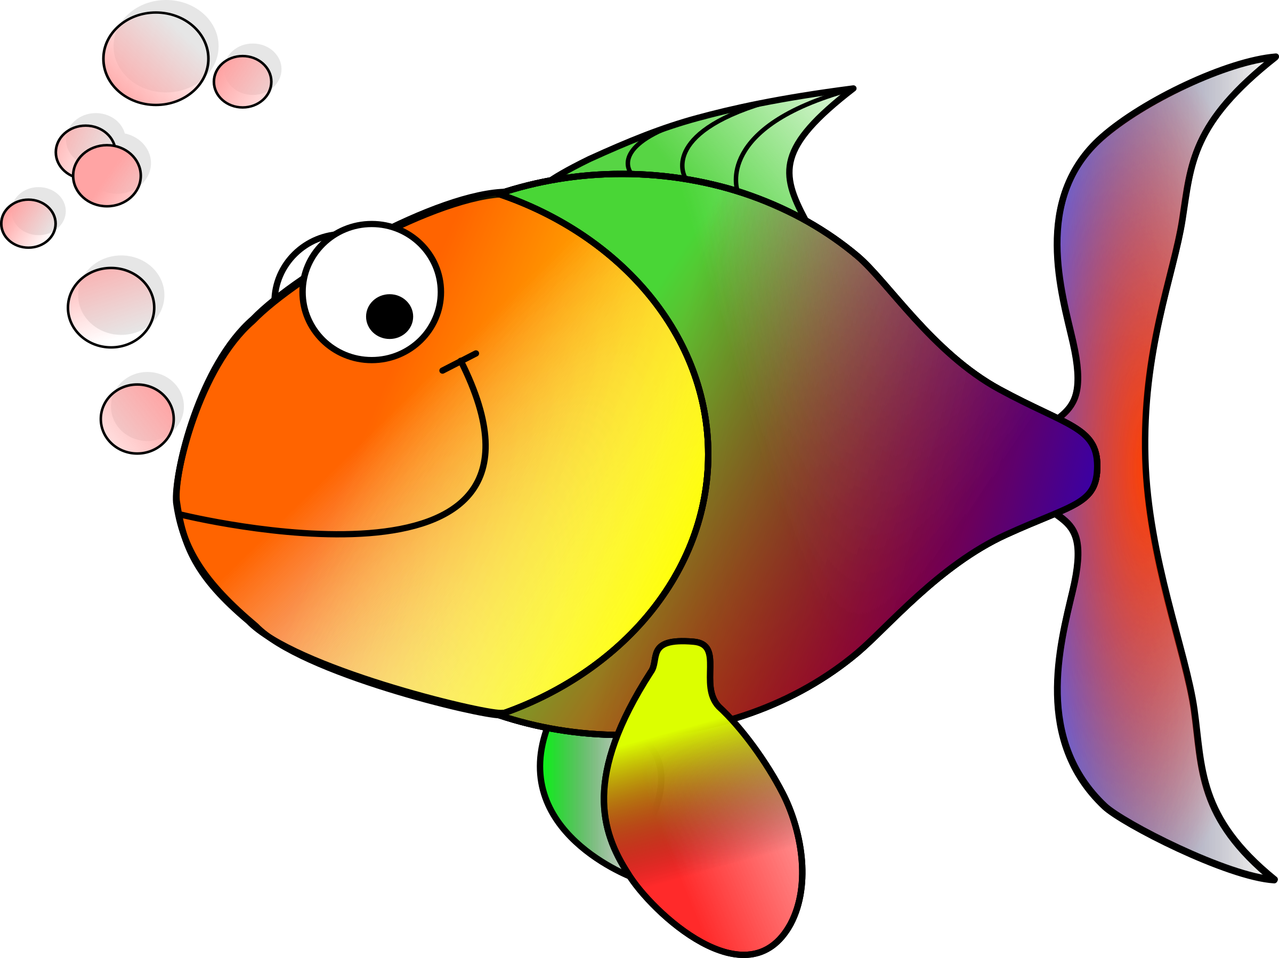
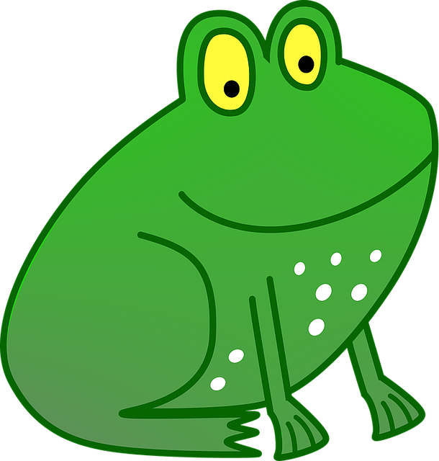
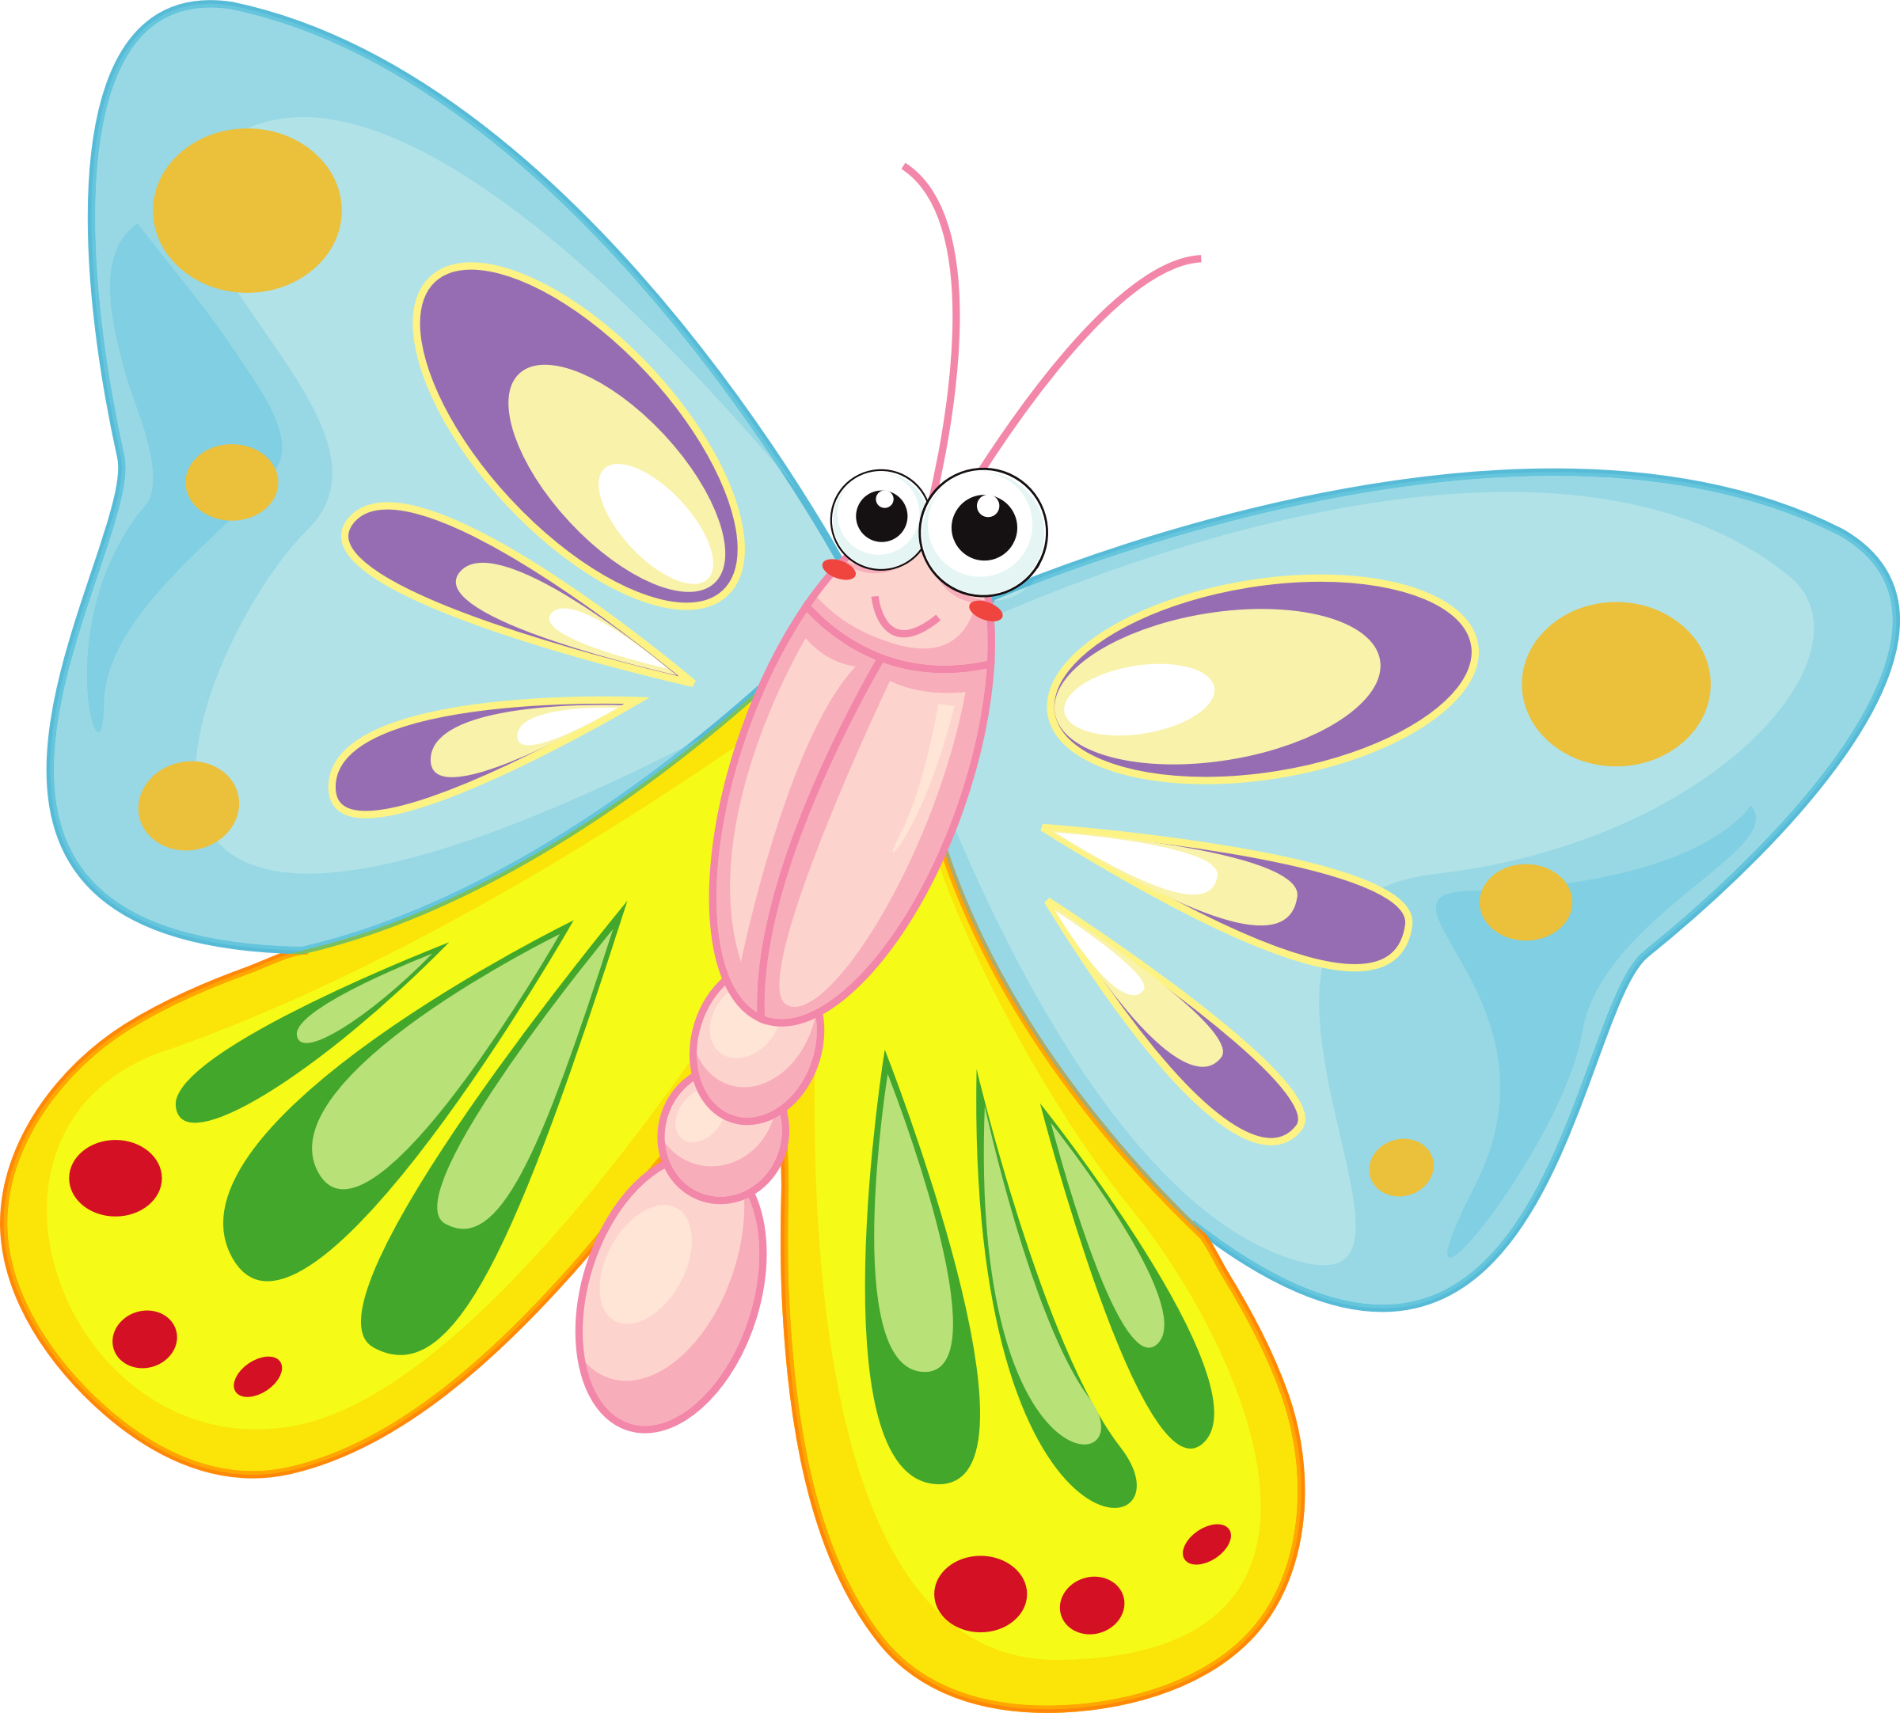
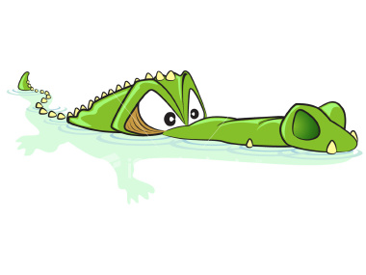
Fish
Cod
Salmon
Birds
Penguins
Ducks
robins
Reptiles
Snakes
Crocodiles
Alligators
Turtles
dinosaurs
Amphibians
Frogs
Toads
newts
Insects
Butterflies
Flies
spiders

