Slide 1
Well done!
Super work so far. We’re going to start some Literacy now.
Question words
Can you think of any?
Clue
Lots of them start with wh

Slide 2
Did you get all these?
Did you spot this symbol?????
It’s called a question mark. Practise writing it on a page.
Not all question words start with wh
How…?
Could…?
Did…?
What
When
Who
Where

Slide 3
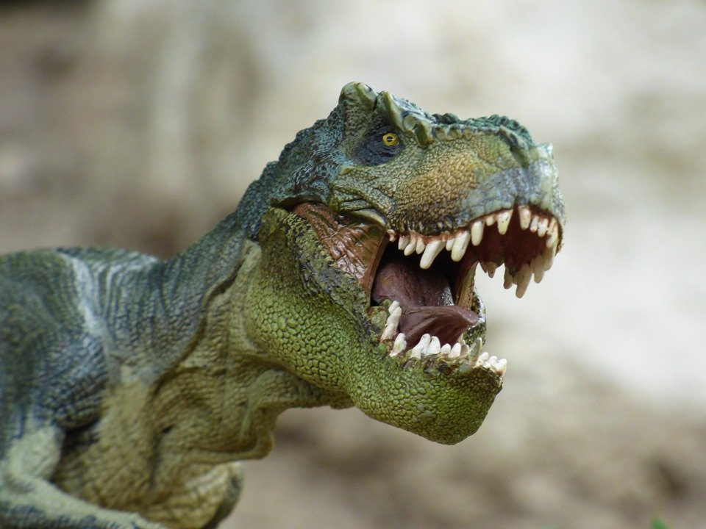
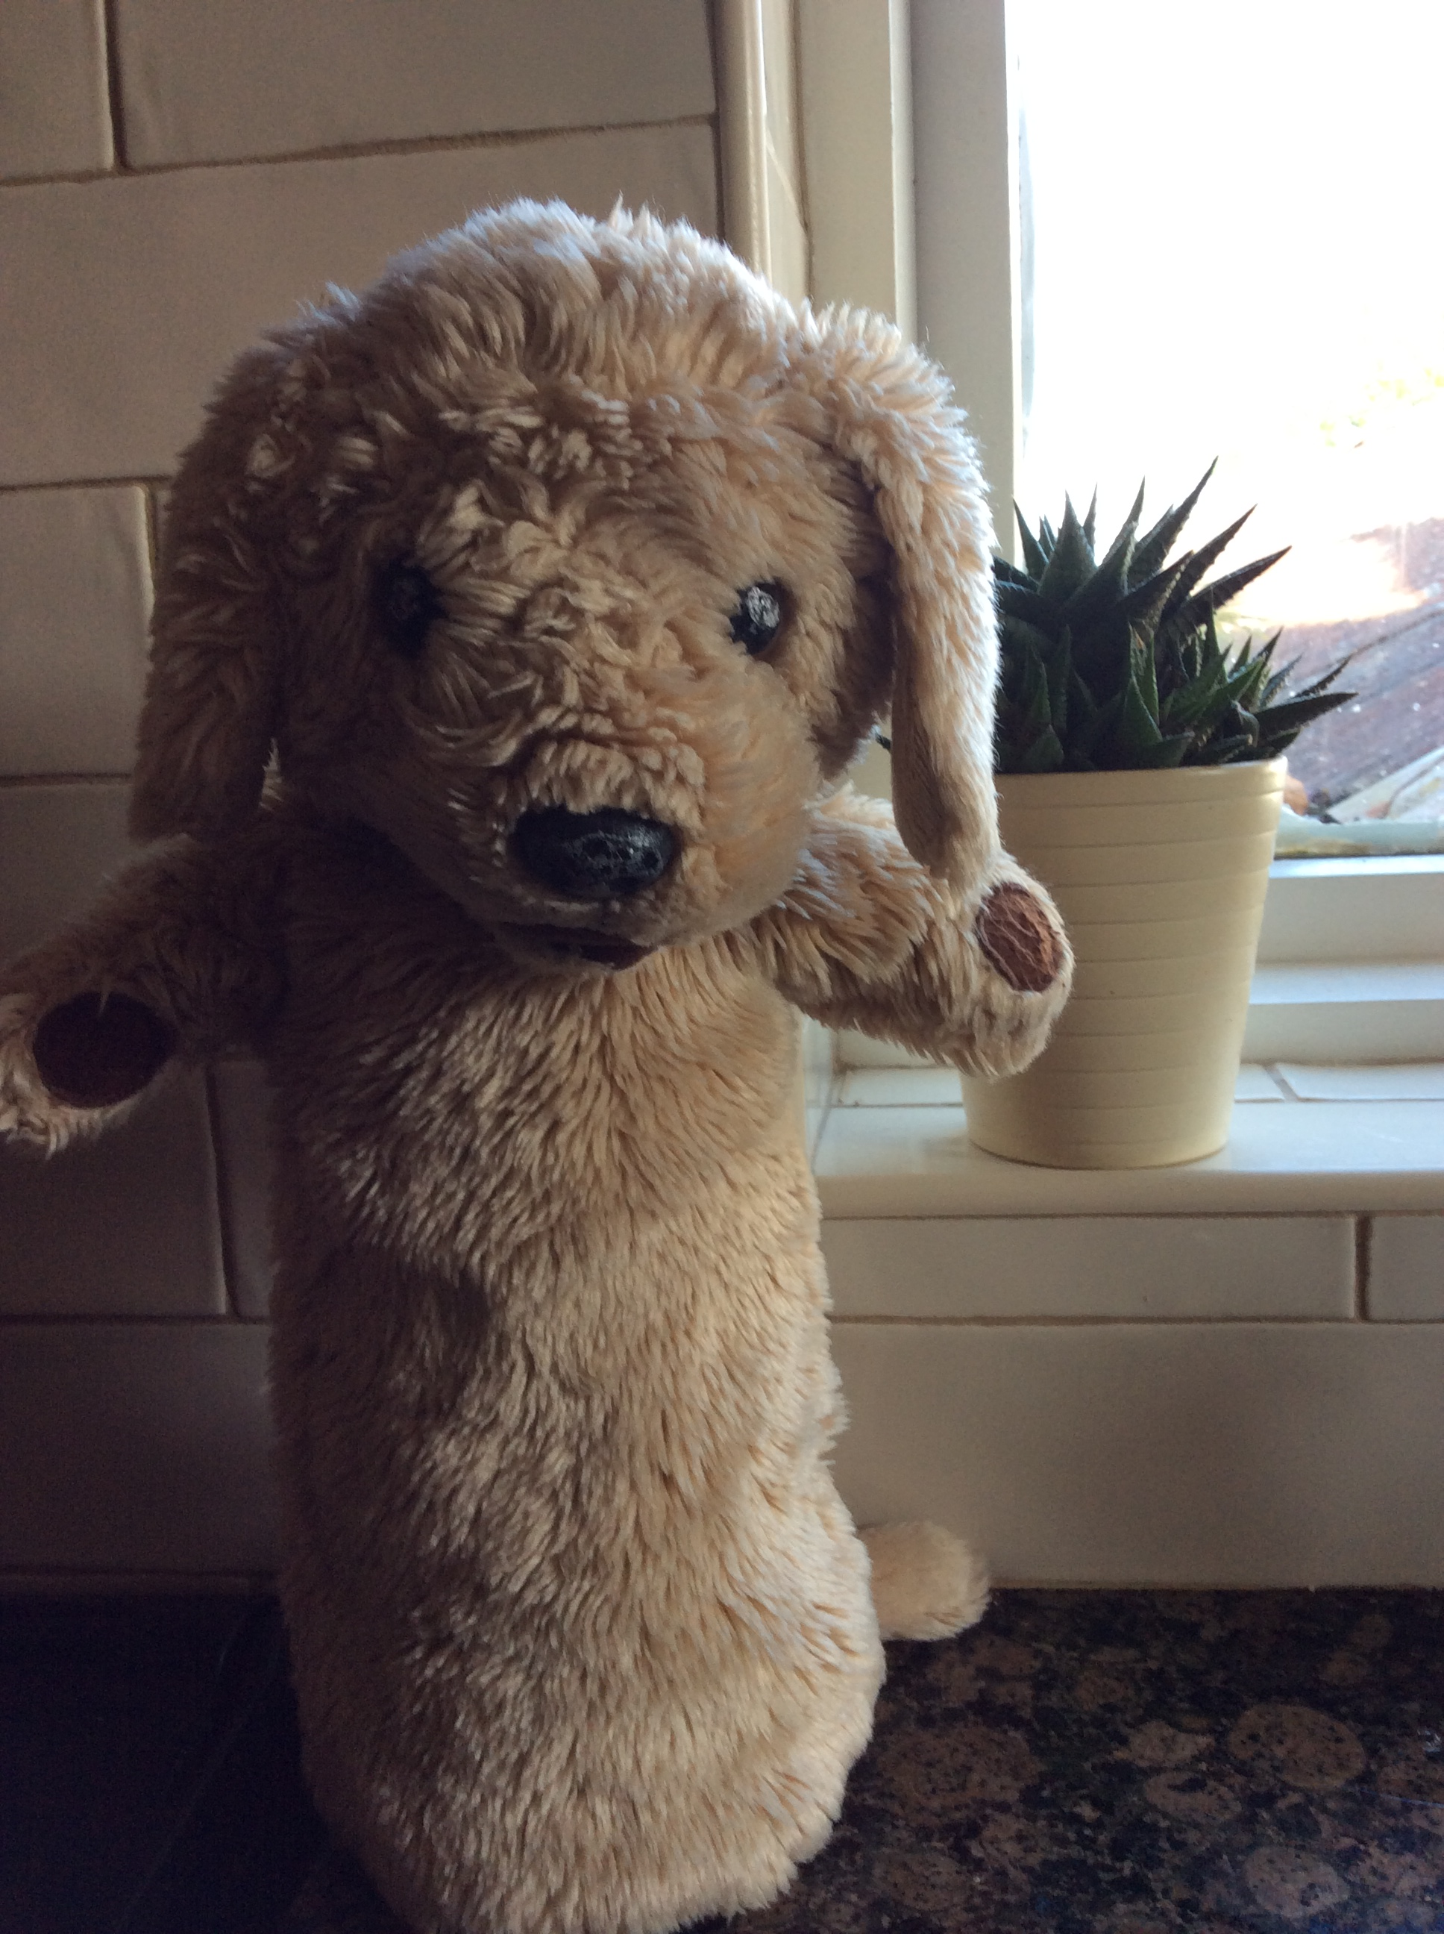
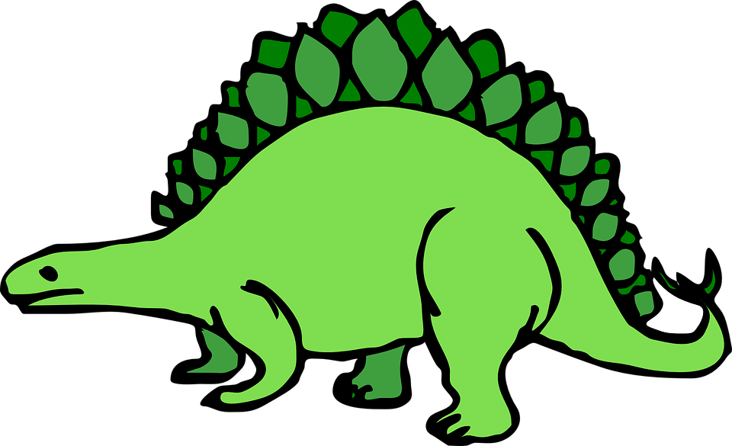
We are going to learn about dinosaurs. What would you like to find out?
Make a list of questions you have. A grown-up can help you write this. Use the question words on the last page to start your question and don’t forget to finish with a question mark. If you need help click again to see Marley’s questions.
When did dinosaurs live?
How did dinosaurs die?
What dinosaur was the biggest?
Could dinosaurs fly?
Could dinosaurs swim?
What did dinosaurs eat?
Did dinosaurs fight?

Slide 4
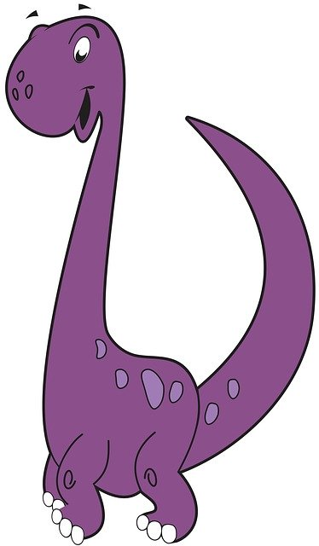
Finding information
Do you remember where to find information?
Non- fiction books -remember to use the contents page to help you find information. Do you have any dinosaur books?
Or you could look on the internet.
See if you can find out any answers to your questions about dinosaurs.

Slide 5
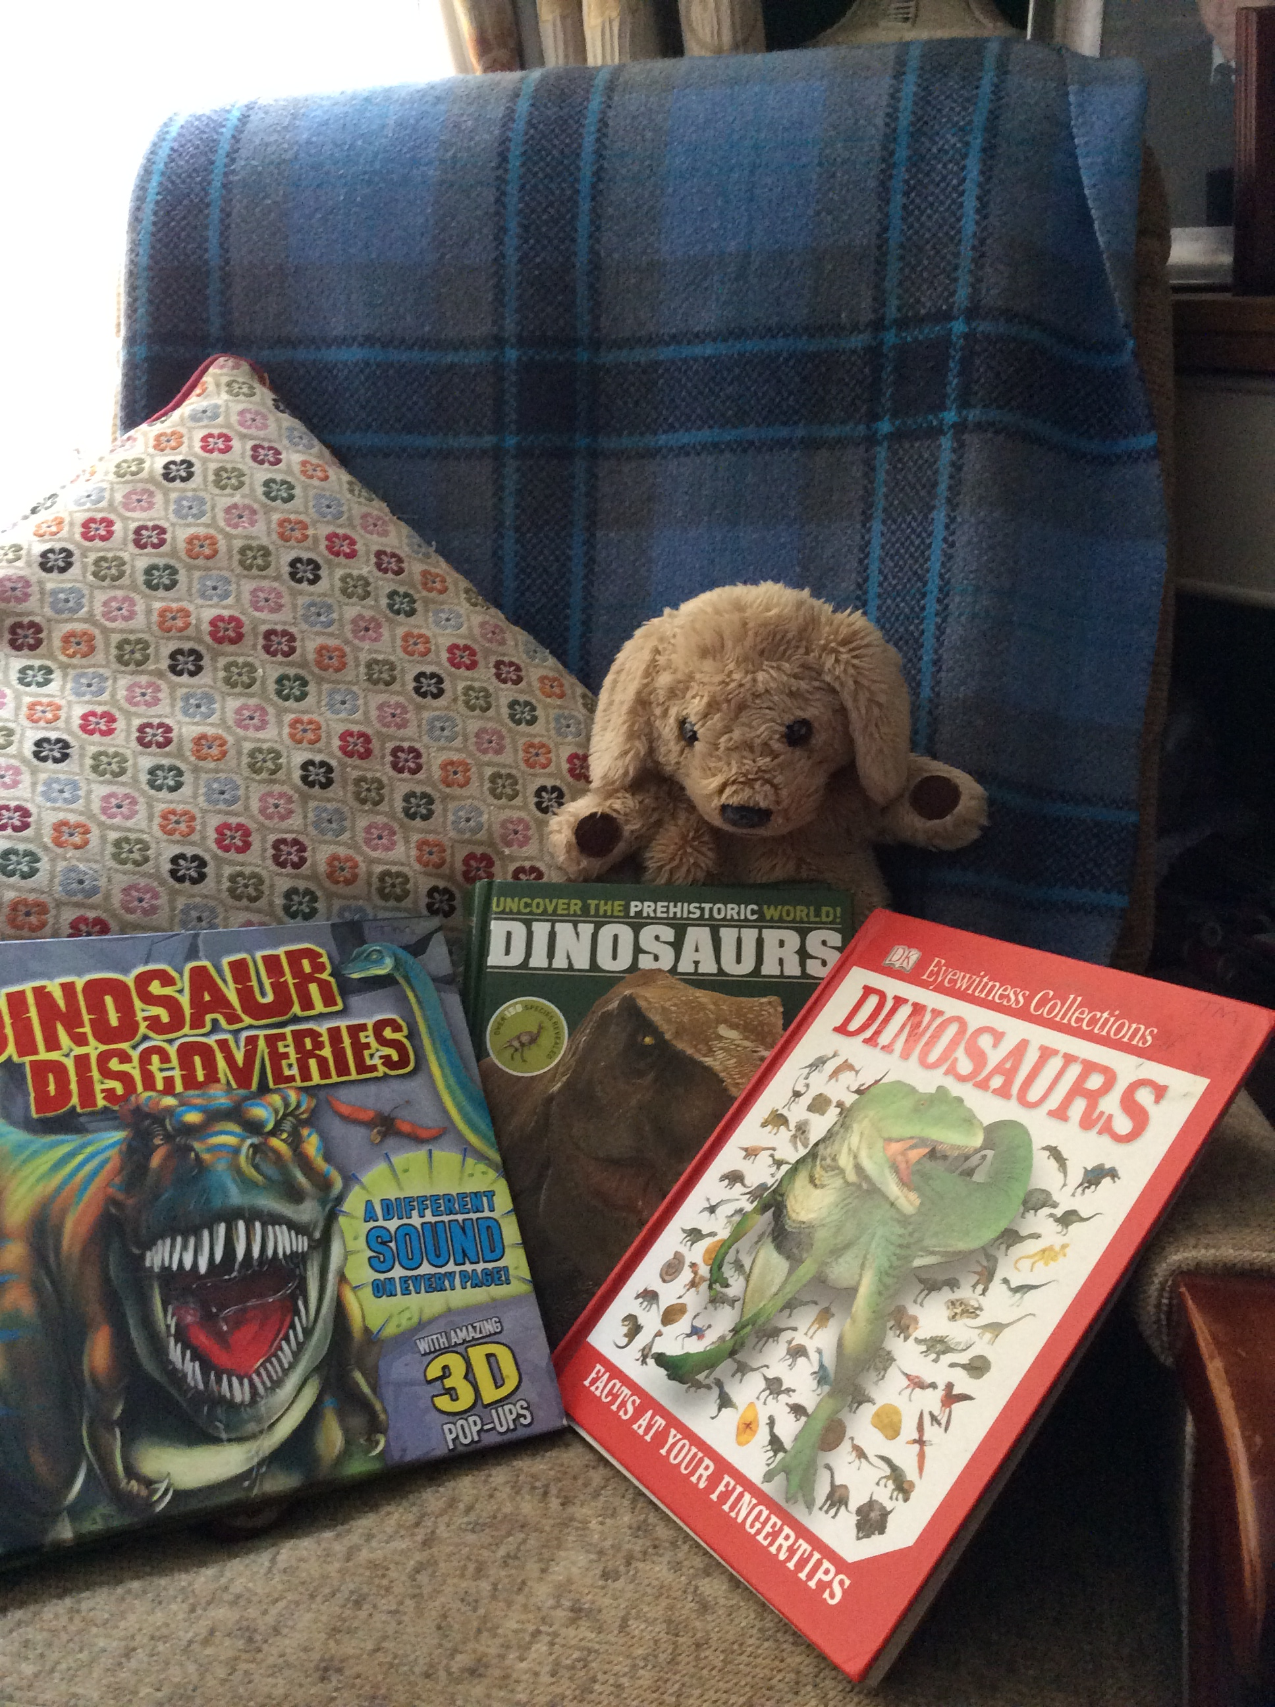
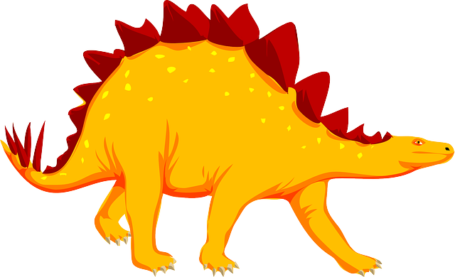

Slide 6
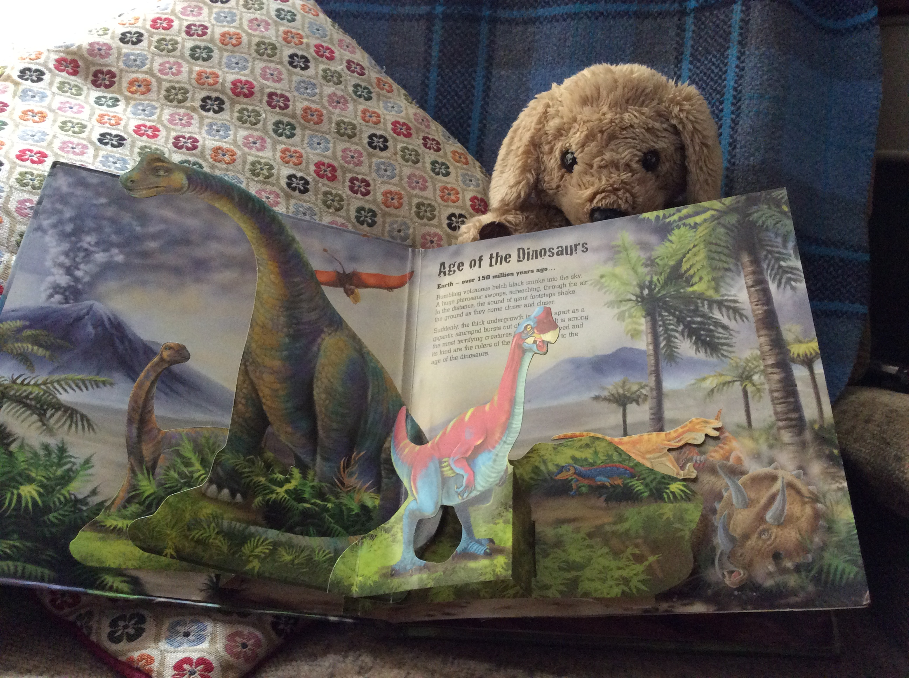
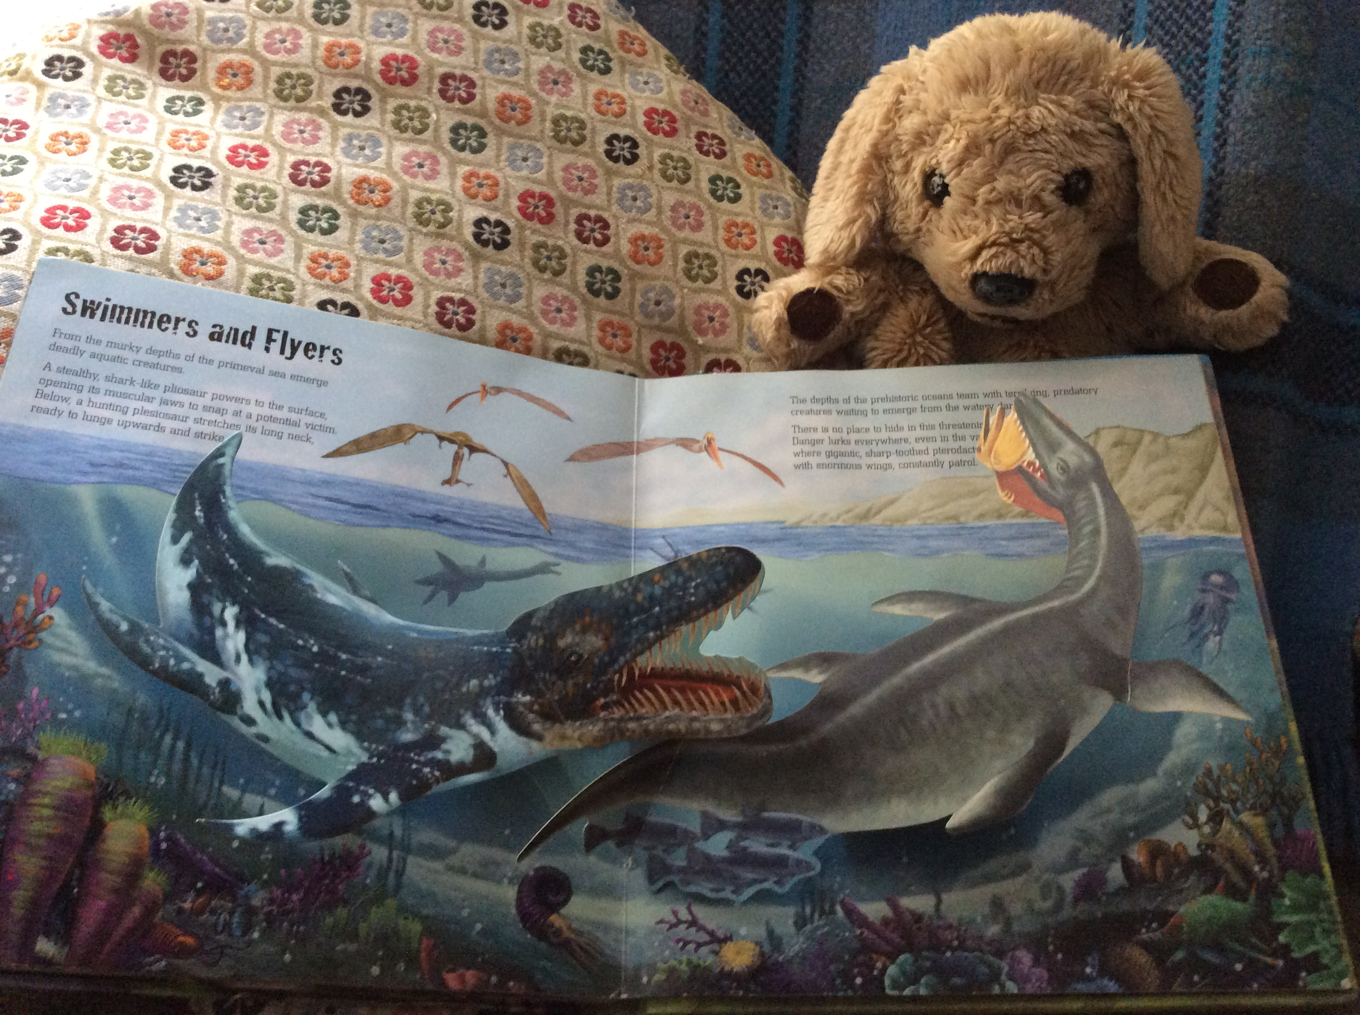
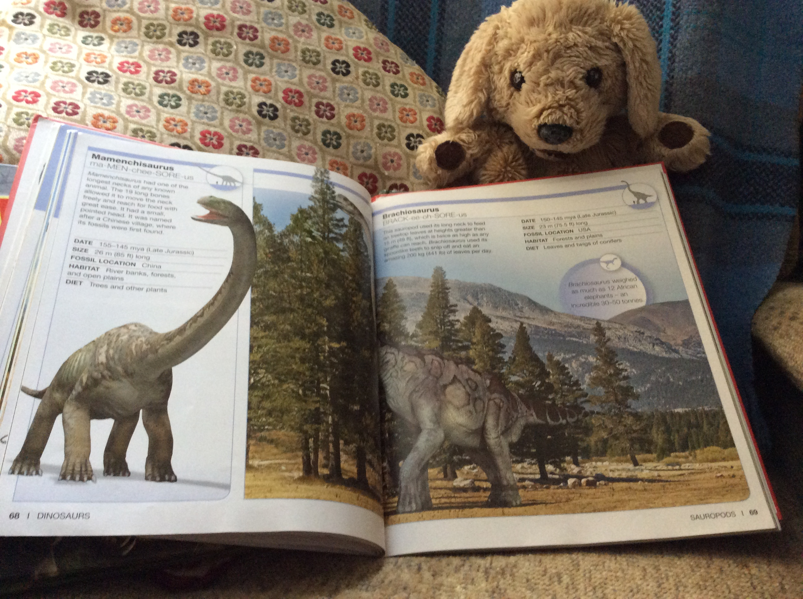
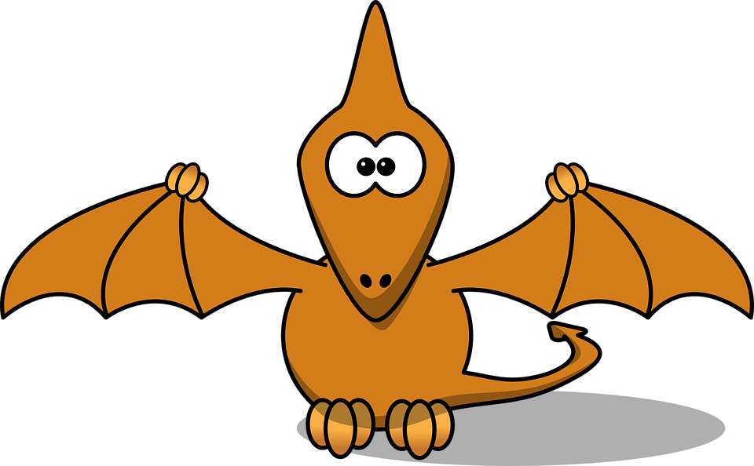
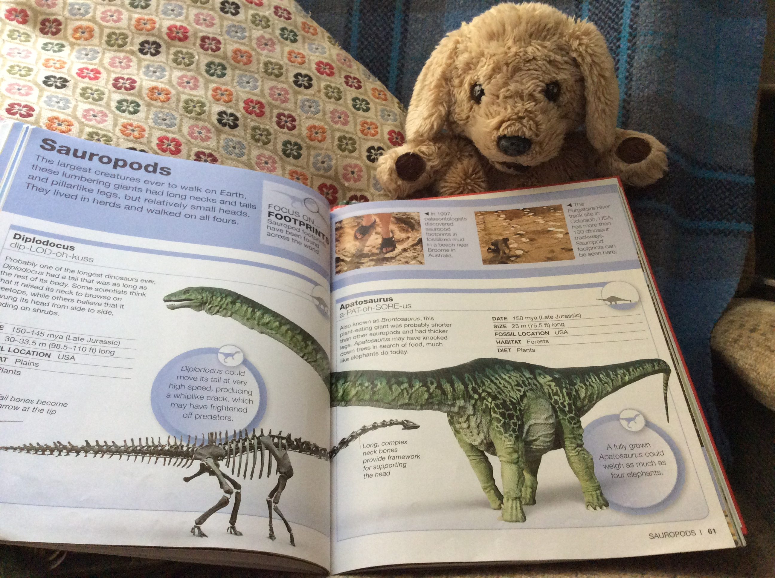
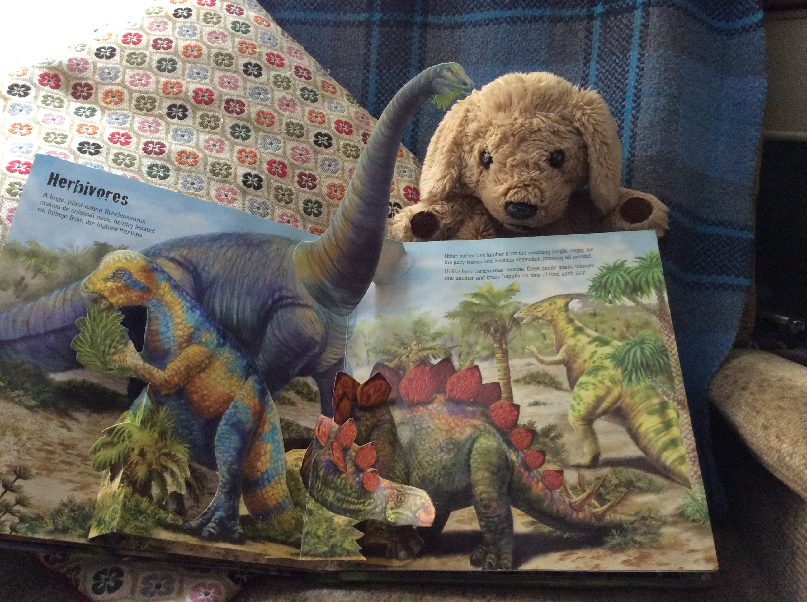
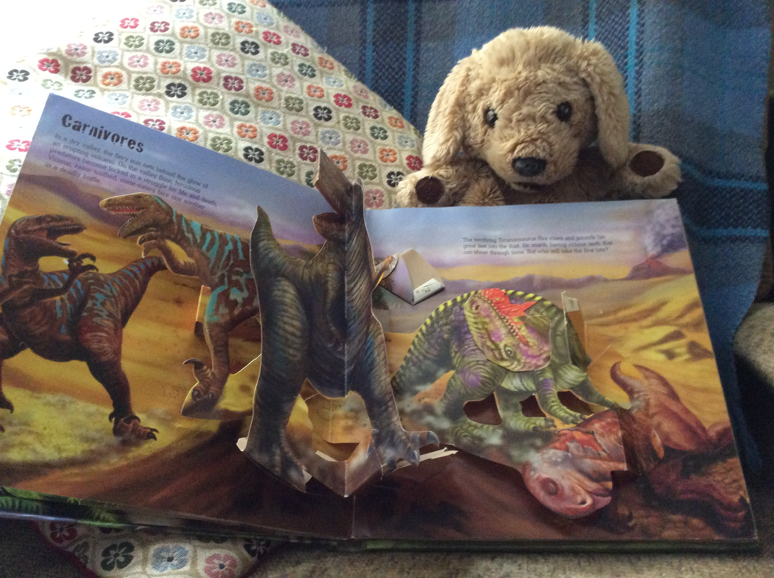
Look for the following things when you are reading information books.
information
pictures
captions
fascinating facts
diagrams

Slide 7
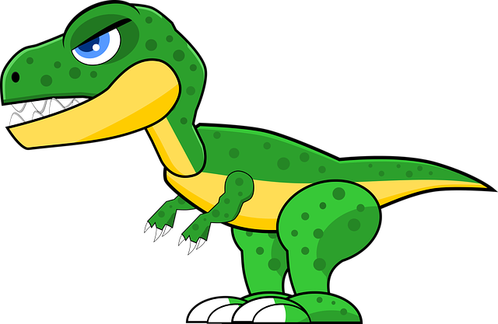
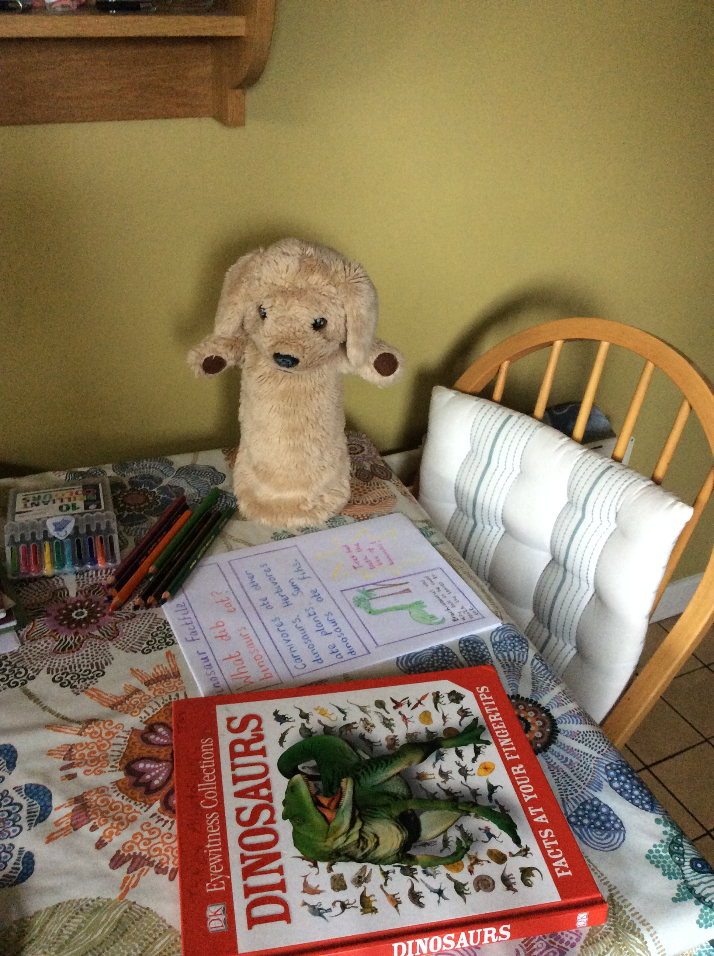
Make your own dinosaur factfile
If you want to, you can take a photo of your factfile on a phone and send it to Teacher.
Question
Answer
Interesting fact
Can you find Marley’s spelling mistakes?
picture

