Slide 1
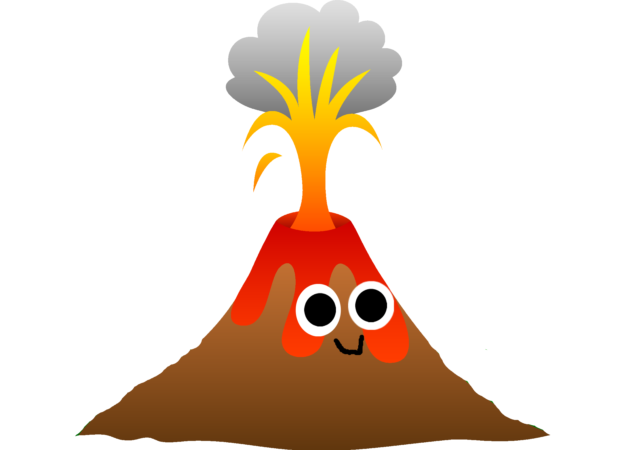
Well done P2s ! you are working really hard.
How about a fun science experiment?
Find a small jar or yoghurt pot (those little yoghurt drink bottles are good if you have one.)
If you want to make it look real, pile some stones up around the bottle so it looks like a volcano. Do this in a tray or outside. (It’s very messy and smelly!)
Carefully spoon 2 teaspoons of bicarbonate of soda into the bottle. Pour in a couple of drops of red or yellow food colouring or both. Pour in some vinegar and see what happens!
If you did this in a tray, go and look for some leaves and sticks and put your toy dinosaurs in to make a prehistoric habitat and have a play. You can keep adding stuff to the volcano if you want it to erupt again. Have fun!

Slide 2
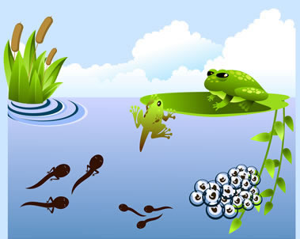
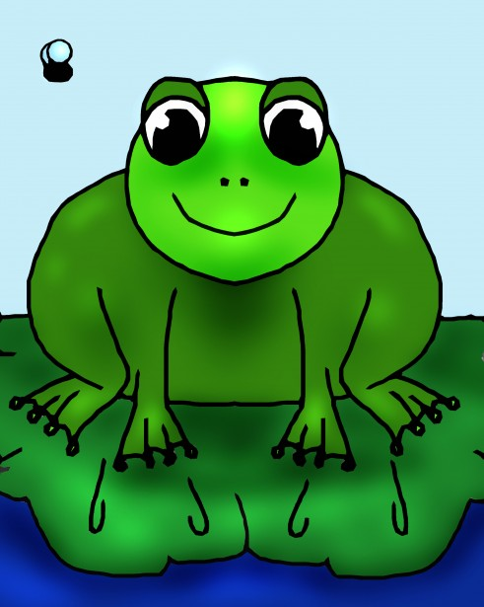
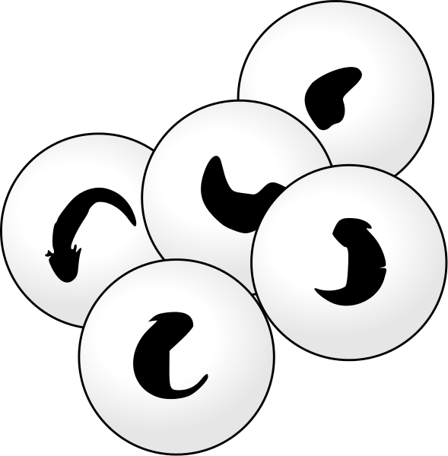
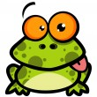
Life cycle of a frog
Frogs lay eggs too but they don’t look like chicken eggs
https://www.youtube.com/watch?v=F3ElGMVU6SY
Right click on the link and select open hyperlink to watch the video. (More frog stuff available on study ladder,)

Slide 3
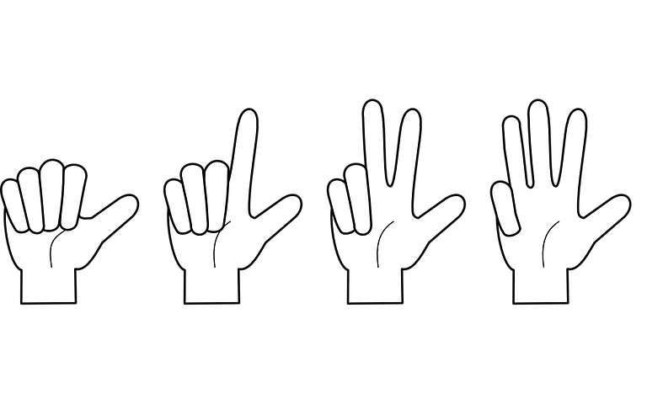
Wow, you are working so hard. I hope you are having fun.
Do you feel like doing some counting today?
You will see some sums like this in your book.
3+ = 7
Sometimes these are a bit difficult. Marley puts the smaller number in his head and uses his fingers to count up to the bigger number, and that’s the answer! Try it that way.
How many fingers are you holding up? That’s the answer. That’s called finding the difference.
3
4 5 6 7

Slide 4
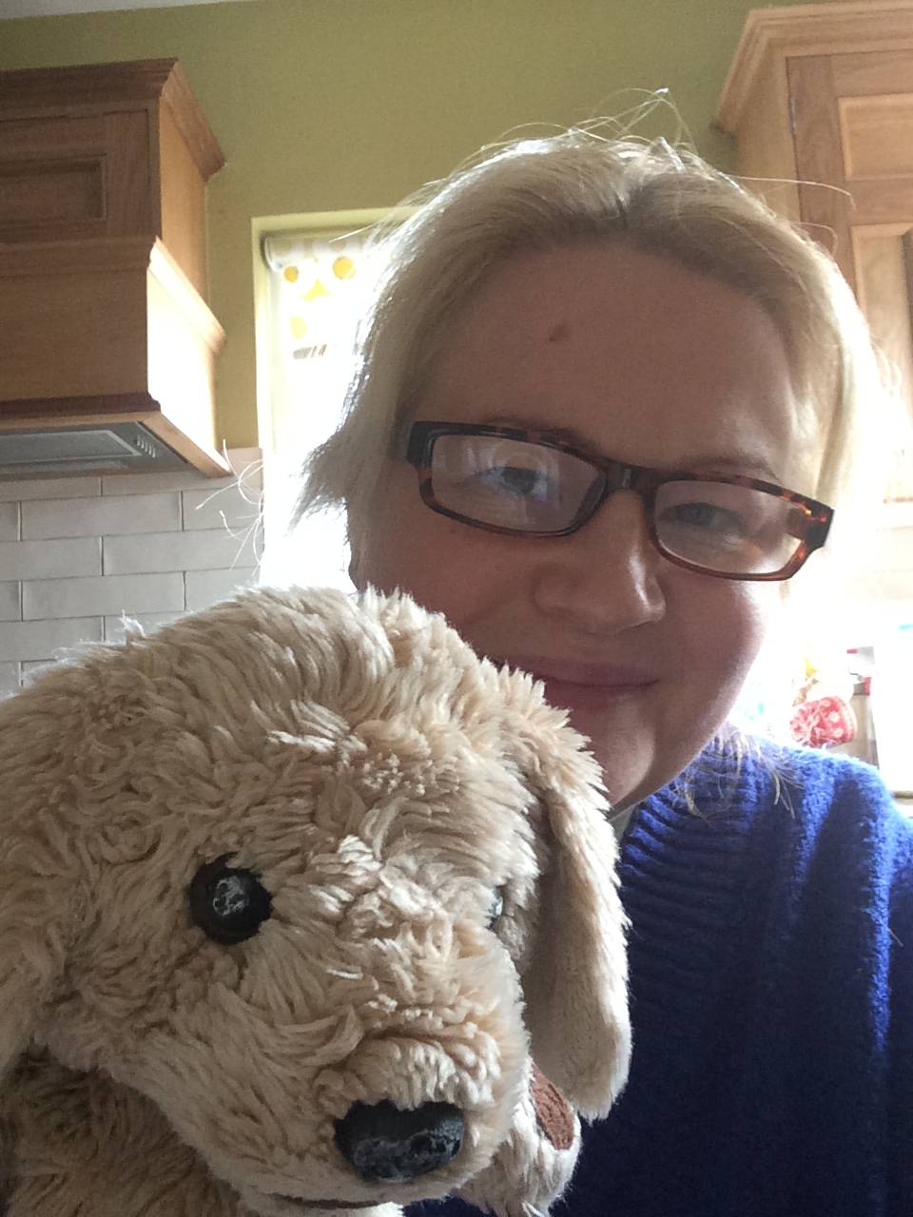
Fantastic work.
Marley and Mrs Mulholland miss you all very much. We hope you’ve enjoyed doing your lessons from Teacher’s kitchen instead of our classroom! Marley thinks it’s funny. If you want to, you can send us pictures of you doing your experiments or of your work by email or phone.

Slide 5
Dear Parents / guardians, For your interest, this is a very basic overview of what we would normally cover in p2 in april. Please don’t feel under any pressure to replicate this but you may want to try some of it or just do your own thing.
Overview: April Themes: Easter -Who lays eggs? Dinosaurs | RE- Grow in Love Learn about Jesus’ death, burial and resurrection. Listen to Jesus’ teaching about love and forgiveness. Recognise that they are loved and respected. Develop respect for God and know the importance of the commandments; love God and love one another. | TSPC Continue to work on questioning skills and finding answers to questions. Work in groups and work in pairs. Sort, classify and explore. Homemade Volcano experiments. | PDMU PATHS -Understand sharing and caring. Understand how sharing makes the giver feel good too. Understand that there are things that it is ok not to share. Give more advanced compliments. Review the feelings we have learnt so far.
World Around Us Life cycle of a frog. Find out who else lays eggs. Sort and classify animals into simple groups. Talk about traditions of Easter. Find out about different dinosaurs. Look more closely at the dinosaur’s different types of teeth. Classify them into meat and plant eaters. Learn about the importance of toothcare. Investigate some reactions when different substances are combined – make volcanoes. | Literacy Write simple questions. Use a question mark. Think of questions prior to reading for information. Use books for a specific purpose. Write descriptive words for dinosaurs. Write dinosaur factfiles. Read books about unusual pets and discuss pros and cons of these. Use simple dictionaries and understand their alphabetical arrangement. Phonics sounds: er, ir, or, ur Double letters on the end of words eg: ll – wall, ss – fuss, zz -buzz | Maths Focus on addition and subtraction. Know by heart all number bonds for 10 Begin to use the +/- and = signs to record mental calculation in a number sentence, recognise the use of symbols to stand for an unknown number Read the number names to 20 Develop mental confidence when adding or subtracting To find the difference in sizes between collections of objects. To begin to connect finding the difference with taking away and counting back. Estimate and measure capacities. Compare capacities and use associated language. | Play Measure and compare capacities by filling and emptying containers with cupfuls, spoonfuls, jugfuls etc.. Read, draw & write about and play with dinosaurs & reference books. Explore different materials. Make collages. Dinosaur, Easter and monster themed art Playdough monsters Continue with planting and taking care of plants and monitoring growth. ICT – use the internet to find information

